Slide 1
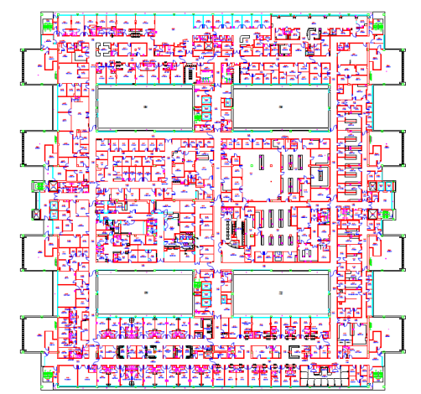
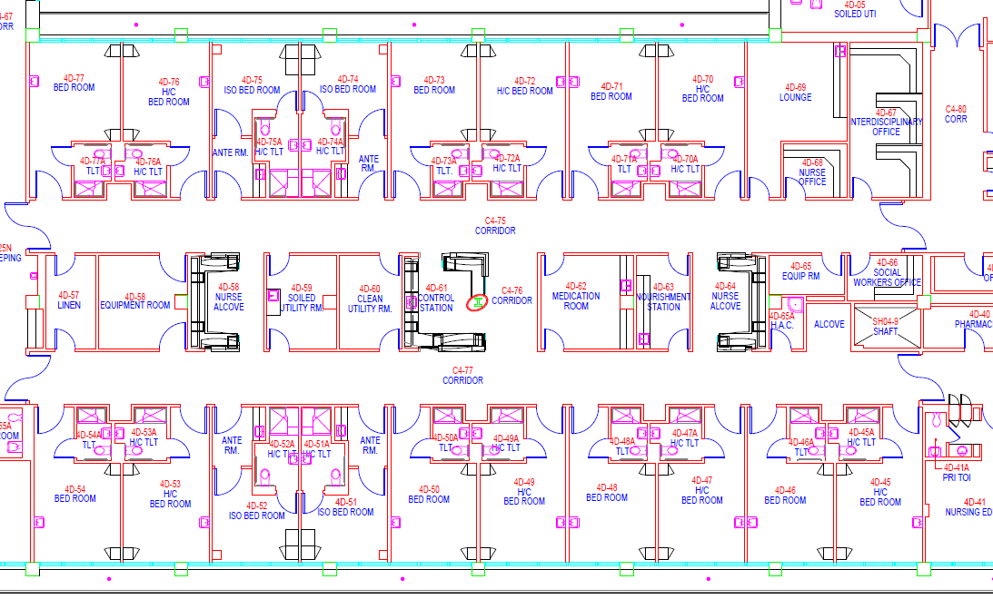
4TH Floor
N
Attachment 5 (Project Location Map) to Project 605-16-430 (Renovate 4SW Bathrooms)

