Slide 1
Utility Shutdown Process
LLVAMC FMS-Project SOP

Slide 2
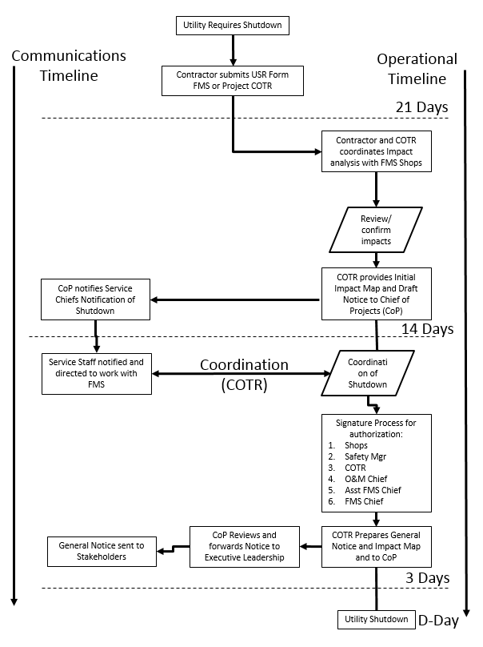
Click to see Slide
Click to see Slide

Slide 3
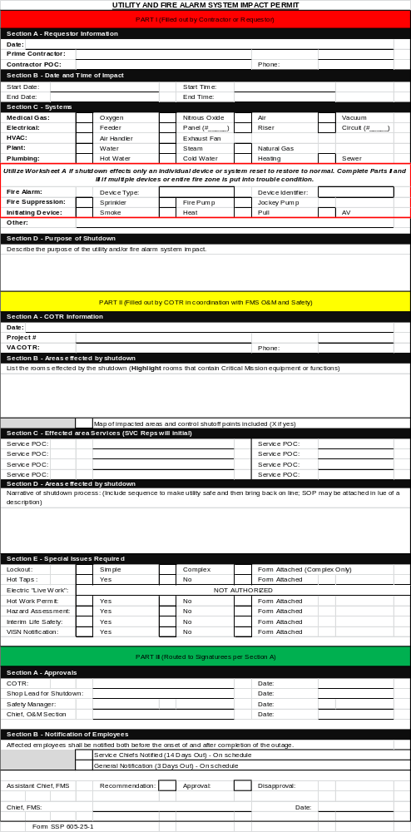
Permit Process (Form SSP 605-25-1)
Step 1: Contractor fills out Part I and sends to COR by 21-Days from required shutdown date.
Step 2: COR reviews and does initial assessment of impacted areas outside the work area.

Slide 4
Permit Process (Form SSP 605-25-1)
Step 3: COR coordinates with appropriate staff from effected services and FMS shops to ensure the plan for the shutdown, resource requirements and staff responsibilities.
(Print Name and Initial are annotated in section C)

Slide 5
Permit Process (Form SSP 605-25-1)
Step 4: COR signs and submits permit to supervisors in section A of Part III

Slide 6
Permit Process (Form SSP 605-25-1)
Step 6: Chief of Projects will review and make recommendation.
Step 6: Assistant Chief, will review and make recommendation.

Slide 7
Permit Process (Form SSP 605-25-1)
Step 7: Chief FMS reviews, signs and returns COR
Step 8: COR provides copy to Contractor

Slide 8
14-Day Service Chief Notice
Project: project Name
Outage Type: List utility service to be shutdown
Planning Date and Time: Time and Date (Estimated)
Actions to occur: The contractor renovating the Cath Lab, AMB Contractors, will conduct a shutdown of the fire sprinkler system on 26 Jan 16. The Project PM, PM NAME, is coordinating with your staff the details of the shutdown.
Operational Impacts: List all possible clinical or service operational impacts.
L/S Impacts: List possible impacts.
Coordination: The VALLMC team with the FMS PM as the lead will plan and coordinate all operational and L/S impact mitigation actions and provide details approximately 3-days out from the planned outage.
POC: PM Contact info
Include Map of effected area
Submitted by COR Via email to Chief of Projects NLT 14-days out

Slide 9
3-Day General Notice
**************CONSTRUCTION NOTICE (Utility Shutdown)************
WHEN: Tuesday, January 26, 2016 from 7 am to 9 am
WHO: Advanced Medical Builders
WHAT: Fire Sprinkler shutdown to facilitate renovations for the 4E-60 Angio Lab Siemens Artis Q Biplane project
ACTIONS: Fire sprinkler shutdown by FMS will begin Tuesday morning at 7:00 AM. An ILSM is not required because the system will be down for less than 4 hours. All alert and notification systems remain operational, and employees will follow the same procedures for a fire incident.
WHERE: Fire Zone 2-3-5 (See Attached Map)
If you have any further questions, feel free to call Adrienne Dunfee, FMS-Project Manager, at extension 4423.
Include Map of effected area
Submitted by COR Via email to Chief of Projects NLT 5-days out

Slide 10
Map Examples

Slide 11
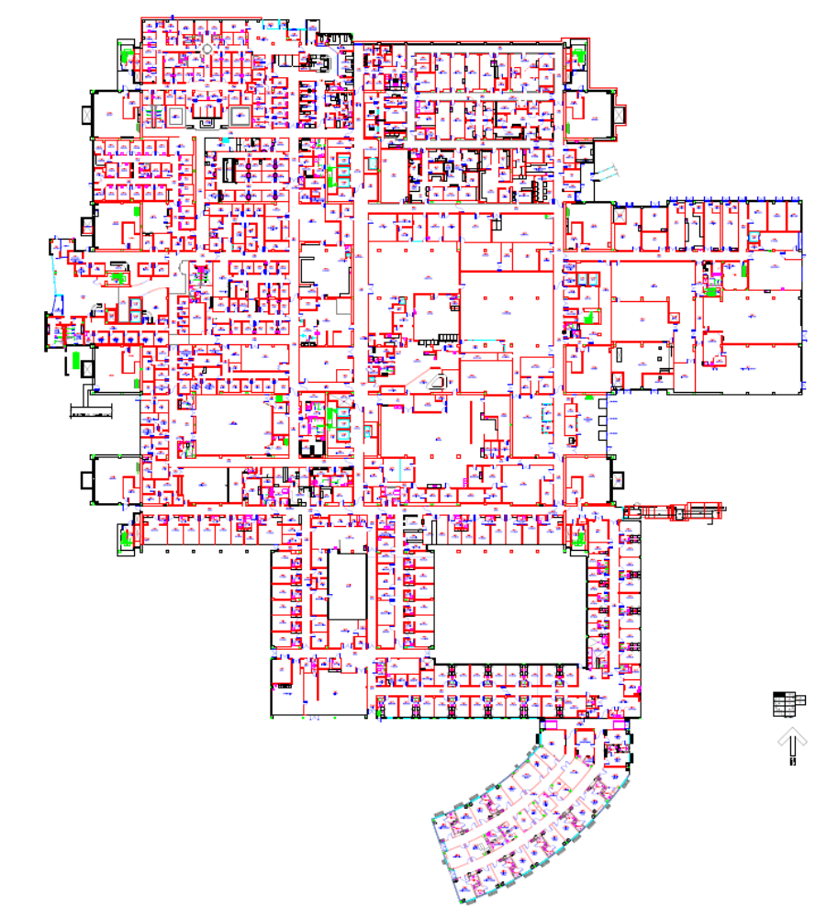
Project Name: Triage Sink
Shutdown Type: Domestic Water
Date and Time: 1/12/16 , 4am to 6am
Legend
Effected Area
Work Area
System
Shutoff Points
ILSM Symbols
Access Denied
Alternate Route
Egress Points
1st Floor

Slide 12
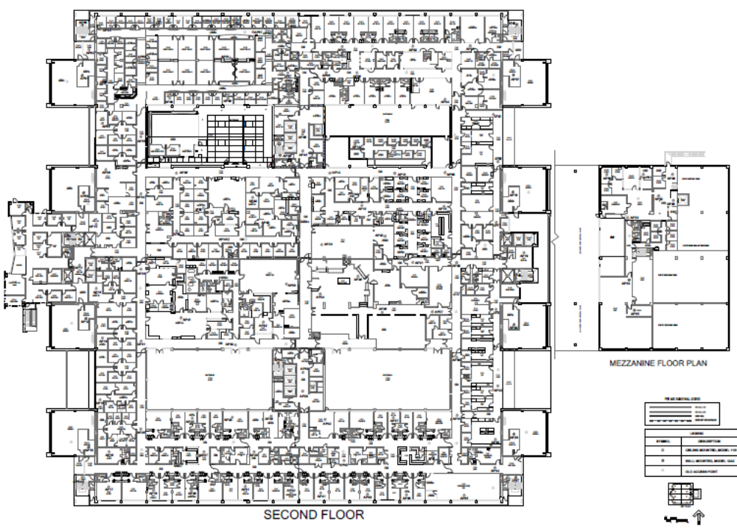
Project Name:
Shutdown Type:
Date and Time:
Legend
Effected Area
Work Area
System
Shutoff Points
ILSM Symbols
Access Denied
Alternate Route
Egress Points
2nd Floor

Slide 13
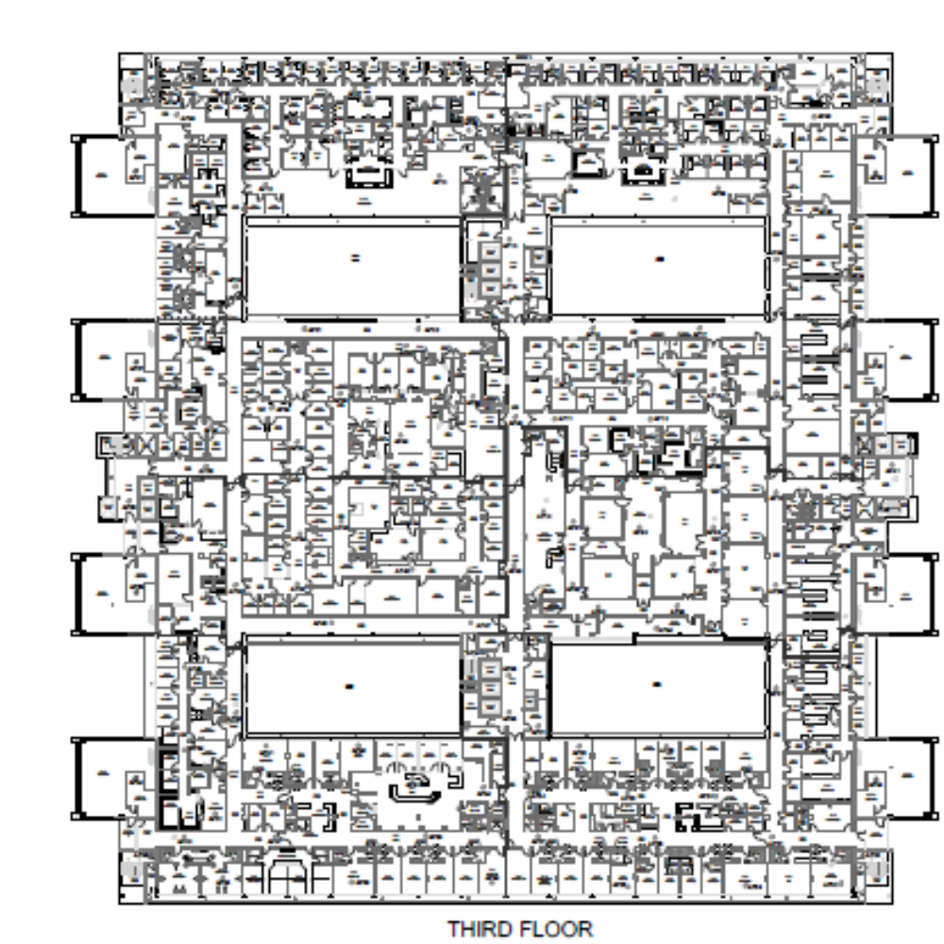
Project Name:
Shutdown Type:
Date and Time:
Legend
Effected Area
Work Area
System
Shutoff Points
ILSM Symbols
Access Denied
Alternate Route
Egress Points
3rd Floor

Slide 14
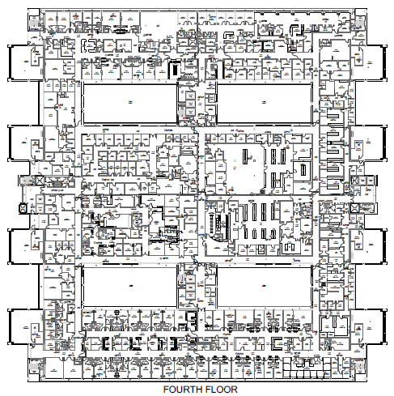
Project Name:
Shutdown Type:
Date and Time:
Legend
Effected Area
Work Area
System
Shutoff Points
ILSM Symbols
Access Denied
Alternate Route
Egress Points
4th Floor

