Slide 1


Welcome
DEPARTMENT OF VETERANS AFFAIRS
Welcome to
Department of
Veterans Affairs
Industry Day Conference
July 24, 2018
For
Construction Management Services

Slide 2

Introductions
Program Office:
Office of Real Property
Program Management:
Mitch Ortiz
Office of Construction and Facilities Management
Contracting Office:
Office of Facilities Acquisition
Director of Acquisition Support Services:
Zebulon Fox
Contracting Officers:
Johnathan Taylor
Catalin “Marcel” Parfenti
One cohesive acquisition team moving towards one procurement solution.

Slide 3
Agenda
10:00 AM to 10:10 AM – Meet and Greet (Industry Attendees)
10:10 AM to 10:15 AM – Industry Day Start/Introductions/ Review Agenda- Johnathan Taylor
10:15 AM to 10:30 AM – Opening Remarks (Zebulon Fox, Director of Acquisition Support Services)
10:30 AM to 11:30 AM – Program Requirements- Mitch Ortiz (Questions and Answers)
11:30 AM to 12:30 PM – Break Lunch (Room is available for industry networking) (Presentation will be disconnected)
12:30 PM to 1:30 PM – Contract and Timeline (Questions and Answers)- Johnathan Taylor
1:30 PM to 2:30 PM – Industry Recommendations (White Board Exercise)
2:30 PM to 3:00 PM – Networking (Industry Attendees)

Slide 4
Industry Feedback
How many SDVOSBs are present in person, on the phone or online?
How many VOSBs are present in person, on the phone or online?
What other small business categories are in attendance today?
How many other than small businesses are in attendance today?

Slide 5
Opening Remarks by Mr. Fox

Slide 6
Program Requirements by Mr. Ortiz

Slide 7
Design Phase Services
(6-9 months)
Project Management of Design Development
  Coordinate and facilitate meetings between A/E and clients
  Coordinate the design review process through Dr. Checks
  Tenant Improvement (TI) Management
    Monitor the budgeted cost of TI throughout the design
Tenant Improvement Management
  Support reconciliation Schedule B and C IAW final construction drawings (SFO only)
  Itemize and Estimate TI costs to support the Contracting Officer’s final TI negotiation (RLP only)

Slide 8
Construction Phase Services
(18-24 months)
Participate in Post-Award Kickoff Meeting
Tenant Improvement Reconciliation/Verification
  Support VA’s verification during a final site inspection all Schedule B/C or TI items have been provided IAW previous agreements
Change Order Support
  Estimate, support in negotiations, document
Project Schedule Monitoring
  Monthly review of Lessor’s schedule, Report to SRE with recommended action
Construction Progress Reporting
Site Visits, Meetings and Inspections
Coordination of GFE (Gov’t furnished, Lessor installed)
Maintain Lease File

Slide 9
ORP Additional Services
Scheduling
Issue/Claims Resolution
Independent Testing Services
Special Inspections
Claims Analysis
Cost Estimating
Administrative

Slide 10
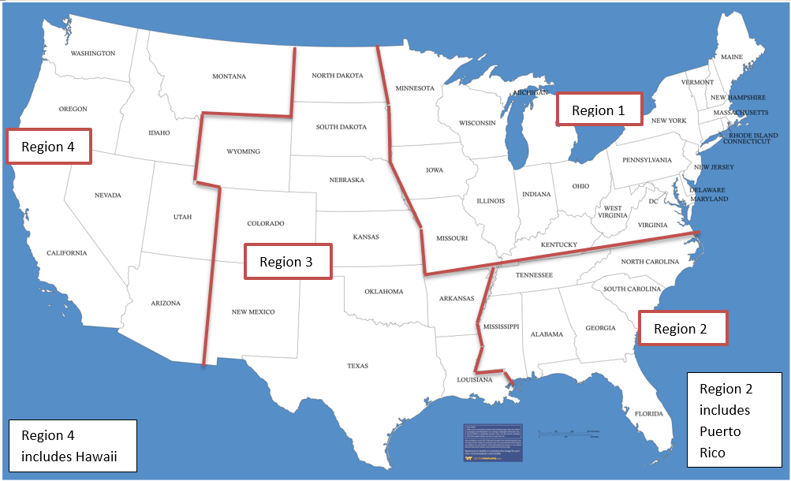
Geographical Regions

Slide 11
Region 1
Project Location | Size | Planned Award
Lowell, MA | 35,163 | FY17 Q1
Traverse City, MI | 22,500 | FY18 Q2
Charlotte Hall, MD | 17,741 | FY18 Q3
Frederick, MD | 15,958 | FY18 Q4
Lincoln, NE | 72,000 | FY18 Q4
Detroit, MI | 31,124 | FY19 Q2
Des Moines, IA | 36,045 | FY19 Q2
Youngstown, OH | 30,000 | FY19 Q3
Fredericksburg, VA | 378,461 | FY19 Q3
Portland, ME | 56,637 | FY19 Q3
Rochester, NY | 31,064 | FY19 Q3
Terre Haute, IN | 36,827 | FY19 Q3
West Indianapolis, IN | 67,721 | FY19 Q3
Worcester, MA | 40,000 | FY19 Q3
Ann Arbor, MA | 36,453 | FY19 Q3
Boston Research, MA | 40,604 | FY19 Q3
Pittsburgh, PA, | 53,466 | FY19 Q3
Lorain, OH | 20,052 | FY19 Q4
Brick, NJ | 60,000 | FY19 Q4

Slide 12
Region 2
Project Location | Size | Planned Award
Charleston CMOP, SC | 91,807 | FY18 Q3
Cobb County, GA | 64,000 | FY18 Q4
Columbus, GA | 55,000 | FY18 Q4
New Port Richey, FL | 114,000 | FY18 Q4
St. Augustine, FL | 16,595 | FY19 Q1
Charleston, SC | 75,000 | FY19 Q1
Chattanooga, TN | 75,000 | FY19 Q1
Myrtle Beach, SC | 84,000 | FY19 Q1
Ponce, PR | 114,300 | FY19 Q1
San Juan, PR | 52,000 | FY19 Q2
Daytona Beach, FL | 106,826 | FY19 Q3
Gainesville, FL | 70,849 | FY19 Q3
Gainesville MH, FL | 39,932 | FY19 Q3
Hampton Roads, VA | 155,169 | FY19 Q3
Jacksonville, FL | 164,054 | FY19 Q3
Lakeland, FL | 92,681 | FY19 Q3
Raleigh, NC | 185,271 | FY19 Q3
Tampa, FL | 114,098 | FY19 Q3
Birmingham, AL | 59,744 | FY19 Q3
Charleston, SC | 48,000 | FY19 Q3
Ocala, FL | 45,499 | FY19 Q3
Pike County, GA | 49,175 | FY19 Q3
Brooksville, FL | 41,297 | FY19 Q4
Orangeburg, SC | 17,723 | FY19 Q4
Rock Hill, SC | 15,962 | FY19 Q4
Sumter, SC | 19,918 | FY19 Q4

Slide 13
Region 3
Project Location | Size | Planned Award
Houston R&D, TX | 48,000 | FY18 Q4
Leavenworth, TX | 88,449 | FY18 Q4
San Antonio, TX | 190,800 | FY18 Q4
Tulsa, OK | 140,000 | FY18 Q4
Lubbock, TX | 94,000 | FY19 Q1
Tyler, TX | 48,425 | FY19 Q2
Rapid City, SD | 40,003 | FY19 Q3
Cape Girardeau, MO | 43,000 | FY19 Q3
Corpus Christi, TX | 58,254 | FY19 Q3
Northern Colorado, CO | 75,645 | FY19 Q3
Johnson County, KS | 22,910 | FY19 Q4
Houston Dom, TX | 35,827 | FY19 Q4
Texarkana, TX | 21,567 | FY19 Q4
Fort Smith, AR | 34,000 | FY20 Q1
Denver, CO | 184,718 | FY20 Q4

Slide 14
Region 4
Project Location | Size | Planned Award
Bakersfield, CA | 30,100 | FY18 Q4
Redding, CA | 77,000 | FY18 Q4
Honolulu, HI | 66,000 | FY19 Q1
Phoenix, AZ | 203,000 | FY19 Q1
San Diego, CA | 99,986 | FY19 Q1
Tucson, AZ | 15,000 | FY19 Q2
San Diego, CA | 27,923 | FY19 Q3
Santa Rosa, CA | 53,870 | FY19 Q3
Missoula, MT | 59,990 | FY19 Q3
Oxnard, CA | 41,027 | FY19 Q3

Slide 15
Networking Lunch
11:30 to 12:30

Slide 16
Contract and Timeline by Mr. Taylor

Slide 17
Timeline
  July 24, 2018- Industry Day
  July 31, 2018 - Capabilities Statements due
  Late Summer 2018 - estimated solicitation date
  Winter CY 2018 - estimated award date

Slide 18
Contract Data
This is a CFM Contract(s) for Office of Real Property Projects
One base year, four (4) one-year options
Minimum: $1,000
Maximum: $15,000,000 per contract
Multiple Award Indefinite Quantity Indefinite Delivery (IDIQ) Contract

Slide 19
Capabilities Statement
Firms are not required to submit a capabilities statement, but they are strongly encouraged to do so.
Capabilities statements are not proposals and are not evaluated for award. Rather, they are used as part of VA’s market research to determine an acquisition strategy
Acquisition strategy includes the decision of whether there is a sufficient number of capable firms to justify a procurement be set-aside.
Firms may provide an attachment to ask or answer questions and provide suggestions
Due July 31, 2018 (see https://www.fbo.gov/?s=opportunity&mode=form&id=29506d9863ebdaf2b04a44873dd8c204&tab=core&_cview=1)

Slide 20
Potential Procurement Considerations (Basic List)
Submission Requirements | Evaluation Factors
Proposals shall be in writing VA will not accept telephonic, telegraphic, facsimile VA will not pay any costs incurred by offerors for developing and submitting proposals Initial proposal should contain the offeror’s best terms for technical and price Responsive Offerors will submit proposals in two (2) severable parts: Price Proposal on SF1449, Signed SF1449 RFP Signed SF30 Amendments Technical Proposal (shall not include cost or price information) Past Performance Questionnaires/ CPARS Note: This slide is not all inclusive. | Best value Technical non-priced factors when combined are approximately equal to price, The Government may make trade-offs The evaluation will be conducted on the factors specified in the Solicitation which are listed in descending order of importance All sub-factors will be listed in descending order of importance Technical Evaluation Factors Capability to Perform Experience (Projects by Type) Key Personnel (Resumes/CV) Organizational Structure/Management Organizational Team Structure Management Plan 3) Past Performance Price

Slide 21
Fair Opportunity Procedures
Fair opportunity per FAR 16.505(b)(1)
The contracting officer shall—
Provide a fair notice of the intent to make a purchase, including a clear description of the supplies to be delivered or the services to be performed and the basis upon which the selection will be made to all contractors offering the required supplies or services under the multiple-award contract; and
Afford all contractors responding to the notice a fair opportunity to submit an offer and have that offer fairly considered.

Slide 22
Pricing
Firm Fixed Price
IDIQ level by Labor Categories
Anticipate Task Orders will be Firm Fixed Price

Slide 23
Firm Fixed Price
A firm-fixed-price contract provides for a price that is not subject to any adjustment on the basis of the contractor’s cost experience in performing the contract. This contract type places upon the contractor maximum risk and full responsibility for all costs and resulting profit or loss. It provides maximum incentive for the contractor to control costs and perform effectively and imposes a minimum administrative burden upon the contracting parties. FAR 16.202-1

Slide 24
Socioeconomic Considerations and the
“Rule of Two”

Slide 25
Market Research Rule of Two
On June 16, 2016, the U.S. Supreme Court reversed a lower court decision impacting the Department’s original implementation of the Veterans First Contracting Program. This is known as the “Kingdomware Decision” which enforced the Rule of 2 in VA Contracting
For SDVOSB and VOSB firms Rule of Two is mandatory, not discretionary and its text requires the Department to apply the Rule of Two to all contracting determinations, including the issuance of each Task Order under an IDIQ contract.

Slide 26
Rule of Two
What is the “Rule of Two”?
Provides that a contracting officer of the Department shall award contracts by restricting competition to Service Disabled Veteran-Owned Small Businesses and then Veteran Owned Small Business if the officer reasonably expects that at least two such businesses “... will submit offers and that the award can be made at a fair and reasonable price that offers best value to the United States.” 38 U. S. C.§8127(d)

Slide 27
SAM and VETBiz
It is vital that Contractors be registered in the www.sam.gov web page
It is vital that SDVOSB Contractors and VOSB Contractors be registered in both www.sam.gov and https://www.vip.vetbiz.va.gov/

Slide 28

Contact for Small Business
Procurement Review Team Helpline
(202) 632-5378
Email: OSDBUAcqSupport@va.gov
Strategic Outreach (202) 461-4448
Email: OSDBU@va.gov
https://www.vip.vetbiz.va.gov/
OSDBU Call Center at 1-866-584-2344
https://nvsbe.com/#

Slide 29
Potential Expansion of CM Services
VA Mission Act
Seismic
Major
Minor
Renovations
Cemeteries

Slide 30
Industry Recommendations

Slide 31
Industry Feedback
What are your concerns with the contract data?
What are your concerns with submission requirements?
  Is it reasonable to request email submissions with 5MB size limits?
What are your concerns with Evaluation?
What are your concerns with Performance evaluations?
What are your concerns with Pricing?

Slide 32

THANK YOU FOR YOUR INTEREST WITH THE VA!

