Slide 1

Coatesville Veterans Affairs Medical Center
Replace Uninterruptible Power Supply (UPS) Telephone Room
542-18-112
542-18-4-9125-0017
Photo Attachment to Statement of Work
April 16, 2018
Contracting Officer Representative: Thomas Bucci
Thomas.Bucci@VA.gov 610-384-7711 x3218 Building 70 Room 105
Contracting Officer: Elizabeth Morin
Elizabeth.Morin3@VA.gov

Slide 2
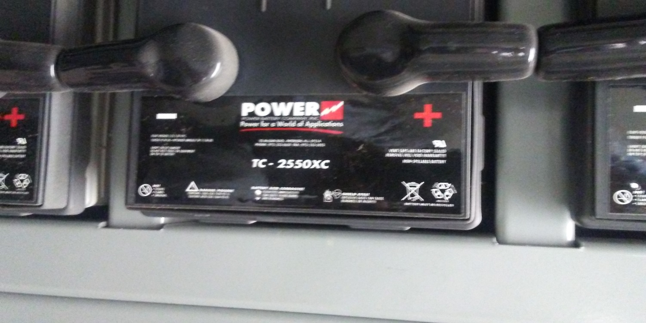
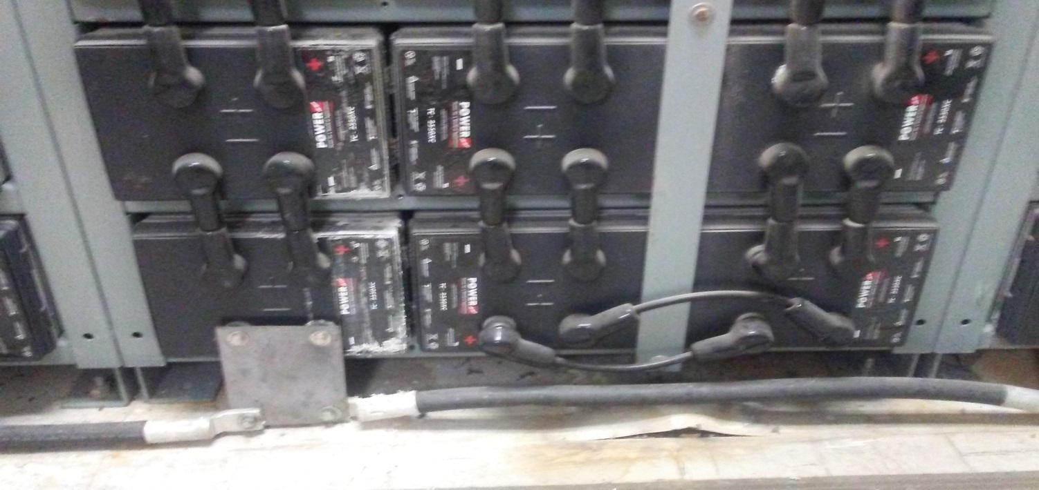
Battery Model Number times 72 batteries
Multiple Batteries are leaking and damaging floor

Slide 3
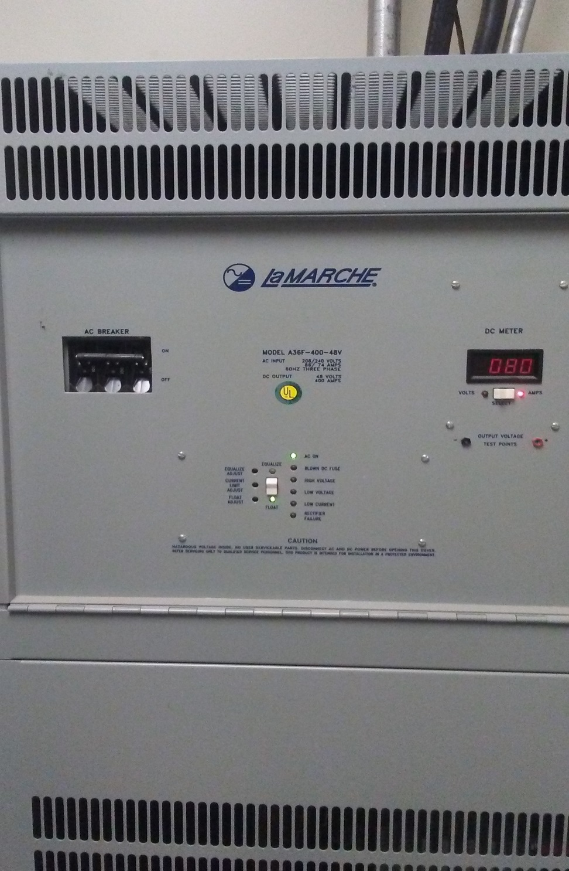
LaMarche Charger
Model number: A36F – 400 – 48V
AC Input: 208/240 Volts 86/74 Amps 60 HZ 3 PH
DC Output: 48 Volts, 400 Amps
Control package x 2

Slide 4
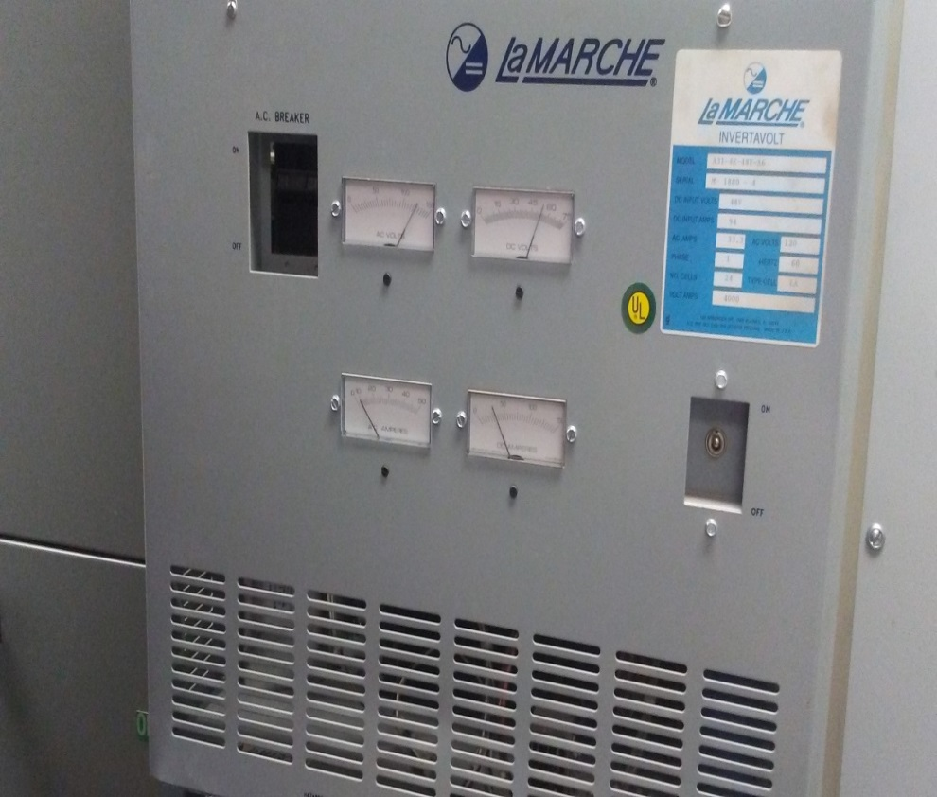
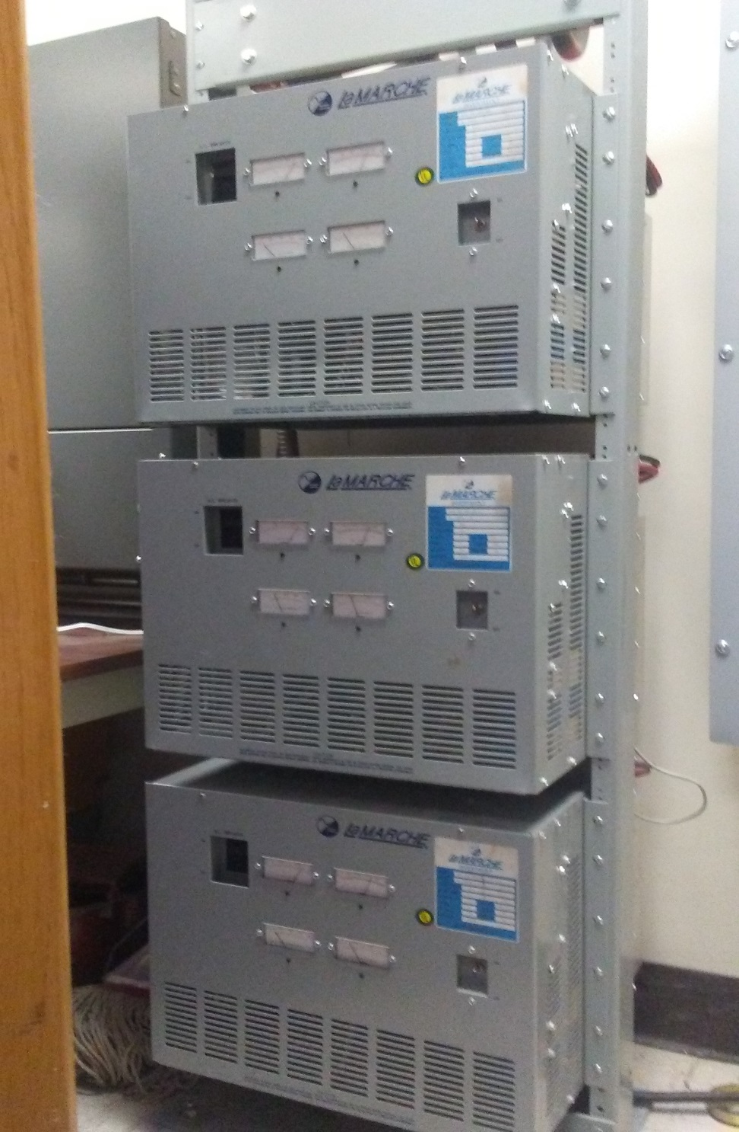
Inverters x 3
LaMarche Invertavolt
Model number: A31-4K-48V-A6
Serail number: M 1880 – 4
DC Input volts: 48V
DC Input amps: 94
AC Amps: 33.3 AC Volts:120
Phase: 1 Hertz: 60
No. cells: 24 Type cell: LA
Volt amps: 4000

Slide 5
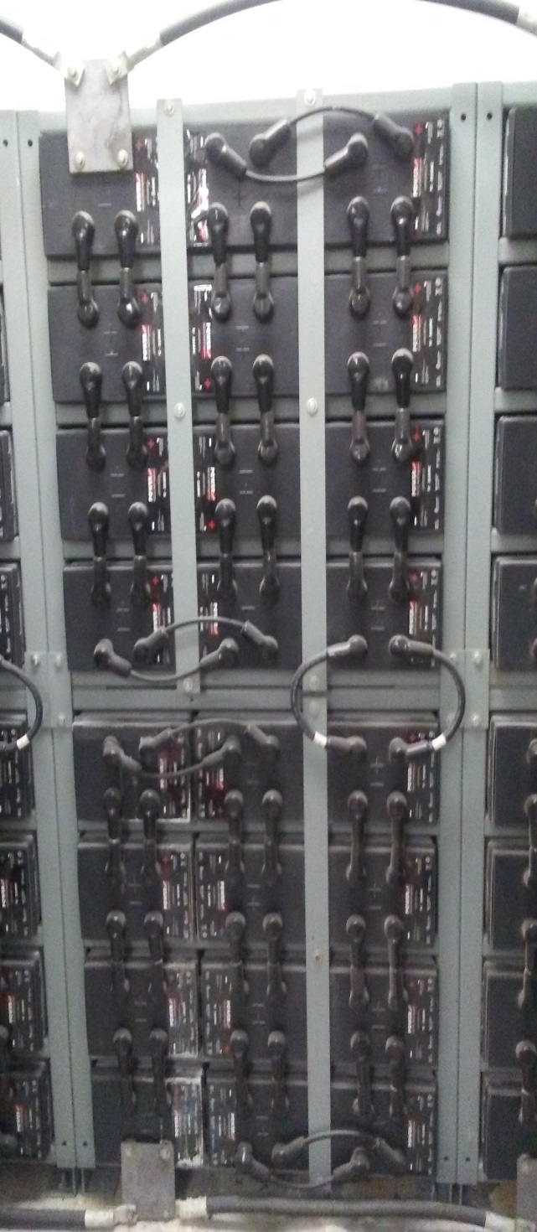
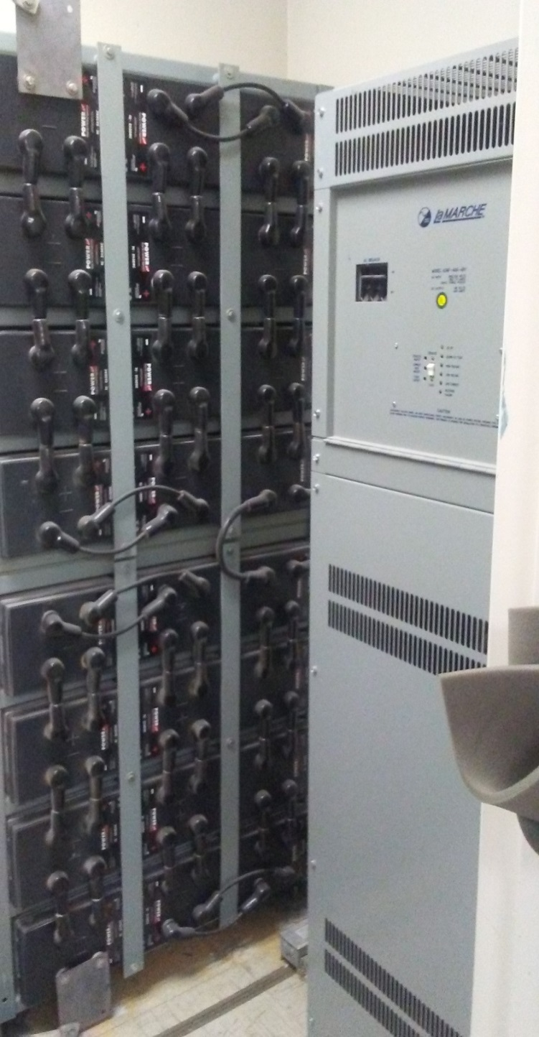
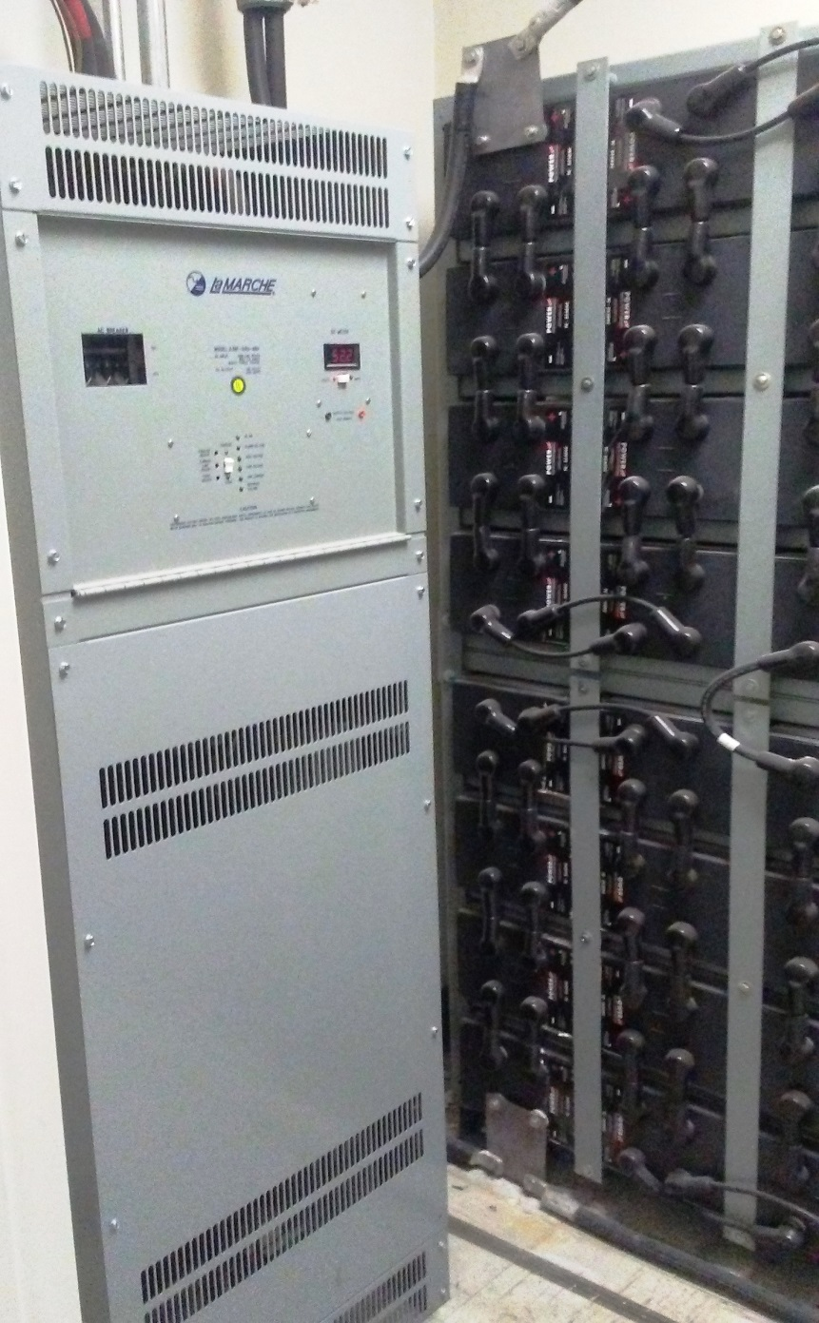
Three pictures were taken to view all of the equipment within this room. There are two control boxes on the left and right and 72 batteries between the two boxes. The room measures 10’w x 5’d x 9’h.
Contractor is to attempt to design the package to allow all components to fit within this room IF POSSIBLE.

Slide 6
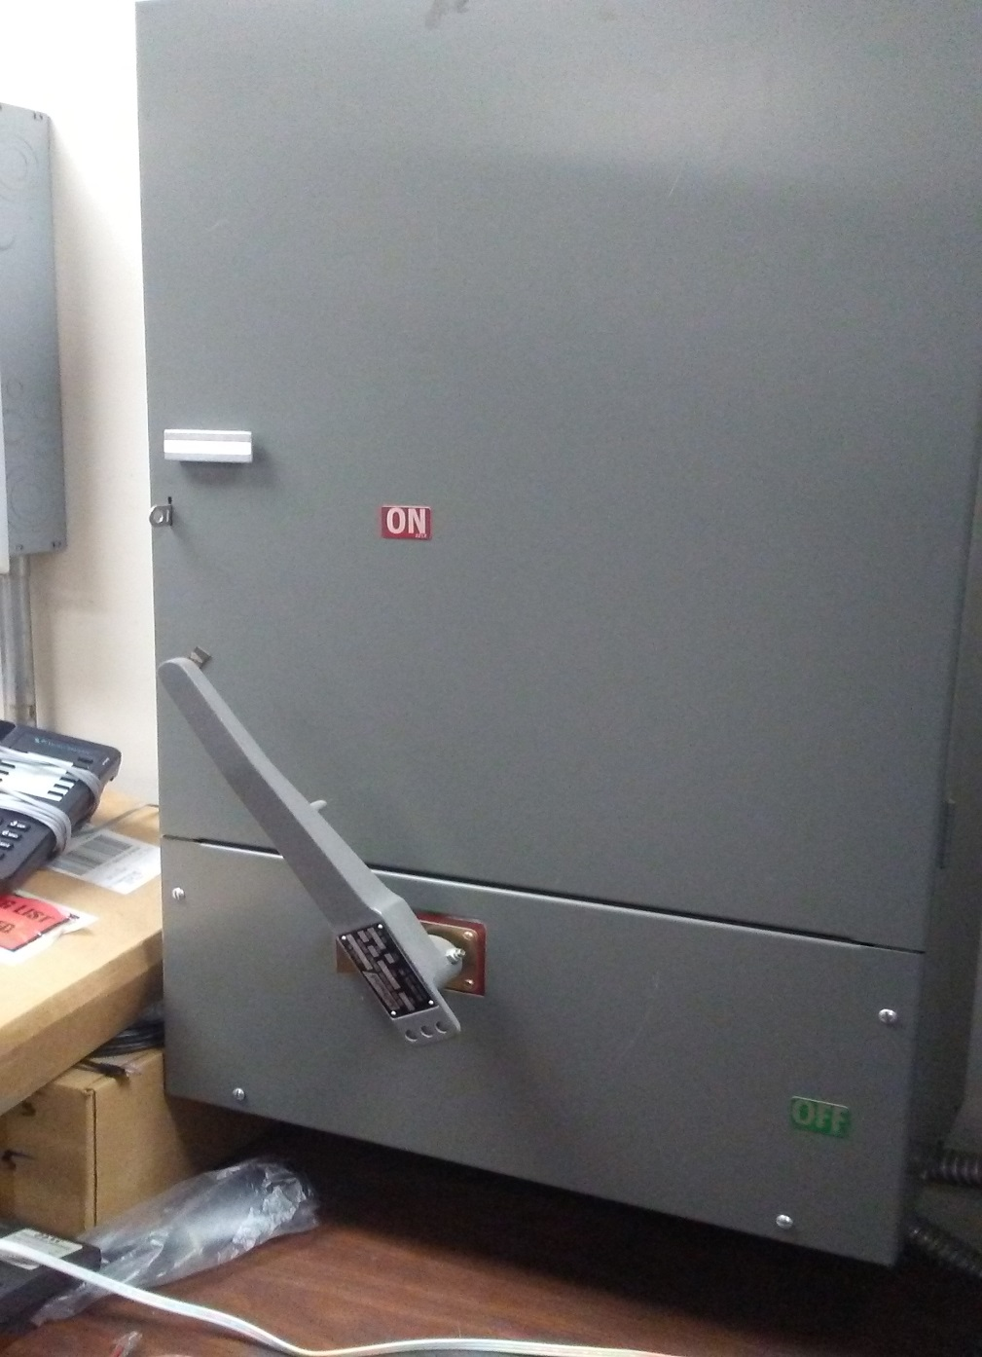
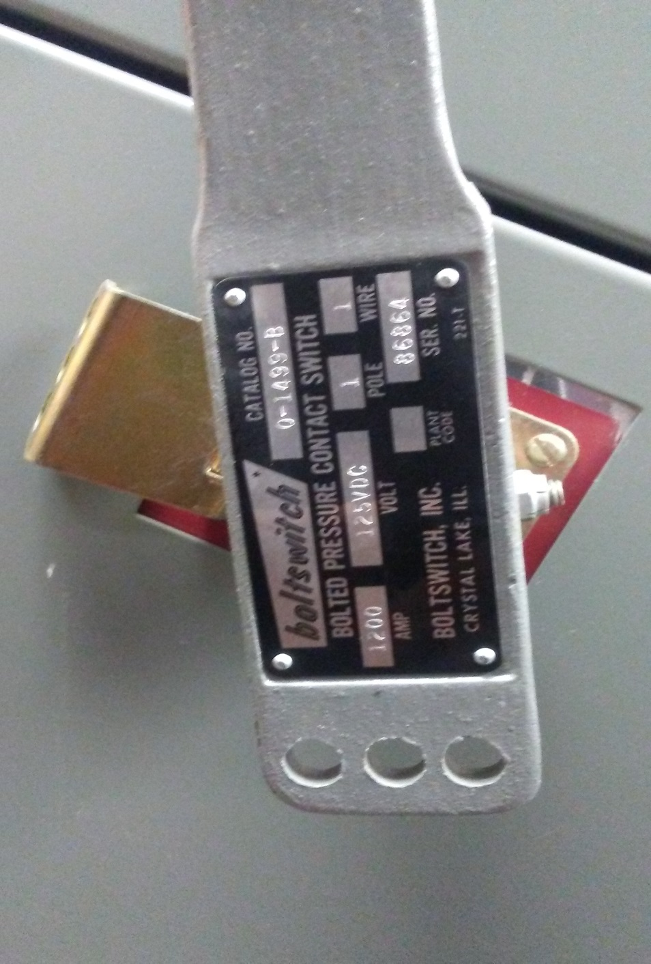
Breaker panel is barely visible to the left in this picture – this shall remain intact but breakers will be replaced. The remainder of the pictures on this slide are of the 1200 AMP disconnect with a close-up of the Model Number. This device will be replaced.

