Slide 1
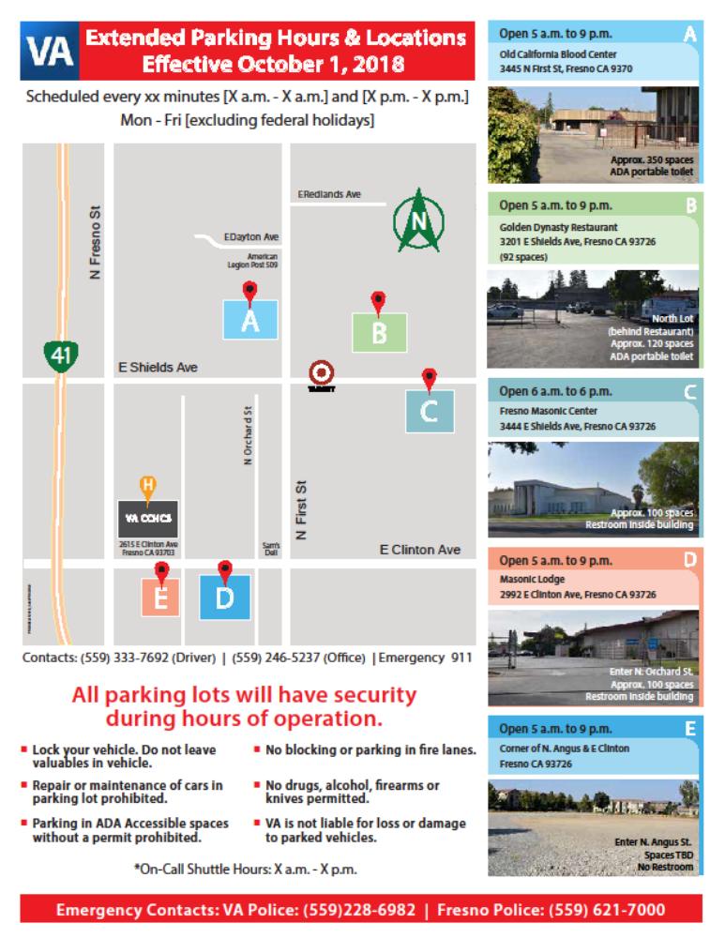
Lots & Times
Lot Hours
  5 AM - 9 PM
    A : Central California Blood Bank, 3425 N. First and 3445 N. First St. Fresno, CA 93726.
    B: Midtown Plaza. 3201 E. Shields Ave. Fresno, CA 93726.
  6 AM – 6 PM , hours determined by current contract.
    C – Masonic Lodge, 3444 E Shields Ave, Fresno, CA 93726.

Slide 2
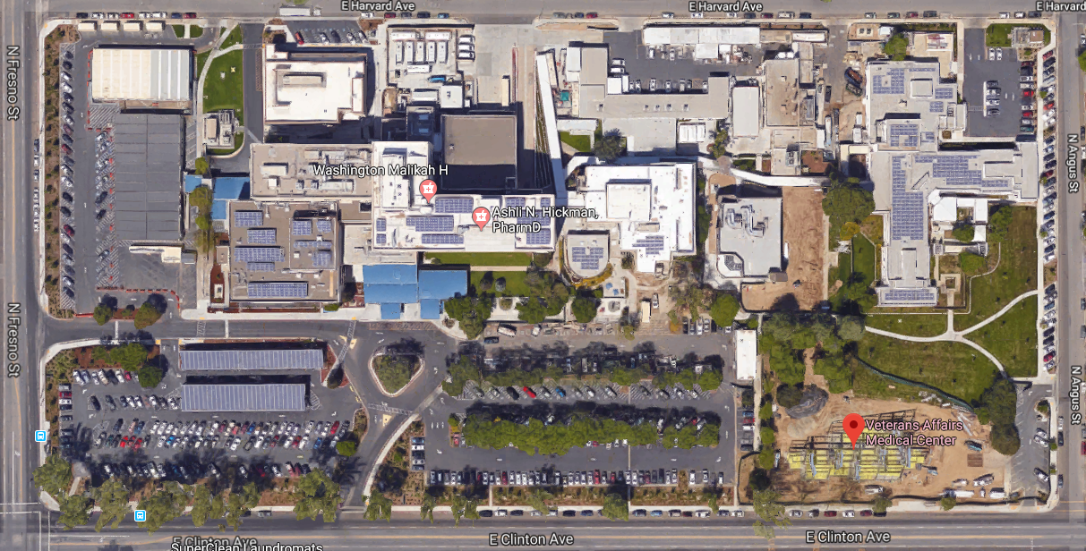
Facility Bus Stop
Pick-Up & Drop-Off will be behind facility in Warehouse loading zones.

Slide 3
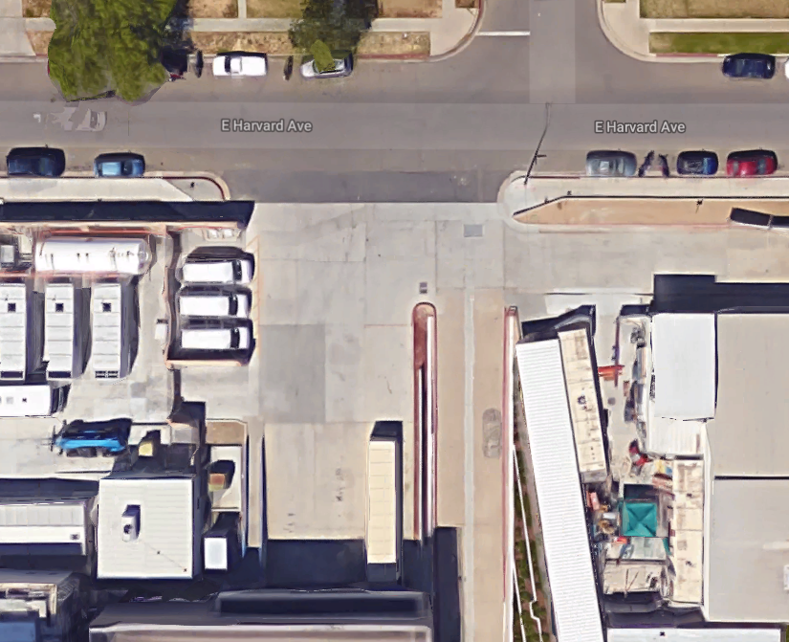
Bus Stop
Pick-Up & Drop-Off will be behind facility in Warehouse loading zones.

Slide 4
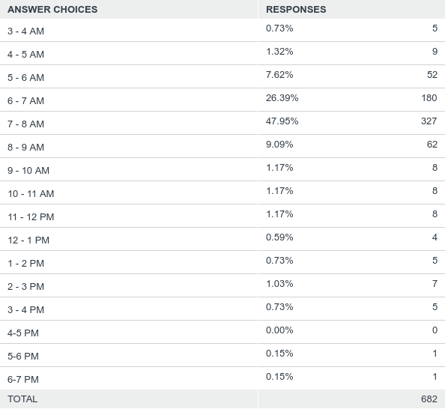
Q1: What time do you usually arrive at the Fresno facility Monday - Friday?
Answered: 682 Skipped: 2

Slide 5
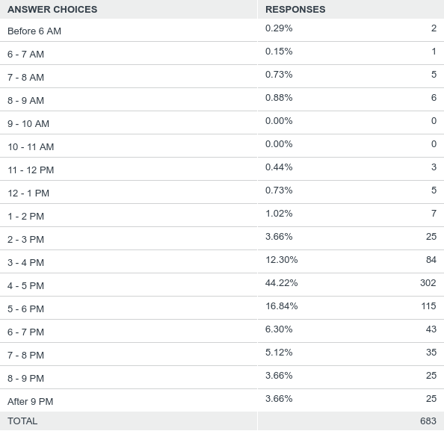
Q2: What time do you usually leave the facility after work?
Answered: 683 Skipped: 1

Slide 6
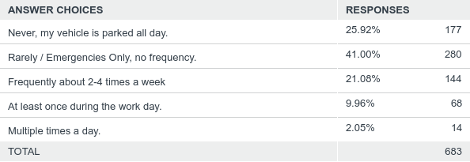
Q3: Do you use your vehicle for lunch / errands during the work day?
Answered: 683 Skipped: 1

Slide 7
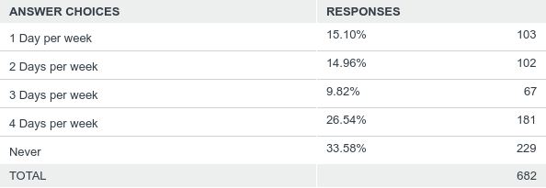
Q4: Thinking about your response to question #1; how many days during the work week do you arrive earlier to work?

