Slide 1

DEPARTMENT OF VETERANS AFFAIRS
Community Based Outpatient Clinic
Santa Rosa, CA
RLP No. 36C10F18Q0571
Pre-Bid Conference
October 2, 2018

Slide 2
Meeting Minutes
Clearly state your name and company affiliation
Clearly reference the RLP Section number or attachment to which your question pertains
- Please speak up so everyone can hear your questions
Our goal is to answer your questions
Any questions after today, must be submitted in writing to Cindy Schneider, CRCRE @cschneider@crcre.com no later than October 12, 2018.
Official Responses will be posted on FBO through and Amendment

Slide 3
Conference Agenda
Santa Rosa, CA
Community Based Outpatient Clinic
RLP 36C10F18Q0571
Welcome
Introductions
Pre-Bid Meeting Objectives
Project Overview
Process Overview – Review of RLP Package
Overview building conceptual plans
Questions and Comments

Slide 4
INTRODUCTIONS
Department of Veterans Affairs (VA) Project Team
Anntwinette Dupree-Hart, Contracting Office, VA Central Office
Kelli Witt, Project Manager, VA Central Office
Kimber Kay, Facility Planner, SF VA Medical Center
Andy Lamendola, Senior Resident Engineer, VA Central Office
Ryan Anderson, Resident Engineer, CA Central Office
Linda Chan, Planner/Architect, VA Central Office (OCFM)
Patrick Moran, Planner, Western Region, (OCFM)

Slide 5
VETERANS AFFAIRS CONSULTANTS
Real Estate Advisors
Carpenter/Robbins Commercial Real Estate, Inc.
Cindy Schneider
Architectural/Engineering Services
Commanders Concepts Commissioning, Engineering Consultants
Rich Diddams, LEED GA, Chief Executive Officer
Oculus Inc.
Rob Forney, AIA, Director, Senior Project Manager
Christy Johnson, Architect, Project Manager

Slide 6
PROCUREMENT OVERVIEW

Slide 7
PROJECT OVERVIEW
The purpose of the new facility is to expand capacity and services
53,870 ABOA Square Feet Maximum
Minimum of 420 surface/outside parking spaces reserved for the exclusive use of the Government
  These spaces must be secure and lit
Site must be controlled by the successful Offeror
VA to lease premises for a term of up to 20 years
Occupancy is preferred within 540 calendar days, but no later than 730 calendar days, following lease award
Offeror finances the project through completion of construction

Slide 8
Mandatory offer requirements
Offers Due: November 13, 2018 – 4:00 PM ET (1:00 PM PT)
Submit compact discs to Carpenter/Robbins as follows: (NO Email submittals will be accepted.)
  Volume I – Technical Proposal: 6 CDs; No Hard Copy Accepted
  Volume II – Price Proposal: 1 CD; No Hard Copy Accepted
One set of compact discs (Volume I and Volume II) to Anntwinette Dupree-Hart (Contracting Officer) and Kelli Witt (Project Manager)
CDs must be bookmarked (CDs only, No DVDs)
Initial and sign all pages of your submittal
Offers that do not comply specifically and correctly with RLP directions are at risk of being determined non-responsive

Slide 9
COMMUNICATIONS AND AWARD
VA will award based on the Best Value, price and other factors considered
VA may award this contract based on initial offers
VA may elect to establish a competitive range
Negotiations may be conducted with only the most highly qualified bidders in order to determine the Best Value to the Government
Price evaluation is based on Net Present Value (NPA) Price per ABOA Square Foot basis (RLP Section 4.05)
Award occurs upon execution of the Lease by the Contracting Officer

Slide 10
PROJECT OVERIVEW
Best Value Source Selection Procurement
Price and Technical Factors will be evaluated
Technical Factors are evaluated by Technical Evaluation Board (TEB)
Pricing information is not given to TEB members
Price is evaluated by the Contracting Officer
Price is approximately equal to Technical Factors when combined
Price
Technical
Factors

Slide 11
SUBMITTALS DISKS MUST
BE INDEXED

Slide 12

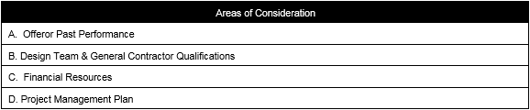

RLP SECTION 4.03 TECHNICAL FACTORS
Clear responses to each Factor are critical to proper evaluation of your offer
Technical Factors are listed in descending order of importance
FACTOR 1. Technical Evaluation Factors
FACTOR 2: Offeror’s Qualifications and Past Performance
FACTOR 3: Operations & Maintenance Plan

Slide 13
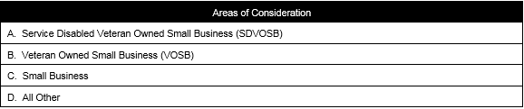
RLP SECTION 4.03 TECHNICAL FACTORS
FACTOR 4: Socio-Economic Status
SMALL BUSINESS
In order to receive consideration for any small business classification, as a component of these evaluation criteria, small businesses must:
Register and provide a DUNS Number validated in SAM.GOV
Completed Representations and Certifications in SAM.GOV that have been entered or updated within the last 12 months, are current, accurate, complete, and applicable to this solicitation (including the business size standard applicable to the NAICS code referenced for this solicitation)
Provide the SAM.GOV print out verifying offering entity’s status
Provide SBA web print out showing registration or a signed acknowledgement of application from the Small Business Administration

Slide 14
RLP SECTION 4.03 TECHNICAL FACTORS
SDVOSB and VOSB
Status as a Service-Disabled Veteran-Owned Small Business is determined in accordance with 13 CFR Parts 125.8 through 125.13. Additionally, the SDVOSB or VOSB evaluation criteria, the offeror MUST be registered and have an active status in the Vendor Information Pages (VIP) database at http://www.vip.vetbiz.va.gov/. Offerors must provide a copy of the Center for Verification and Evaluation (CVE) Verification letter at initial offer and with final revised proposals. The Offeror’s DUNS must correspond to the DUNS in SAM.GOV.
The core requirements for a company to become verified are:
The Veteran owner(s) have direct, unconditional ownership of at least 51% of the company (38 CFR 74.3) and have full decision making authority (38 CFR 74.4 (g));
The Veteran manages the company on both a strategic policy and a day-to-day basis (38 CFR 74.4);
The Veteran holds the highest officer position (38 CFR 74.4(c)(2));
The Veteran should be the highest compensated employee unless there is a logical explanation otherwise submitted by the Veteran as to how taking a lower salary than other employee(s) helps the business (38 CFR 74.4 (g) (3)); and
The Veteran has the managerial experience of the extent and complexity needed to run the company.

Slide 15
RLP SECTION 4.03 TECHNICAL FACTORS
JOINT VENTURES
For purposes of this solicitation a Joint Venture (JV) is a Partnership. An Offeror may submit a proposal in the form of a Joint Venture only if the existing Joint Venture has a corresponding DUNS Number in https://www.SAM.gov and all the proposal submission documents are in the name of the existing Joint Venture, not the individual partners of the Joint Venture. These include, but are not limited to:
GSA Form 3518
GSA Form 1364A
GSA Form 1217
Financial Resource Commitment Letters
Offerors who are an existing Joint Venture may submit a proposal under this solicitation subject to conditions outlined in detail in this section of the RLP

Slide 16
RLP SECTION 4.03 TECHNICAL FACTORS
OTHER THAN SMALL BUSINESSES
If the contractor is offering as a Large Business and subcontracting opportunities exist, the offer must include with the initial offer a Small Business Subcontracting Plan as defined in FAR 52.219-8, FAR 52.219-9, and VAAR 852.219-9 which are included by reference in this solicitation. An acceptable template can be found on the following website: http://www.va.gov/oal/business/fss/sbsp.asp. This is a suggested format only. Other formats are acceptable; however, all identified elements must be included for your plan to be processed and approved. Additional guidance is included in FAR 52.219-9. The subcontracting plan will be evaluated and rated on the demonstrated plan of meeting or exceeding VA’s small business goals outlined in the table below and the following:
Reflects a valid corporate commitment between all parties in providing subcontracting opportunities for small business, small disadvantaged business, women-owned small business, HUBZone small business, veteran-owned small business, and service-disabled veteran-owned concerns. Includes the strength and specificity of each corporate commitment (i.e., what type of commitment, how binding is the commitment, how specific is the commitment to this proposed effort, and what types of tasks are included in these subcontracting opportunities).
Reflects a one year history demonstrating your corporate commitment to meet your subcontracting goals/targets by providing Individual Subcontracting Report (ISR), for those contracts/projects in which you are submitting under Past Performance. If goals were not met on the ISR, provide an explanation as to why the goals/targets were not met.
Demonstrates realistic targets expressed in dollars and in percentages of the total proposed subcontracting dollars for each small business category listed above.
Reflects compliance, at a minimum, with VA goals listed below.

Slide 17
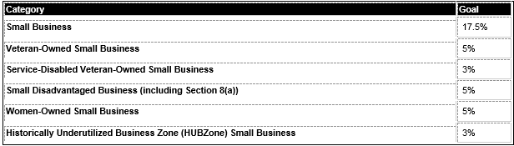
RLP SECTION 4.03 TECHNICAL FACTORS
Reflects compliance, at a minimum, with VA goals listed below.
For Small Businesses: If the Offeror is a small business concern, the Offeror is not required to submit a small business plan.
The subcontracting plan submitted with the offer will be evaluated on the extent to which the proposal provides Small Business Subcontracting targets that meet the Department of Veteran Affairs Small Business goals for this project and the extent to which the offeror’s Small Business Subcontracting Plan establishes reasonable efforts demonstrating the subcontracting targets can be met during the performance of the contract. Failure to submit subcontracting plan at the time of initial offer shall make the offeror ineligible for award of the contract.

Slide 18
REQUIRED SUBMITTALS
RLP-Section 3.02 Technical and price proposal requirements
  Receipt of Proposals (submittal due date/location)
  Two Volumes: 1-Technical; 2-Price
  Submittal Checklist
  Timely Delivery
RLP-Section 3.06
Ensure response addresses all items listed (subparagraph A-Z)
  HIGHTLIGHTS
  3.06E Site Submission
  F Site Control
  I SAM Registration
  R Energy Star
  S Green Globes
  U Seismic
RLP-Section 3.07 TIA and amortization
VA may elect to pay some or all of the allowance lump sum
RLP Section 1- Make sure submittal addresses requirements outlined in this section and current wage notes
RLP Exhibits 22A/22B – labor standard provision and wage notes
Conceptual Plans – Provide both CAD and PDF versions for VA review

Slide 19
OVERVIEW OF DESIGN CONCEPT
DRAWINGS
Commander’s Concepts Commissioning
Engineering Consultants
SDVOSB
Oculus, Inc.
Architectural Consultants (sub-contractor)

Slide 20
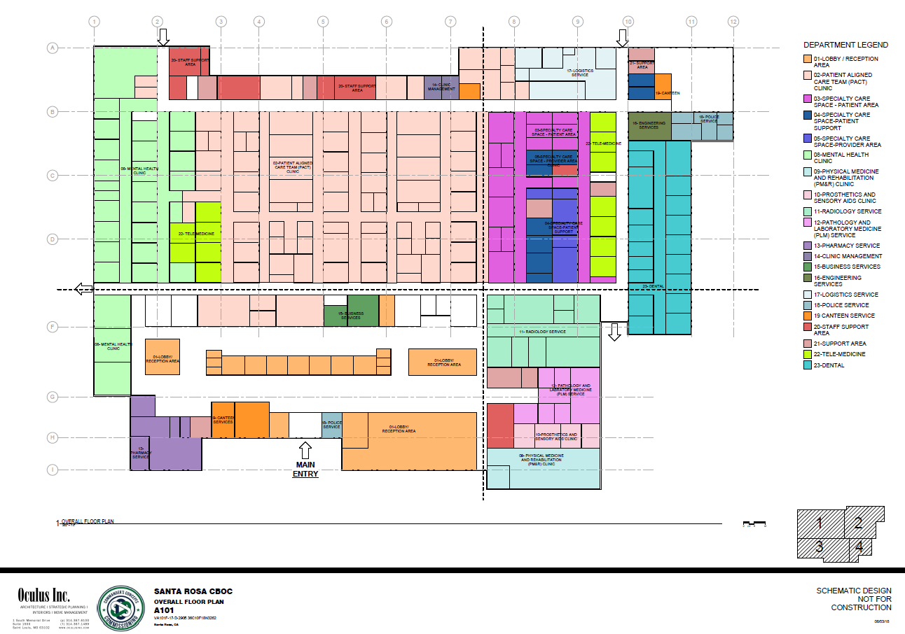
CONCEPTUAL SPACE PLANS

Slide 21
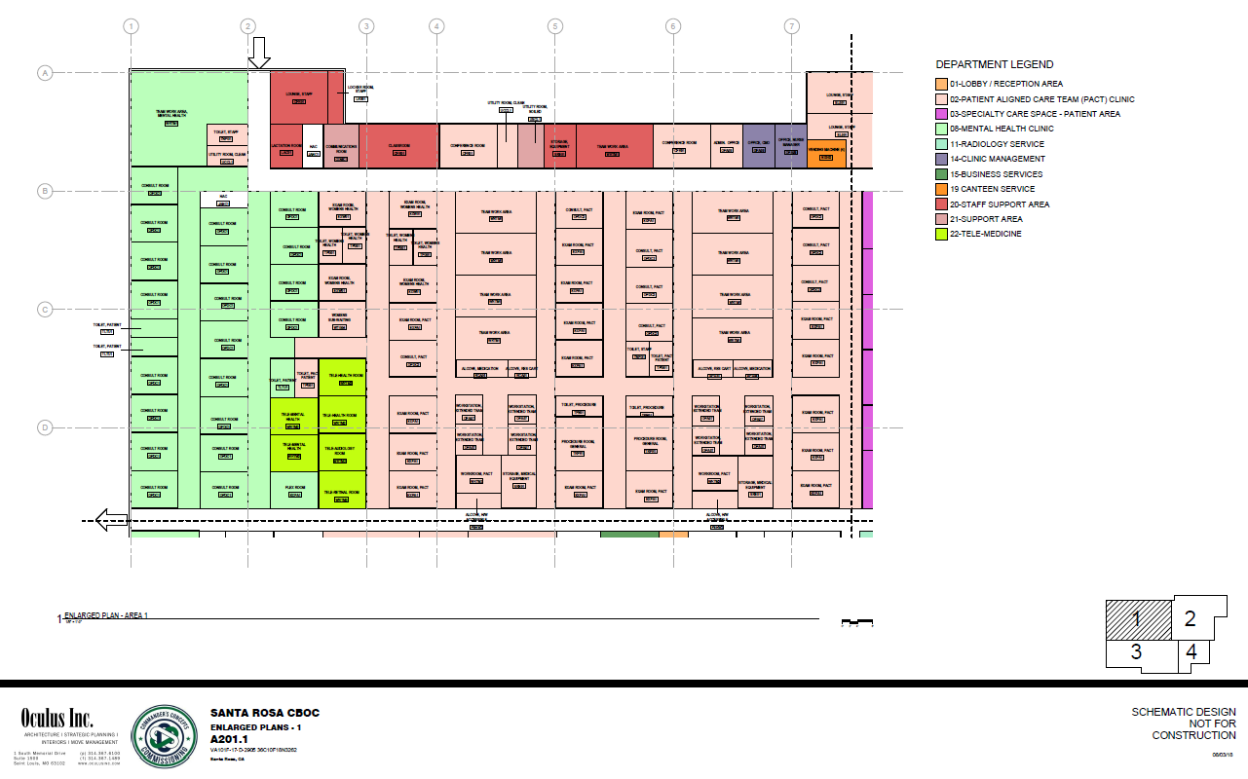
CONCEPTUAL SPACE PLANS

Slide 22
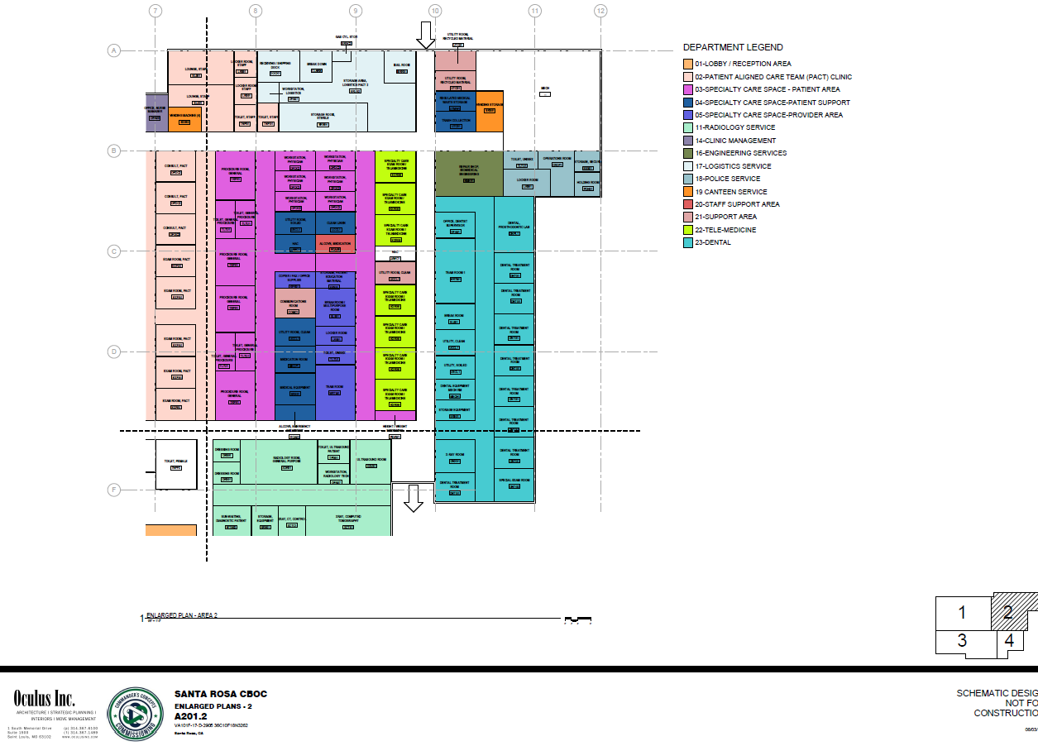
CONCEPTUAL SPACE PLANS

Slide 23
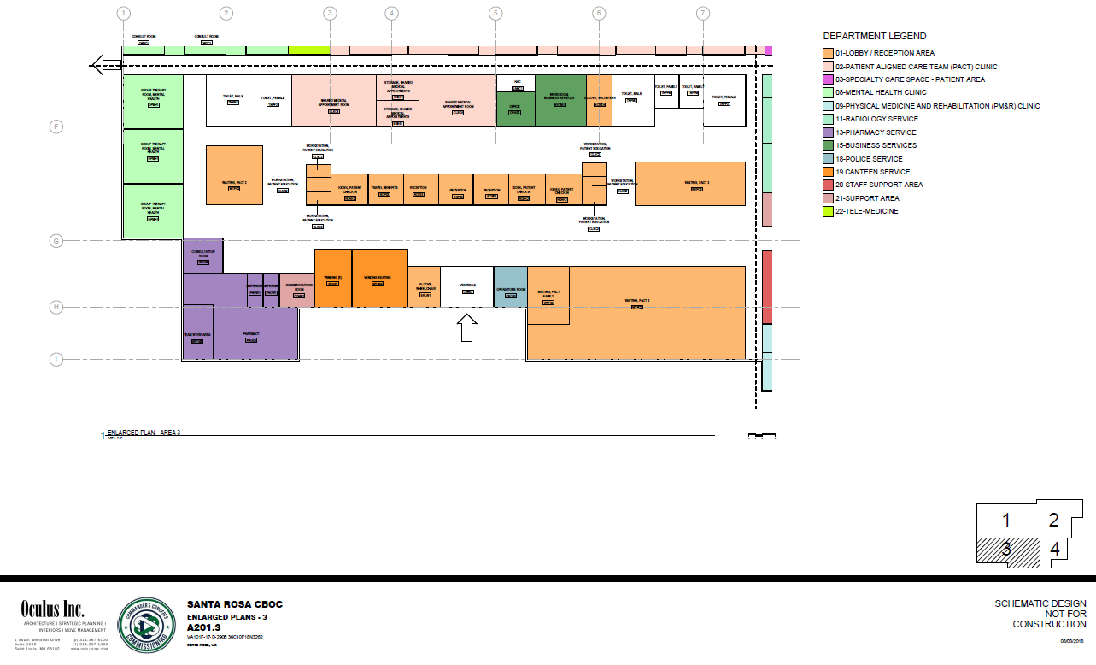
CONCEPTUAL SPACE PLANS

Slide 24
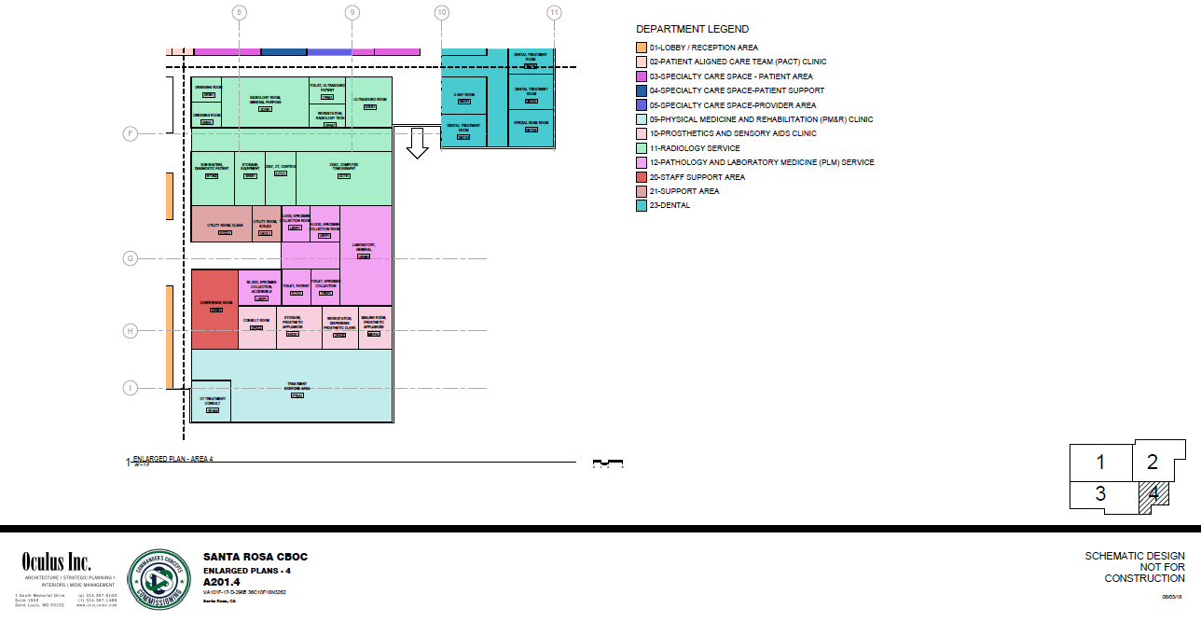
CONCEPTUAL SPACE PLANS

Slide 25
BUILDING CODES AND STANDARDS
The Lessor shall design and construct the building and site work in accordance with this
solicitation, all applicable Federal regulations, local Building and Zoning Codes and
ordinances, and applicable utility company requirements. The term "local building and
zoning codes and ordinances," or similar text, shall be understood to mean the current
codes and regulations as approved and administered by Authorities Having Jurisdiction
(AHJ) at the project location at the time of permitting. Where there is a conflict between
the various codes or standards, the most stringent shall apply.
Refer to RLP Appendix D1 for details regarding
Criteria for VA leased facilities
Applicable state and local building codes
The Joint Commission (TJC)
NFPA 99
NFPA 101
ABAAS
VA Guidelines
OSHA
ASHRAE
ASPE
FGI

Slide 26
DESIGN CONCEPT
Show us – submit detailed drawings and design graphics, INCLUDING SITE DESIGN
Tell us – submit concise narrative descriptions detailing design benefits to VA
Each Offeror will be evaluated on its ability to develop the site and landscaping to provide a well designed facility
Stick with the plan – plans and specifications not in accordance with the Government’s requirements may be deemed unacceptable and rejected

Slide 27
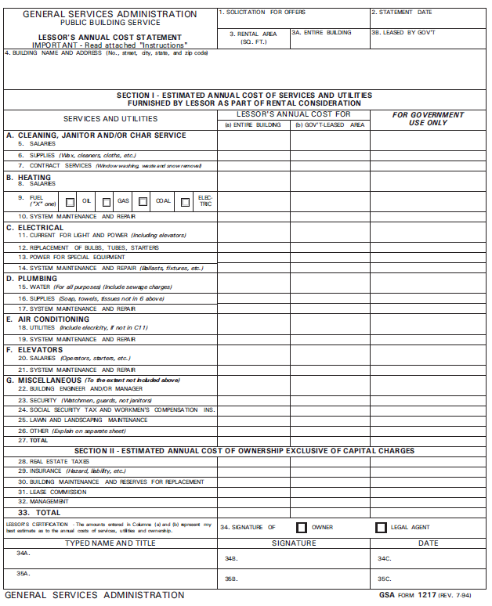
GSA Form 1217 – Operating Expenses
Line 27 = Total Estimated cost of Services & Utilities
Items below line 27 are built into the base rental rate.

Slide 28
SAM REGISTRATION
Demonstrating an active registration
PDF of Offeror’s Reps & Certs
Registration is for offering entity
Registration is for NAICS 531120
Small Business status certification

Slide 29
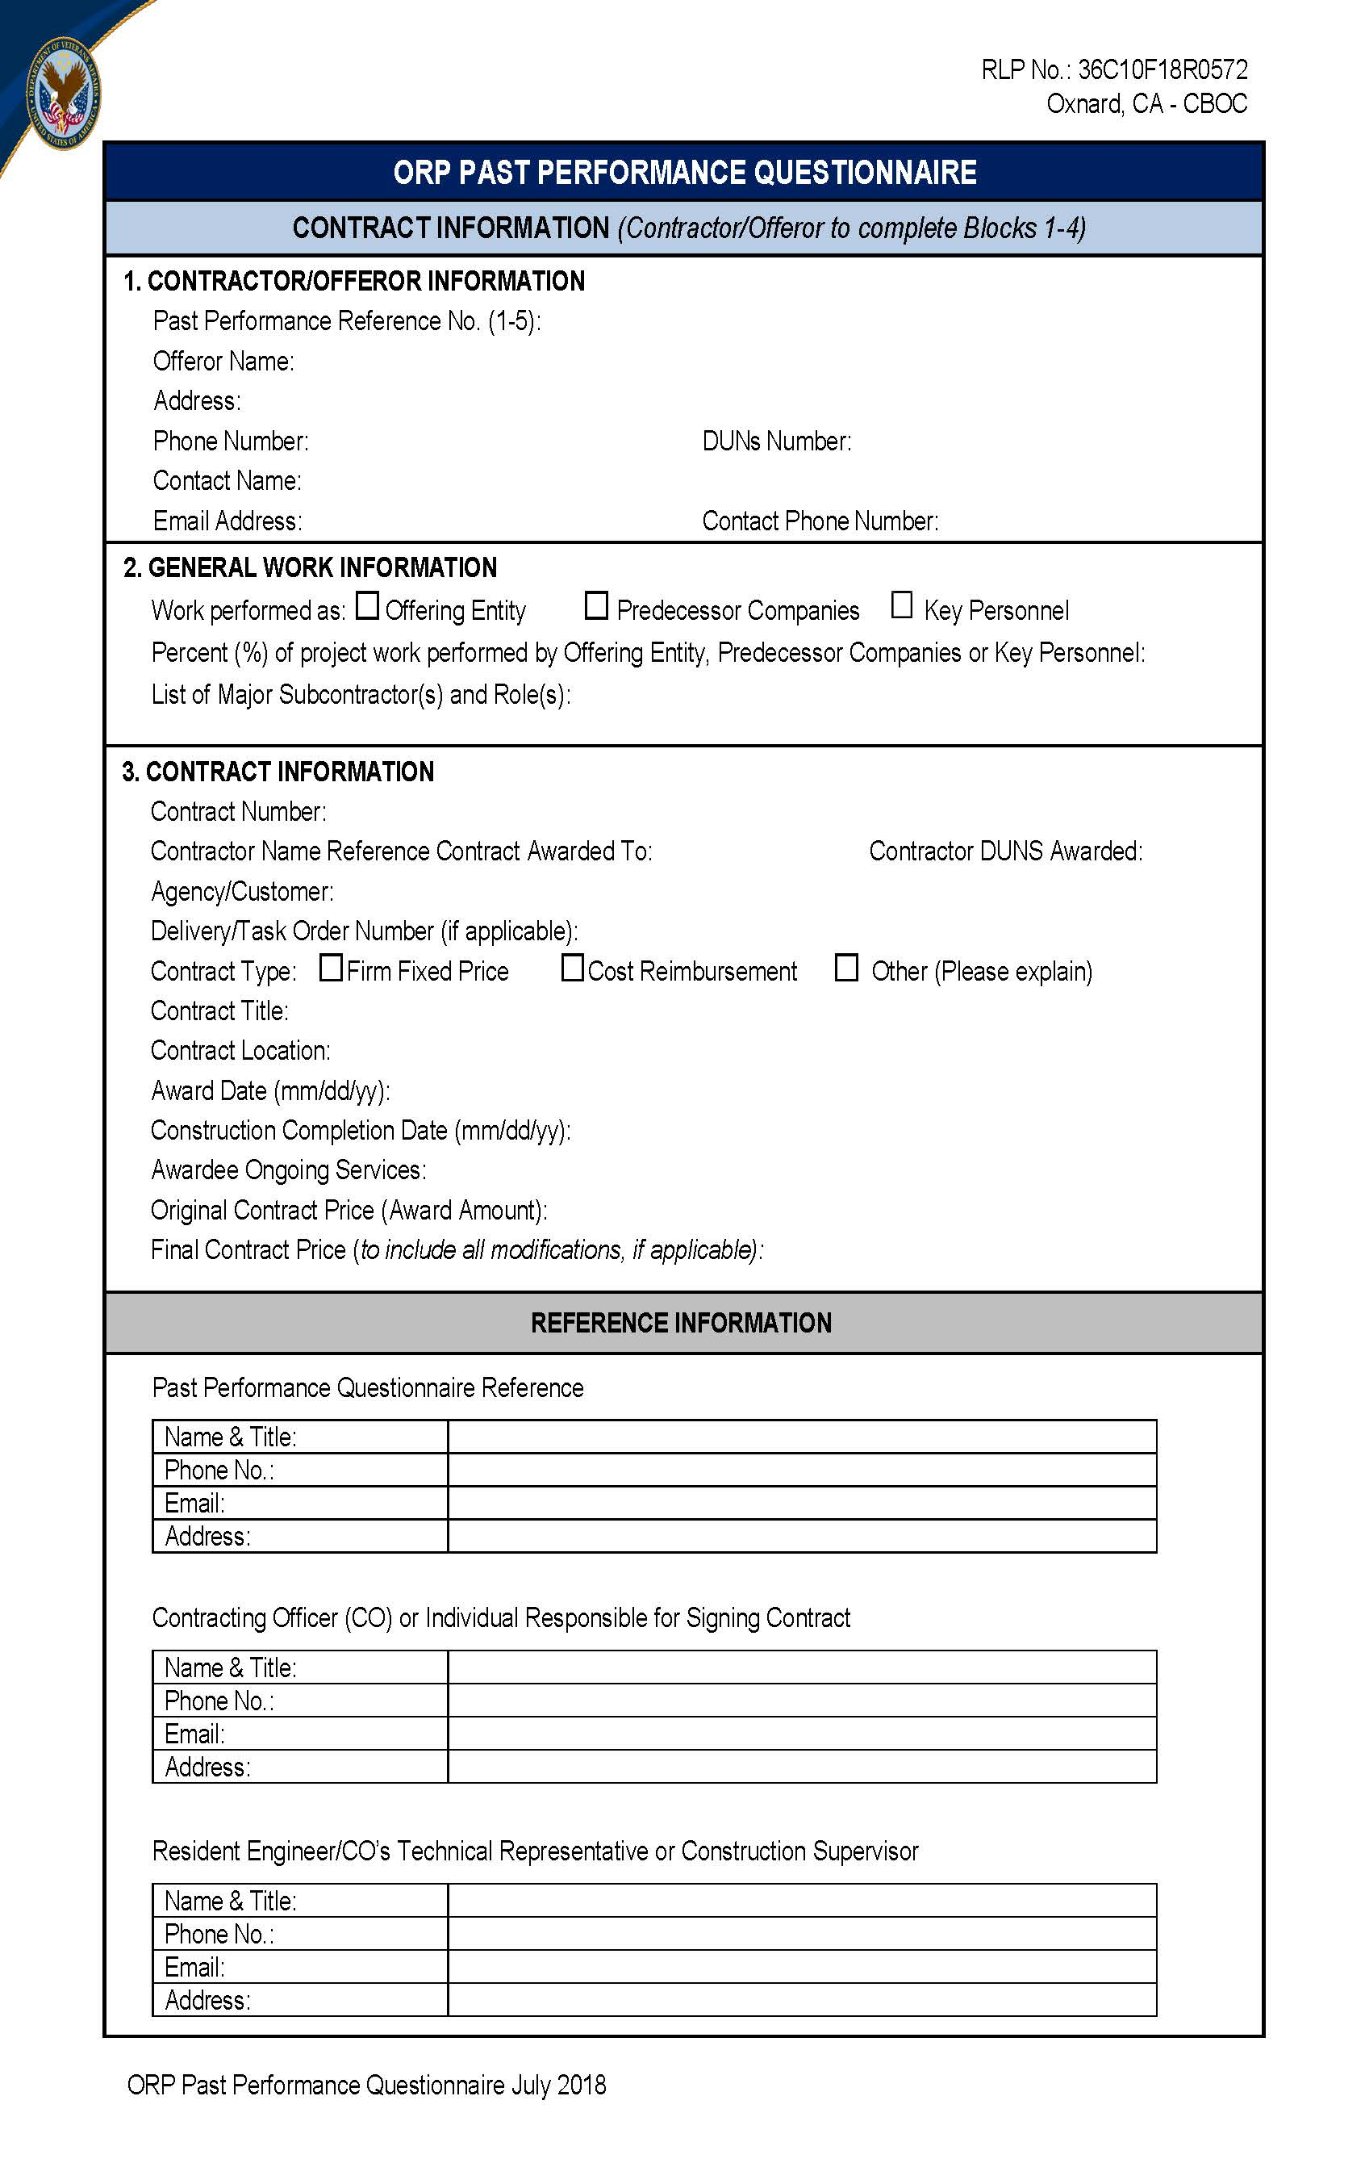
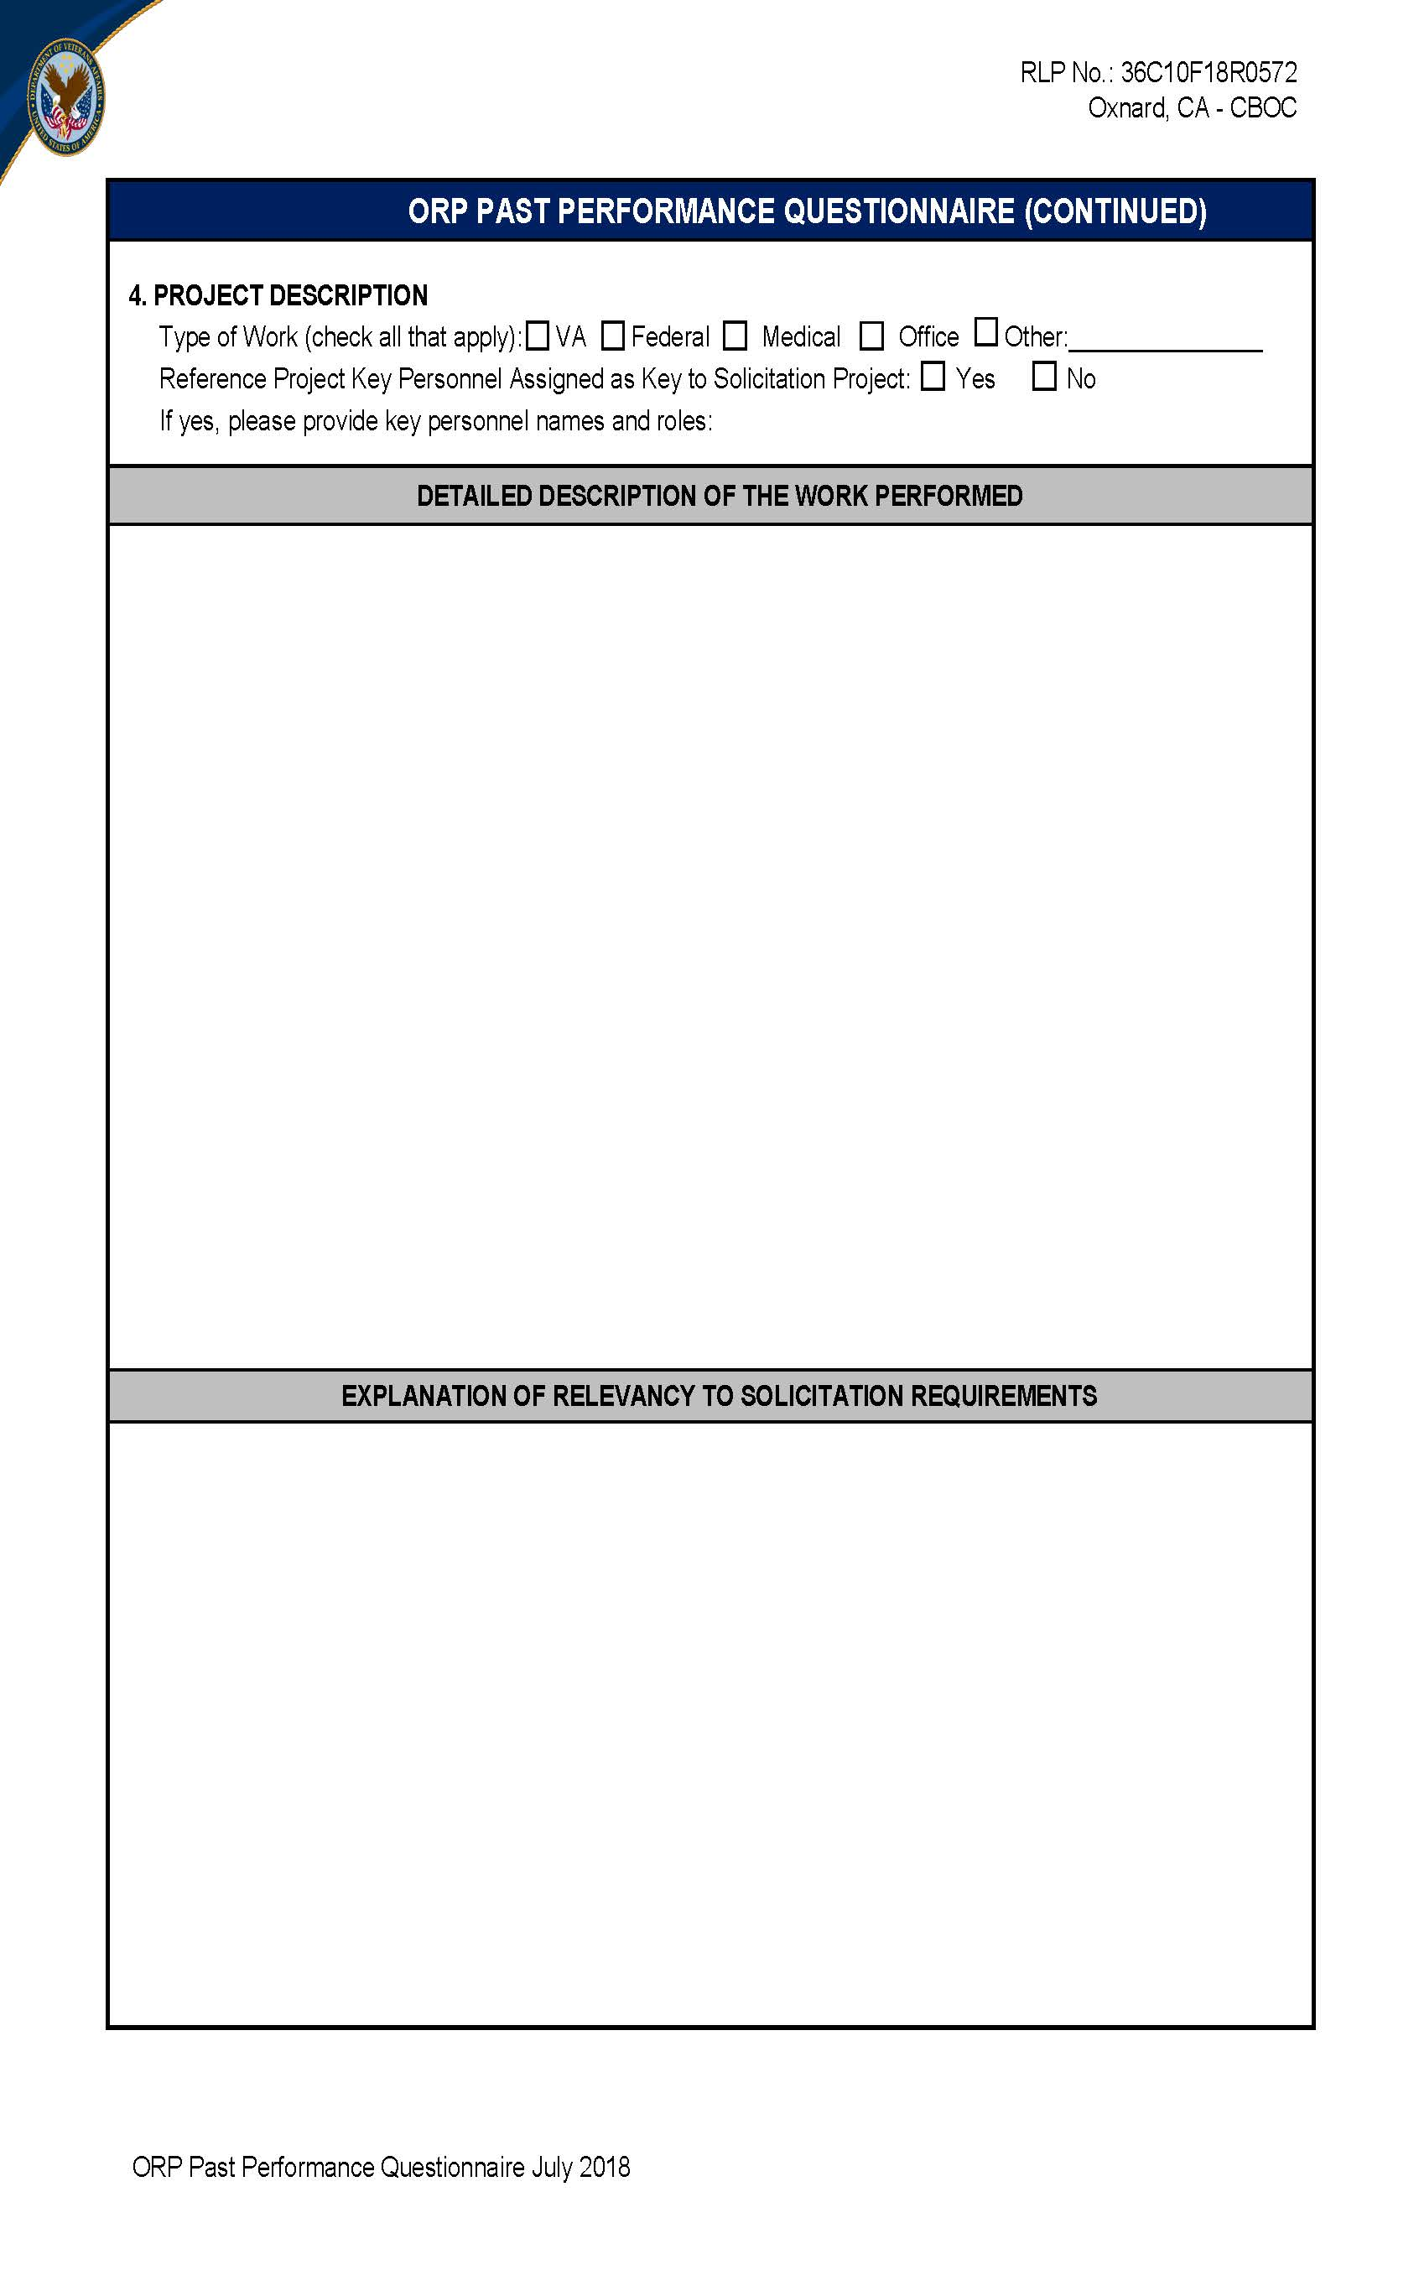
Past Performance & Reference Check
+
Minimum of 3 Reference Check Forms
See Section 4.04 of the RLP

Slide 30

DAVIS BACON
The wages to be paid during performance under this lease contract must conform to the Department of Labor’s General Wage Decision No. CA 180025, dated 09/07/2018, and as may be amended during the procurement and period of construction of the leased premises. A copy of the standards is provided as attachment 22B to the RLP. It is the Lessor’s responsibility to obtain and maintain the most current rates.
The contractor shall submit within 10 calendar days of receipt of the award any class of laborers or mechanics which is not listed in the wage determination and which is to be employed under the contract to the Contracting Officer for approval. Including any additional classifications and wage rates.

Slide 31
Development Requirements
2.11 DUE DILIGENCE AND NATIONAL ENVIRONMENTAL POLICY ACT REQUIREMENTS - RLP (SEP 2014)
A. Environmental Due Diligence
1. At the direction of the LCO, the Offeror must provide, at the Offeror’s sole cost and expense, a current Phase I Environmental Site Assessment (ESA), using the American Society for Testing and Materials (ASTM) Standard E1527-13 and timeline, as such standard may be revised from time to time. In accordance with ASTM standards, the study must be performed by an environmental professional with qualifications that meet ASTM standards. This Phase I ESA must be prepared with a focus on the Government being the “user” of the Phase I, as the term “user” is defined in E1527-13. Failure to submit the required study may result in dismissal from consideration.
RLP Section 2.13 CULTURAL RESOURCES STUDY (VA JUL 2018)
A Cultural Resources Study is required with initial offers. The Government has determined that it requires a brief preliminary study to predict the likelihood of the Lease Acquisition’s impacts on cultural resources. The Cultural Resources Study shall include the following work:
RLP Section 5.01 OFF SITE-IMPROVEMENTS
The cost of off-site improvements will be borne by the Lessor. The Lessor is responsible for determining the cost of off-site improvements prior to lease award, and including the costs of off-site improvements in the proposed rent…
RLP Section 5.02 DUE DILIGENCE
The Lessor acknowledges its duty to conduct reasonable site inspections for the proposed site. The Lessor warrants that it has considered all factors which a prudent, experienced bidder customarily uses in making judgments about site conditions, quantity, quality and methods of performing the particular work…

Slide 32
RLP Section 5.03 APPLICABLE LAW
Any provision in this Lease that purports to assign liability or require expenditure of funds to the Lessor shall be governed by the provisions of the Contract Disputes Act of 1978, 41 USC 601-613, Anti-Deficiency Act, 31 USC 1341, and the Federal Tort Claims Act, 28 USC 2671 et seq.
RLP (Lease Paragraph 2.04) WAIVER OF RESTORATION
The Lessor shall have no right to require the Government to restore the Premises upon termination of the Lease, and waives all claims against the Government for waste, damages, or restoration arising from or related to (a) the Government's normal and customary use of the Premises during the term of the Lease.
RLP Section 3.04 BUDGET SCOREKEEPING; OPERATING LEASE TREATMENT
The Government will award a Lease pursuant to this RLP only if the Lease will score as an operating lease under Office of Management and Budget Circular A-11, Appendix B. Only offers that are compliant with operating lease limitations will be eligible for award.

Slide 33
MINIMUM REQUIREMENTS:
Certificate of Occupancy Required
Natural disaster-resistive features, reference VA 18-8 Seismic Design Requirements , GSA, and ICSSC RP 8 Standards. (Where local Seismic Code is more stringent, comply with local code).
  GREEN GLOBES
Centers for Disease Control (CDC) requirements for Tuberculosis
Federal Regulations
Local Building Codes and Ordinances
Davis-Bacon Wages
Uniform Accessibility Standards (UFAS) and (ABAAS)
VA Barrier Free Program Guide PG-18-13

Slide 34
SUMMATION
A few important points:
Read all parts of the RLP in their entirety
Make certain all documents that require signature have been signed by the authorized signatory for the Offering Entity.
The Offering Entity with the Offering Entity’s DUNS must be registered in SAM and must be registered un the NAICS code for this procurement which is 531120. Your Form 3518 must also be completed for the Offering Entity and signed by the signatory authority.
Provide completed 1364 for each pricing structure offer along with a 1364 attachment for each pricing structure.
VA will not accept conditional offers.
If you are submitting for Small Business credit under the Technical Evaluation Criteria, you MUST submit the documentation that is identified in the RLP or you will not receive credit under this evaluation factor.
Evidence of Capability to Perform – Financial Resources. You MUST submit the required information. ALL financial information MUST be included in the Technical Proposal. Materials sent separately will not be considered.
Submit a timely offer. Late submittals may not be considered.

Slide 35
QUESTIONS?
THANK YOU
FOR ATTENDING

