Slide 1
Prosthetic and Sensory Aids Service Briefing to Dental Implant Industry
Joyce Edmondson, Clinical Liaison
Prosthetic & Sensory Aids Service
October 2018

Slide 2
Discussion Topics
Prosthetic & Sensory Aids Service Program Overview
Implant Pre-authorization Procurement Process
FY18 Category Breakdown of PSAS Budget

Slide 3
Prosthetic and Sensory aids service
(psas) Overview:
Our mission is to provide medically appropriate equipment, supplies, and services that optimize Veteran health and independence.
The goal of Prosthetic and Sensory Aids Service (PSAS) is to ensure devices and services for Veterans are strategically sourced and consistent with clinical need.
PSAS utilizes national acquisition strategies to:
  Leverage economies of scale for Prosthetic items to ensure best value, low cost, and high quality is achieved.
  Partner with clinicians through Integrated Product Teams.
  Increase timely procurement of Prosthetic items.
  Improve procurement and payment efficiencies (order more and purchase less) while complying with Federal Acquisition Regulations (FAR) and VA Acquisition Regulations (VAAR).
VHA Handbook 1173 establishes uniform and consistent national policy and procedures for the provision of prosthetic services.

Slide 4

PSAS SERVICES / DEVICES / BENEFITS
Services
Orthotic and Prosthetic Services, Restorations
Home Oxygen
Dog Insurance
Devices
Durable Medical Equipment and Supplies
Wheelchairs and Accessories
Eyeglasses, Blind Aids, Low Vision Aids
Hearing Aids and Assistive Listening Devices
Health Monitoring Equipment
Artificial Limbs/Custom Braces
Surgical Implants
Adapted Sports and Recreational Equipment
Benefit Programs
Automobile Adaptive Equipment (AAE)
Clothing Allowance
Home Improvements and Structural Alterations (HISA)

Slide 5
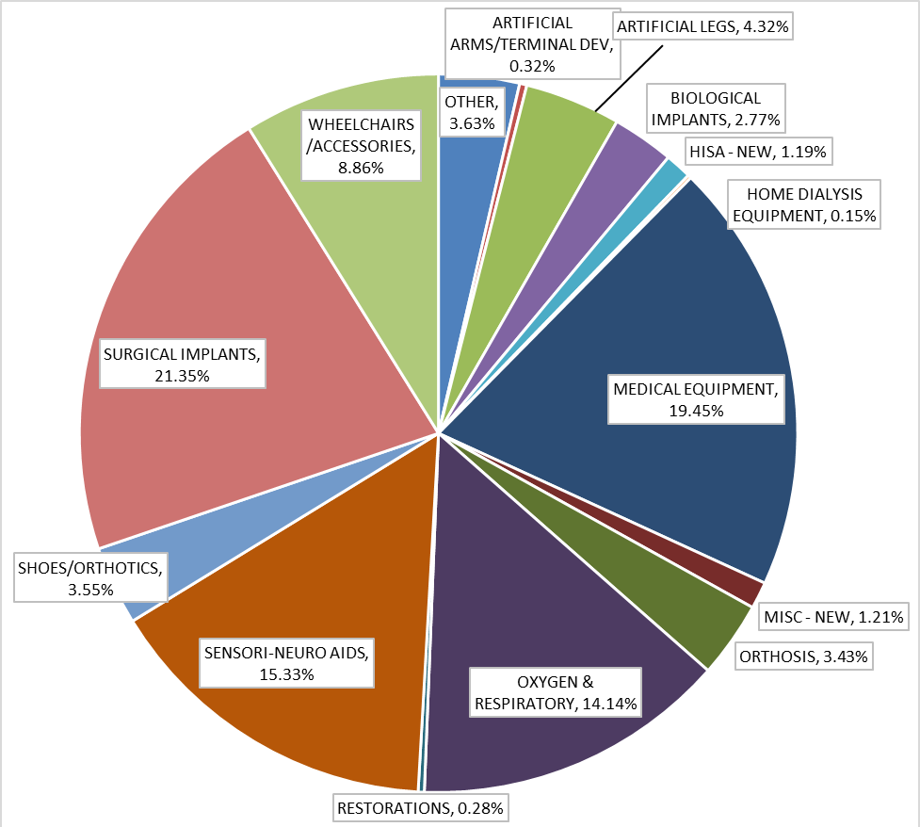
FY 18- CATEGORY BREAKDOWN OF PSAS BUDGET
Over 55% of all Veterans treated in VHA received PSAS items and services.
In FY2018, VA obligated:
~ $3.3B to provide 21M devices/items to 3.4M Veterans.
October 17 , 2018
FAC – Prosthetic & Special Disabilities- PSAS

Slide 6
Implant Pre-authorization Procurement Process
Background:
Prior implant procurement process did not fully comply with the FAR.
VHA implemented the implant pre-authorization procurement process in April 2016, to immediately mitigate the risk of unauthorized commitments .
All implants must be pre-requested and authorized, unless it is a VA-owned inventory item or a consigned item through a consignment agreement negotiated by a VA contracting officer, in order to ensure a contract or purchase order is properly awarded to legally obligate the VA.
Outcomes:
Reduced unauthorized commitments and achieved FAR compliance.
Rectified material weakness findings in IPERA and the Department’s annual Financial Statement of Assurance related to implant procurement.

Slide 7
Overview of the Requirement –
Let’s Talk About Dental Implants
Thomas B. Girvan, DMD, FACP
Chairman, Dental Implant IPT
VHA Office of Dentistry (10NC7)

Slide 8
Background
The fundamental mission of the Department of Veterans Affairs (VA) Veterans Health Administration (VHA) is to provide Veterans, service members, and their families the benefits they have earned through their military service to the United States. VHA accomplishes its mission by delivering patient -centered; personalized services that help Veterans readjust to civilian life and enhance their well-being.
VA provides oral health services to eligible Veterans specified under 38 U.S.C.§§1710(c) and 1712. All VA medical facilities and selected outpatient clinics provide oral and dental examinations and treatment, the goal of VA Dental Services is to provide high quality, cost-effective and evidence-based dental treatment to eligible Veterans.

Slide 9
Background
VHA Prosthetics and Sensory Aids Service (PSAS) have identified dental implants as the preferred product for continued consolidated contracting. The goal is to obtain uniformity, quality products, and volume based-discounts by establishing an enterprise –wide Indefinite Delivery Indefinite Quantity (IDIQ) contract(s). This item meets the commercial item definition at FAR 2.101 and is readily available in the commercial market place to meet the Government ‘s needs.

Slide 10
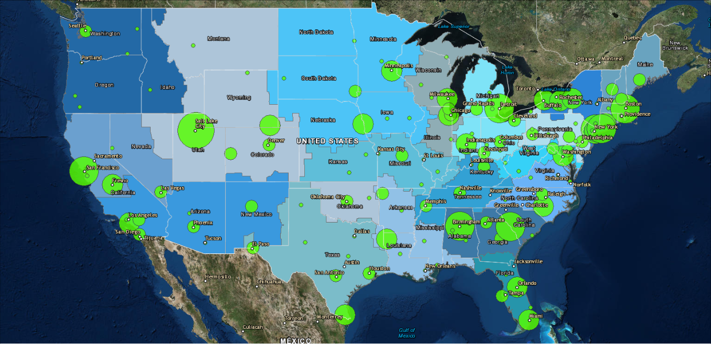
Implant Prevalence FY 08-17
Notes:
This map shows the prevalence of dental implants. The number of unique Veteran patients receiving a D6010 endosteal implant divided by the number of unique patients seen from FY 2008-2017. The prevalence is divided into equal quintiles of 0 – 4.1%, 4.2 – 8.3%, 8.4 – 12.5%, 12.6 – 16.7% and 16.8 – 21%.

Slide 11
Variance in Implant Prevalence
Highest Prevalence
Lowest Prevalence
(4V19) (660) Salt Lake City, UT HCS | 21.0%
(2V07) (521) Birmingham, AL HCS | 15.4%
(2V07) (509) Augusta, GA HCS | 15.3%
(1V02) (632) Northport, NY HCS | 14.9%
(1V01) (523) Boston, MA HCS | 14.6%
(5V21) (662) San Francisco, CA HCS | 14.4%
(1V02) (526) Bronx, NY HCS | 14.3%
(3V10) (553) Detroit, MI HCS | 12.7%
(1V02) (630) New York Harbor HCS | 12.2%
(3V12) (695) Milwaukee, WI HCS | 12.0%
(3V15) (657A4) Poplar Bluff, MO HCS | 0.2%
(1V04) (542) Coatesville, PA HCS | 0.1%
(4V19) (623) Muskogee, OK HCS | 0.1%
(4V16) (586) Jackson, MS HCS | 0.1%
(1V06) (590) Hampton, VA HCS | 0.0%
(1V05) (517) Beckley, WV HCS | 0.0%
(1V04) (562) Erie, PA HCS | 0.0%
(3V10) (655) Saginaw, MI HCS | 0.0%
(5V20) (692) White City, OR HCS | 0.0%
(4V16) (502) Alexandria, LA HCS | 0.0%

Slide 12
What are we seeking?
Nationwide multi-vendor/multi-year contracting vehicle to provide all dental implant parts and components for the VA
National contract to address:
  Nationwide coverage for all major implant components
  Expedited ordering and fulfillment
  Best price and service for VA Prosthetics Service
  Ability to meet VA requirements (labeling/sterilization)
  Educational services provided by contractor

Slide 13
What are we seeking?
A contractor should also be able to provide:
  Consignment Agreement
  Just In Time Delivery
  Training

Slide 14
  THANK YOU

Slide 15
Joint venture agreements for compliance with
FAR, VAAR, and Federal regulations
Dr. Linda Williams
202-461-4315
linda.williams11@va.gov

Slide 16
Office of Small & Disadvantaged Business Utilization
Develops small business goals and goals policy for VA
Secretary’s liaison with the Small Business Administration
Reviews VA procurement actions to ensure small business program sufficiency and the provision of maximum practicable opportunity to Veteran and other small businesses
Provides direct support to VA program offices in developing acquisition packages (primarily in the areas of market research and Integrated Product/Project Team Support
Provides staff assistance visits to VA contracting activities to ensure SBA regulatory guidance is complied with (start FY 2019)

Slide 17
Joint Ventures VAAR 819.7003
A joint venture may be considered a SDVOSB or VOSB concern if –
At least one member of the joint venture correctly represents itself at the time of offering or quoting as a SDVOSB or VOSB concern
Each concern is small under the size standard corresponding to the NAICS code assigned to the acquisition
The joint venture meets the requirements of paragraph 7 of the size standard explanation of affiliates in Federal Acquisition Regulation (FAR)19.101
2

Slide 18
Joint Ventures VAAR 819.7003
The joint venture meets the requirements of 13 Code of Federal Regulations (CFR) 125.15, modified to include veteran-owned small businesses where this CFR section refers to SDVOSB concerns. Also see VAAR 852.219-10, VAAR 852.219-11, and Class Deviation-Veterans First Contracting Program (VFCP 2016) dated July 25, 2016.
Information about joint ventures and teaming arrangements is included in Information Letter 049-06-4 dated March 9, 2006.
Must send a copy of the approved joint venture or teaming agreement to OSDBU.

Slide 19
Joint Ventures
A. Main Characteristics:
1. Co-management
2. Sharing profits and losses (JV managing venture must be the small business and receive 51% of profits and perform 40% of the JVs required work percentage of 51%)
3. Limited duration
B. Competing as a joint venture:
1. Joint ventures should be formed before submitting offer
2. Agreement should provide for contract performance
3. SDVOSB & VOSB joint ventures must be verified by CVE prior to submission of offer, and JV must remain verified at time of award
3

Slide 20
Joint Ventures - Small Business Set-Asides
All partners must be small businesses under the size standard of the NAICS code being solicited; and
Under the All Small Mentor Protégé program, Joint Ventures approved by SBA gain the advantage of having affiliation disregarded for contracts won by that Joint Venture.
5

Slide 21
Joint Ventures - Small Business Set-Asides
A. The Joint Venture may be awarded up to three contracts within 2 years
B. Government can award to JV if all partners are small under the NAICS code, with the exception for SBA-approved All Small Mentor-Protégé relationship (when a small business may Joint Venture with a large business).
Affiliation
is a term used to define a business relationship a small business may have with
other firms and the affect that relationship has on that firm’s business size status.
It is not Limitation of subcontracting which places limitations on the amount of
work that a small business prime contractor can subcontract out.
6

Slide 22
Affiliation – Ostensible Subcontract Rule & Affiliation
Unusual Reliance on a Subcontractor (see SBA OHA Size appeal of Charitar Realty, SBA Number SIZ-5806 (2017)
“Four Key Factors to determine if an ostensible subcontractor creates affiliation”
The proposed subcontractor is the incumbent contractor and is ineligible to compete for the procurement?
The prime contractor plans to hire the large majority of its workforce from the subcontractor?
The prime contractor’s proposed management previously served with the subcontractor on the incumbent contract?
The prime contractor lacks relevant experience and must rely upon its more experienced subcontractor to win the contract?
7

Slide 23
  Remember Size Matters in:
  Small Business Set-Asides (i.e. SDV, VOSB, Women, HUBZONE, VOB) and 8(a) Procurements
  An unrestricted procurement where you are claiming a 10% HUBZone Price Evaluation Preference
  The size standard of the solicitation
A large business cannot be a JV participant on a Small Business/8(a) Set- aside Procurement (unless in an approved All Small Mentor Protégé arrangement)
12

Slide 24
Definitions
SDVOSB is eligible for award if…
-Disability is service-connected as defined in 38 U.S.C. 101(16)
-One or more Service-connected Veterans-
  --Own 51% or more of the firm
  --Manage and control the daily operations of the firm, or in the case of a service-disabled veteran with permanent and severe disability, the spouse or permanent caregiver of such veteran
-Firm meets the small business size standard under relevant industry (NAICS) Code
-Listed in VIP (means they are verified)
VOSB is eligible for award if…
-One or more veterans—
  --Own 51% or more of the firm
  --Manage and control the daily operations of the firm
-Firm meets the small business size standard under relevant industry
(NAICS) Code
-Listed in VIP (means they are verified)
13
Notes:
1. After December 31, 2011, all VOSB’s and SDVOSB’s must be listed as verified in the VIP and registered in CCR in order to receive awards

Slide 25
SDVOSB/VOSB
Small Business Status Protests
VAAR 819.307
Socioeconomic status protests (not size status protests) for
SDVOSB/VOSB are decided by the Executive Director (ED),
VA Office of Small and Disadvantaged Business Utilization (OSDBU) whether raised by the contracting officer or an offeror.
The OSDBU ED’s decision may be appealed to the SBA Office of Hearings and Appeals.
OSDBU will decide socioeconomic status protests until execution of an interagency agreement with the Small Business Administration.
14

Slide 26
Teaming/Joint Ventures Under All Small Mentor -Protégé Programs
A. Broad exclusion from affiliation
B. Ostensible subcontractor rule not
applicable on prime/sub relation
C. Small protégés may joint venture with their mentors, regardless of the size of the mentor.
10
18

Slide 27
General References
13 CFR 121.103, What is Affiliation?
13 CFR 125.9, SBA’s small business mentor-protege program
20

Slide 28
SAC Contracting Team
LeShanna Calahan, Contracting Officer
Strategic Acquisition Center (SAC)

Slide 29
Status of Requirement
Assessing the Market
Ensure our requirement is understood by the Industry and consistent Industry Standards
Determining Capable Sources that can meet all requirements
No Current Acquisition Strategy

Slide 30
Contracting Team
LeShanna Calahan, Contracting Officer
leshanna.Calahan@va.gov
Antonio Ross, Contract Specialist
antonio.ross@va.gov
Ignacio Reyes, Contact Specialist
Ignacio.reyes3@va.gov

Slide 31
Thank You !!

