Slide 1

CAPE CANAVERAL
NATIONAL CEMETERY
PHASE 2 CEMETERY EXPANSION
NORTH MIMS, FLORIDA
SOLICITATION 36C10F20R0017
PROJECT # 934CM2003
PRE-PROPOSAL CONFERENCE
MAY 15, 2020
IAS
Notes:
Please be sure that everyone has signed-in
Hold all questions to the end

Slide 2
Agenda
Opening Remarks
New Acquisition: RFP No: 36C10F20R0017
Submission Requirements
Milestones
Project Scope and Overview
Site walkthrough
Notes:
I would like to make clear that anything said should not be interpreted as a change to the solicitation/contract documents as posted. If a statement is made that is inconsistent with the solicitation requirements, you should not submit your proposal based on the statements, only submit based on the posted solicitation and all amendments.

Slide 3
Opening Remarks
Introductions
VA Representatives
    VA CFM: Elizabeth Monohan, Contracting Officer
    VA CFM: Kevin Dix, Project Manager
    Cape Canaveral Cemetery Director: Don Murphy

Slide 4
NCA Mission
The National Cemetery Administration
honors Veterans and their families
with final resting places in national shrines and
lasting tributes that commemorate their service and sacrifice to our Nation.
President Abraham Lincoln pledged the nation:
“To care for him who shall have borne the battle and for his widow and his orphan.”
That remains VA’s motto today.

Slide 5
National Shrine
To meet this National Shrine standard, VA is using Source Selection with Trade Offs as an Acquisition Strategy
The RFP specifies the selection criteria used to select the Best Value for the Government

Slide 6
Acquisition Requirements
Solicitation is set aside for Service Disabled Veteran Owned Small Business (SDVOSB) in accordance with 38 U.S.C. 8127(d).
Federal , State, and Local Tax (FAR Clause 52.229-3)
  Is the Responsibility of the Contractor
OSHA & VA Requirement (Construction Safety Course)
  Competent Person (supervisor) 30 Hours
  All other employees 10 Hours
Notes:
All Proposal documents are posted and will be posted at www.fbo.gov under the RFP #

Slide 7
Acquisition Requirements
Contract Line Item Numbers (CLINs 001-009)
  Base Award CLIN 001A – CLIN 001B
    To provide maximum flexibility with scope award, the project has been broken into a Base bid and six Options titled A, B, C, D, E & F. The Base bid, Option A and Option F are of greatest importance to the Government. Please note that Option B must be constructed with any of the following options: C, D, E or F.
Cost Magnitude
  Between $20,000,000 - $50,000,000
RFP Due Date
  June 8, 2020, at 4:00 P.M. Eastern Time; Washington, DC
Notes:
1. RFP due date see Block 8 of the SF 1442 for the location

Slide 8
Acquisition Requirements
Bid Bond/Bid Guarantee (SF 24)
  20% of the offer price but shall not exceed $3,000,000
  NAME OF PRINCIPAL MUST BE IDENTICAL WITH NAME ON CONTRACT OR BID
  Make sure you are in compliance with Far Part 28
Annual Representation and Certification
Vendor Information Pages (VIP)
  https://www.sam.gov/SAM/
  https://www.vip.vetbiz.va.gov/
  Must be registered in SAM and VIP prior to submission
Construction Wage Rate Requirements (Davis Bacon Act) Applies
Buy American Act Applies
Notes:
Must be registered in SAM and VetBiz prior to Award

Slide 9
Acquisition Requirements
Completion Time
  Will range depending on the Options awarded, the Base Bid is 548 days after the Notice to Proceed. If the Base and all Options are awarded, then the time is 1,068 days.
Bonds (within 10 calendar days after award)
  Performance Bond 100%
  Payment Bond 100%
  NAME OF PRINCIPAL MUST BE IDENTICAL WITH NAME ON CONTRACT OR BID
  For this solicitation only, ensure that electronic copies of all pages of the bonds, front and back, are transmitted with your package. The paper copies of all bonds should also be included in your hard copy proposal delivery documents.

Slide 10
Acquisition Requirements
Liquidated Damages
  $1,338.00 for each calendar day of delay
Insurance
  Certificate of Insurance required prior to commencing work
    Worker’s compensation and employers liability
    General Liability
    Automobile Liability

Slide 11
Acquisition Requirements
Requests for Information (RFI’S)
  Questions Due: May 20, 2020, at 4:00 PM EST
  Email to:
    Elizabeth.Monohan@va.gov
    Kevin.Dix@va.gov and
    Crystal.Cole2@va.gov
    The subject line to read “Cape Canaveral National Cemetery, RFP #: 36C10F20R0017”
Answers posted on or about: May 27, 2020

Slide 12
Service-Disabled
Veteran-Owned Small Business
Office of Small and Disadvantaged Business Utilization (OSDBU) Washington, D.C.
    http://www4.va.gov/osdbu/
  Contact OSDBU for information on
  Joint Ventures
  Teaming Agreement
  Mentor Protégée (See VAAR 819-71)
  CVE verification
Notes:
JV for VA is a SDVOSB joining with another SB
JV/TA/MPP must be submitted w/proposal

Slide 13
Submission Requirements
1 SF 1442 (pages 1 - 4)
2 Signed Amendments
3 Bid Guarantee/Bid Bond
4 Volume I – Technical Proposal
    No cost information in Technical proposal
    Spiral bound Technical proposal (no 3 ring binders)
    Organize your proposal in accordance with the criteria listed under Instructions, Conditions And Other Statements To Bidders/Offerors, Part II Proposal Information of the RFP

Slide 14
Submission Requirements
    One (1) Sealed Original and Three (3) copies
      1) Past Performance 2) Relevant Experience
      3) Technical Approach 4) Construction/Project Management
      DO NOT PUT ANY PRICING INFORMATION IN VOLUME I
5 Volume II – Price Proposal
    Only one original copy
    Include any JV, Agreements, Reps and Certs and Bonds
    Submit Volumes I & II on a Compact Disc (excel, pdf and word format only)
6 Others Documents
    Representations and Certification completed in SAM
    Joint Venture (registered in Vetbiz prior to proposal submission); approved Teaming Agreement; approved Mentor-Protégé Program

Slide 15
Milestones
1 Solicitation May 1, 2020
2 RFP Due Date June 8, 2020
Items 4 thru 7 are only tentative dates. All communications will be done electronically. Awardee information will be posted, therefore, do not call for status.
3 Technical & Cost Proposal
    Evaluation June 10 2020 – June 24, 2020
4 Contract Award July 30, 2020
5 Notice To Proceed (estimate) August 17, 2020
6 Construction Completion August 21, 2023

Slide 16
VAAR 809-406-2
Cause for Debarment
(a) In addition to the causes listed in FAR 9.406-2, the SDO may debar contractors, based upon a preponderance of the evidence, for
(1) Misrepresentation of Veteran-owned small business (VOSB) or service- disabled, Veteran-owned small business (SDVOSB) status; or
(2) Any deliberate violation of the limitation on subcontracting clause requirements for acquisitions under subpart 819.70.
(b) The SDO shall debar for a period of not less than five years, pursuant to 38 U.S.C. 8127(g), Enforcement Penalties for Misrepresentation, any business concern that has willfully and intentionally misrepresented the status of that concern as a small business concern owned and controlled by Veterans or as a small business concern owned and controlled by service-disabled Veterans pursuant to this subsection.
(1) “Willful and intentional” misrepresentations, for the purpose of debarment actions taken pursuant to subsection (b), are defined as misrepresentations concerning the status of the concern as a small business concern owned and controlled by Veterans or as a small business concern owned and controlled by service-disabled Veterans resulting in an admission, criminal conviction, civil judgment, or administrative decision related to fraud or other criminal acts.
(2) Debarment of a business concern pursuant to subsection (b) shall include the debarment of all principals in the business concern. Debarment shall be for a period of not less than five years.
(a) In addition to the causes listed in FAR 9.406-2, the SDO may debar contractors, based upon a preponderance of the evidence, for
(1) Misrepresentation of Veteran-owned small business (VOSB) or service- disabled, Veteran-owned small business (SDVOSB) status; or
(2) Any deliberate violation of the limitation on subcontracting clause requirements for acquisitions under subpart 819.70.
(b) The SDO shall debar for a period of not less than five years, pursuant to 38 U.S.C. 8127(g), Enforcement Penalties for Misrepresentation, any business concern that has willfully and intentionally misrepresented the status of that concern as a small business concern owned and controlled by Veterans or as a small business concern owned and controlled by service-disabled Veterans pursuant to this subsection.
(1) “Willful and intentional” misrepresentations, for the purpose of debarment actions taken pursuant to subsection (b), are defined as misrepresentations concerning the status of the concern as a small business concern owned and controlled by Veterans or as a small business concern owned and controlled by service-disabled Veterans resulting in an admission, criminal conviction, civil judgment, or administrative decision related to fraud or other criminal acts.
(2) Debarment of a business concern pursuant to subsection (b) shall include the debarment of all principals in the business concern. Debarment shall be for a period of not less than five years.

Slide 17
Project Overview
VA Office of Construction &
Facilities Management
  Kevin Dix, Project Manager

Slide 18
Project Overview
Scope and Elements
  Pre-Placed Crypt full casket gravesites, Oversized casket gravesites, pre-placed urn crypts with integral headstone support boxes, garden niche or terrace sites, Columbarium Niches and Memorial wall markers. Bid Options will be included.
  Access roads and parking, irrigation of new burial sections, landscaping, grading, drainage, signage, site furnishings, protected habitat preservation, wetlands, and mitigation; and geographic information system (GIS) site integration extension into the Phase 2 area.

Slide 19
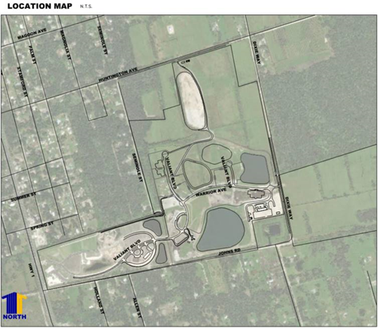
Aerial View of Cemetery

Slide 20
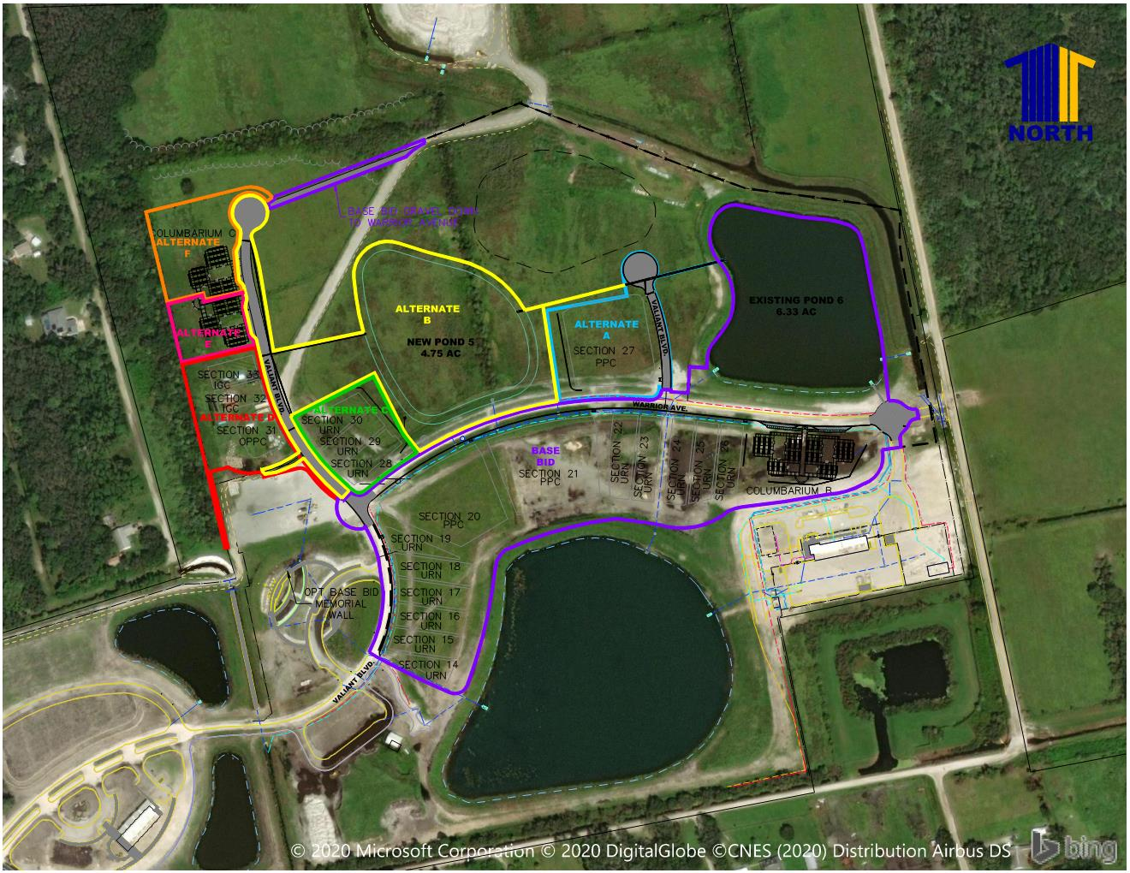
Aerial View of Project Area
access road
Phase 2 project site

Slide 21
BID OPTIONS
  To provide maximum flexibility with scope award, the project has been broken into a Base bid and six Options titled A, B, C, D, E & F. The Base bid, Option A and Option F are of greatest importance to the Government. Please note that Option B must be constructed with any of the following options: C, D, E or F.
Reference drawing of the Bid Options on the next slide.

Slide 22
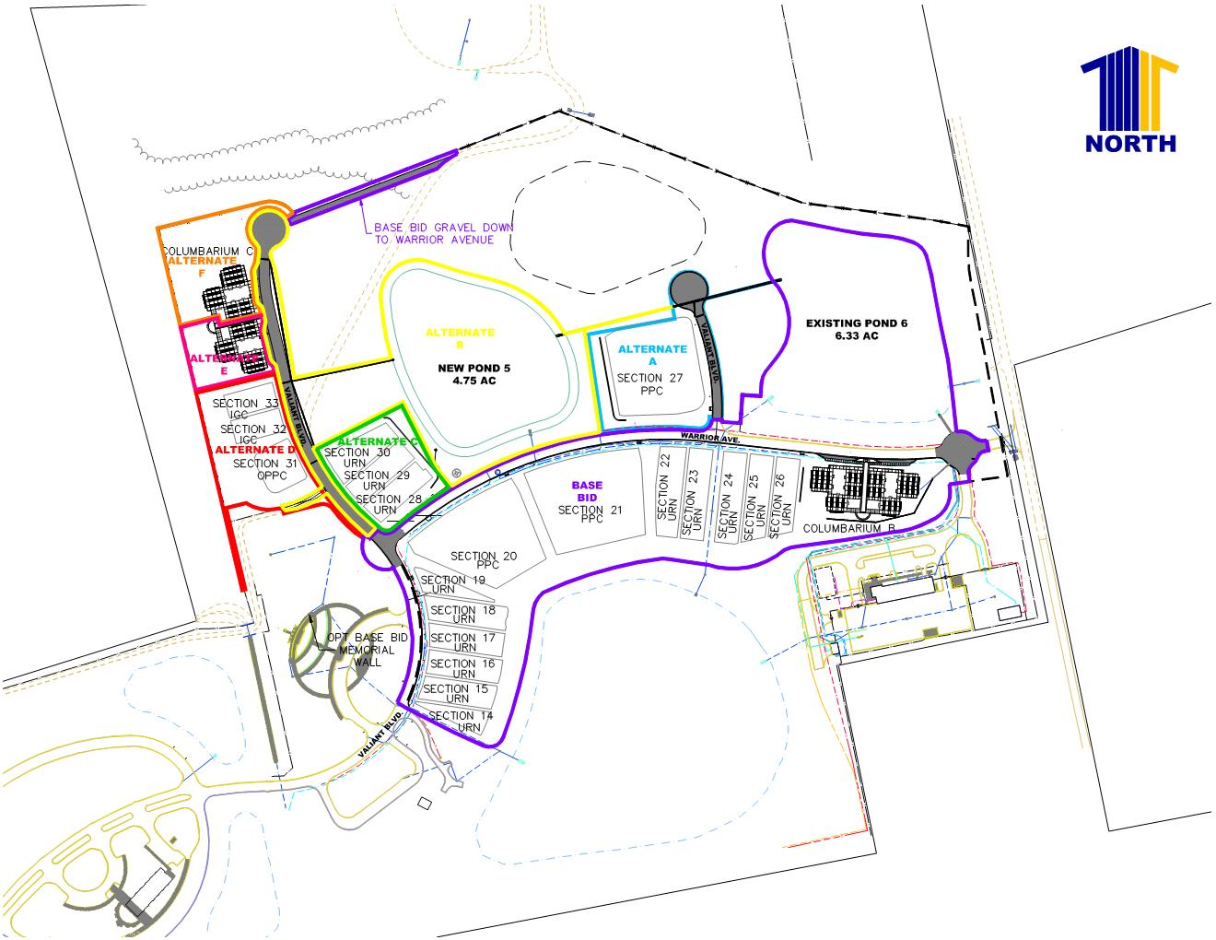

Slide 23
Contractor Considerations
  GC responsible for:
  Best value award (not low price)
  Construction Wage Rate Requirements & Payroll reports
  Safety Plan, including dedicated Safety Officer
  Phasing: cemetery operations take precedence over construction activities
  P6 cost-loaded schedule with monthly updates with requisitions
  Contract Quality Control (CQC) USACE CQM is a plus – National Shrine

Slide 24
Contractor Considerations
  GC responsible for:
  Three phase inspections per USACE standards
  VA Project Management System (TRIRIGA). We provide license/training
  Environmental – SWPPP, NPDES
  Utility coordination
  Testing – soils, concrete, etc.
  Record Drawings (as-builts)

Slide 25
  No questions will be answered during the pre-proposal site visit.
  Submit all Requests for Information in writing per the solicitation.
Questions
Notes:
Identify yourself & company

Slide 26
Site Walkthrough
Cape Canaveral
National Cemetery
5525 US-1
North Mims, FL 32754
Site Walkthrough

