Slide 1
New Models of Care (NMOC)
Preventative Care Veteran Health Portals
Rich Beaudoin, Program Manager
Vendor Solutions Symposium
December 2012

Slide 2
Preventative Care Veteran Health Portals
Program Description
Preventive Care Veteran Health Portal Program is the unifying step towards giving Veterans complete ownership of their health care information and access to several preventive health tools that provide customized education and applications that will foster participation in the patient’s treatment plan
My HealtheVet (MHV) is a Veteran-facing web portal that provides Veterans with several features:
  Veterans can download/store/print their personal health information in several formats via VA Blue Button
  Online refill of VA prescriptions
  Secure message communications with all Primary Care and Specialty care clinics
  Access to custom educational materials
Interfaces or incorporates with several Preventive Care applications to leverage the web portal and foster the patient participating in their own care. The applications include: a Veteran-specific Health Risk Appraisal, several Mental Health applications, and Food and Activity Journals

Slide 3
Current Projects (What we are doing)
Personal Health Record Access Activities
Presentation of the final Blue Button Personal Health Record data fields
  Release 12/15/12
  Complete Field Testing 1/12/13
Home Telehealth Program interface
Consolidated Care Document ( CCD/C32)
  Deployment 1/12/13
  Style sheet to view the CCD
  Direct transfer function to participating providers
Mobile Applications (Clinic In Hand)
  Secure Messaging for Veterans
  Blue Button
  Prescription Refill
  Secure Messaging for Clinicians
Medical Imaging ( CT, MRI, etc.)
508 Compliance
VA Patient Statement interface
USAA Interface to MHV

Slide 4
Current Projects (What we are doing)
Preventive Care Applications
Veteran Health Benefit Handbook ( VBH) Interface
Veteran Health Library (VHL) Interface
Personal Education Management System (PEMS) Interface
eMove Weight Management Application Interface
My Recovery Plan (Mental Health)
  My Goals
  My Medications
  My Medications Tracker
  My Systems Management
Veteran Health Risk Appraisal Program (HRA) integration

Slide 5
Current Projects (What we are doing)
Technology Activities
Secure Messaging Clinician workload credit application
Capabilities Enhancement to increase capacity in the Cloud
OSEHRA/ Open Source
Web Site Redesign
Enterprise Authentication Gateway
New Load & Performance Testing Environment
Automated Regression Testing
Identity Management Upgrades

Slide 6
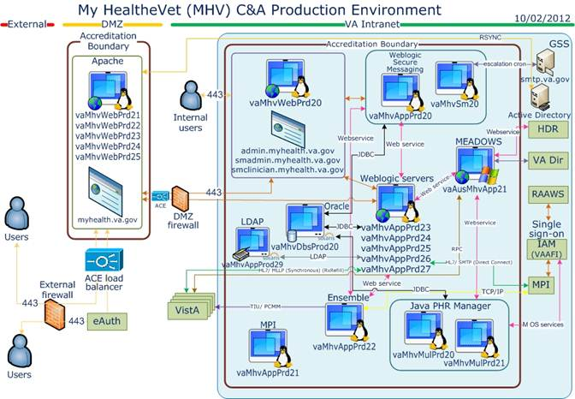
Technologies Utilized/ Capabilities Delivered

Slide 7
Accomplishments to Date
Utilization
  > 2,000,000 registered users ( 86% Veterans)
  > 940,000 Premium Accounts
  > 650,000 BlackBerry users
  > 2,500 BB downloads avg./day
  > 30,000 prescription refills avg./day (> 35M total)
  50,000 avg./visits/day
Secure Messaging & Prescription Refill found to reduce outpatient visits
Incorporated Agile Development
Increased from 1 to 4 Development Teams in 2012
Blue Button Awarded Federal Innovation of the Year, FedScoop, 28 November 2012

Slide 8
Operations Related to the Vendor Community (Who will be using the product)
OSHERA Open Source
  MHV v 12.2 available soon
Veterans
Providers
Caregivers
VA Staff Members
VistA
MDWS
HDR
National Help Desk

Slide 9
Questions and Comments can be addressed this afternoon during the Q&A Session.

