Slide 1
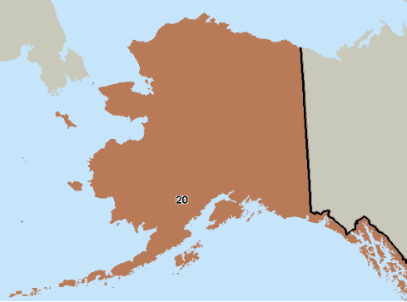
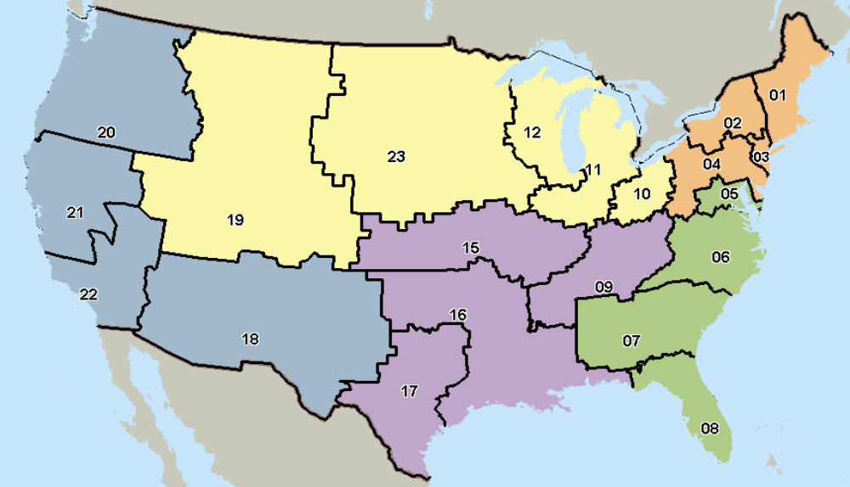

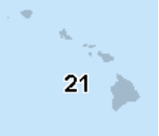
PC3 Regional Model
Encompassing the Entire VHA Network
Region 1
Region 6
Region 4
Region 5
Region 2
Region 3
VA Island locations not on map American Samoa , Guam, Northern Mariana Islands, Philippines (V21) Virgin Islands and Puerto Rico (V8)
Source: VHA Support Service Center (VSSC) Non-VA Care data cube

Slide 2
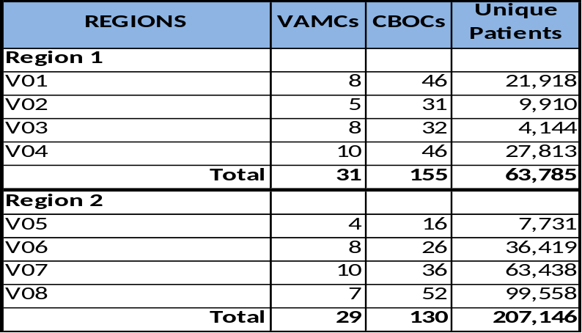
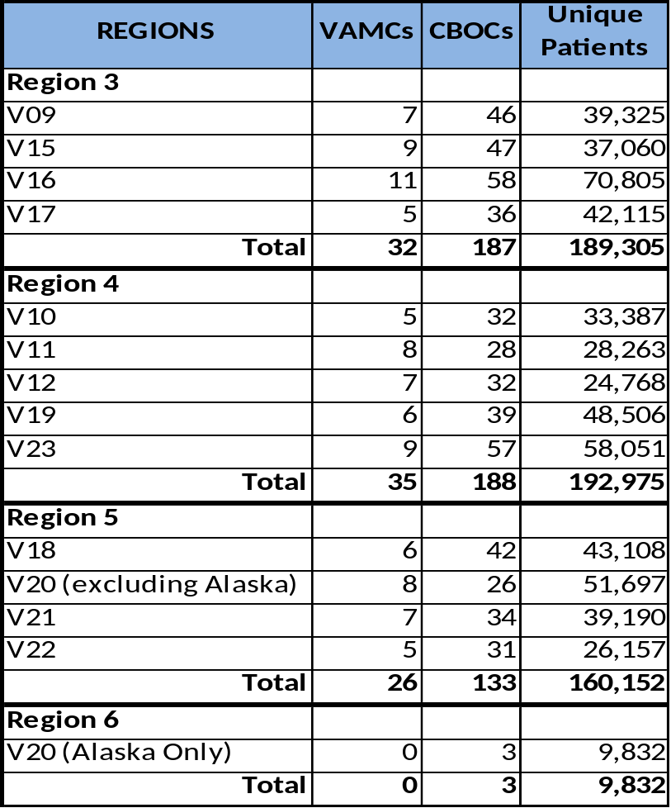
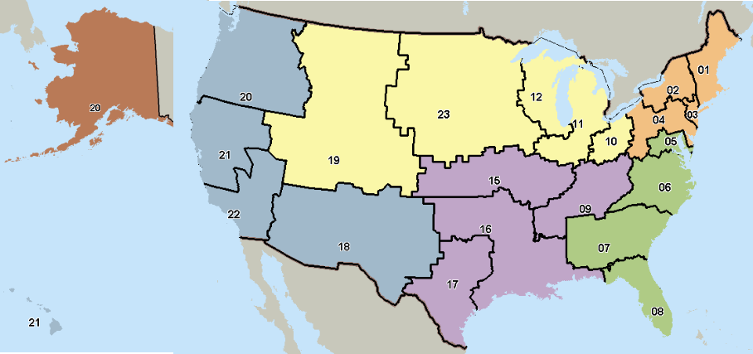
PC3 Regional Model
Detailed Data
Source: VHA Support Service Center (VSSC) Non-VA Care data cube; Planning Systems Support Group (PSSG)

