Slide 1

Department of Veterans Affairs
Network Contracting Office (NCO) 21
Construction Seal Bid – VA261-13-B-0474
Pre-Proposal Conference for the Repair Bldg. 1, 3,5,7, & 210
January 29, 2013
San Francisco VA Medical Center
Auditorium Bldg 7., Room 112

Slide 2
INTRODUCTIONS
VA REPRESENTATIVES:
Contracting Officer: Karen Smith
Engineer: Joseph Wong
Your point of contact for all correspondence: karen.smith3@va.gov

Slide 3
SOLICITATION OVERVIEW – SF 1442
100% Set Aside for Service Disabled Veteran Owned Small Businesses- General Contractor only
FBO is the only authorized website for bid info
All offerors shall be registered in both SAM www.sam.gov & VetBiz http://vip.vetbiz.gov
Offer will be verified that it is an SDVOSB Concern listed as verified in the VetBiz Database

Slide 4

Certified SDVOSB Defined
Offerors must be Center for Veterans Enterprise (CVE) verified via VetBiz at time of offer.
CVE Logo in VIP website constitutes verification.

Slide 5
PERIOD OF PERFORMANCE (POP)/SPECIFICATIONS
360 calendars days
Specifications are included as attachments to solicitation: www.fbo.gov
Magnitude of this project: between $500,000.00 and $1,000,000.00

Slide 6
BID
Bid must include:
Signed SF 1442 with bid amount
Signed Amendments or acknowledge of the amendments on page 2 of the SF 1442
Bid bonds
Company name and Dunn’s number

Slide 7
TECHNICAL QUESTIONS
Submit all solicitation questions in writing – Send questions related to the solicitation documents to my email address karen.smith3@va.gov via an RFI. Submit in a Word Document or in the body of email
Cutoff date for questions will be February 6, 2013 11:00 am Local Time- no further questions will be accepted unless noted in an amendment.
Responses will be obtained and issued by amendment on February 8, 2012.

Slide 8
IFB: VA261-13-B-0474
Repair and Paint Exterior
Buildings 1, 3, 5, 7, and 210

Slide 10
REPAIRS
Concrete Spalls
Loose and Missing Terra Cotta Mortar Joints
Cracked Plaster and Cracked Stucco
Rusted Shelf Angles
Organic Growth
Peeling Paint

Slide 11
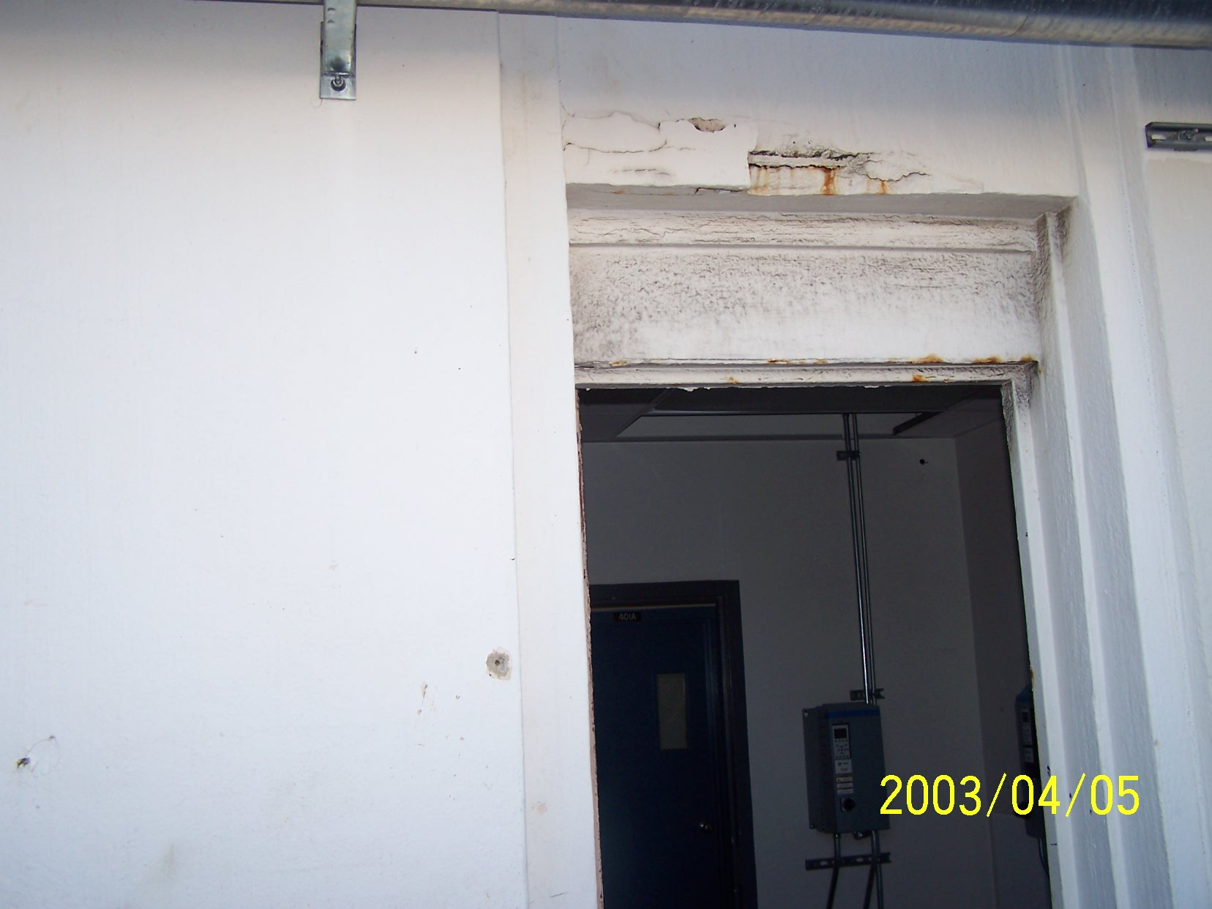

Slide 12
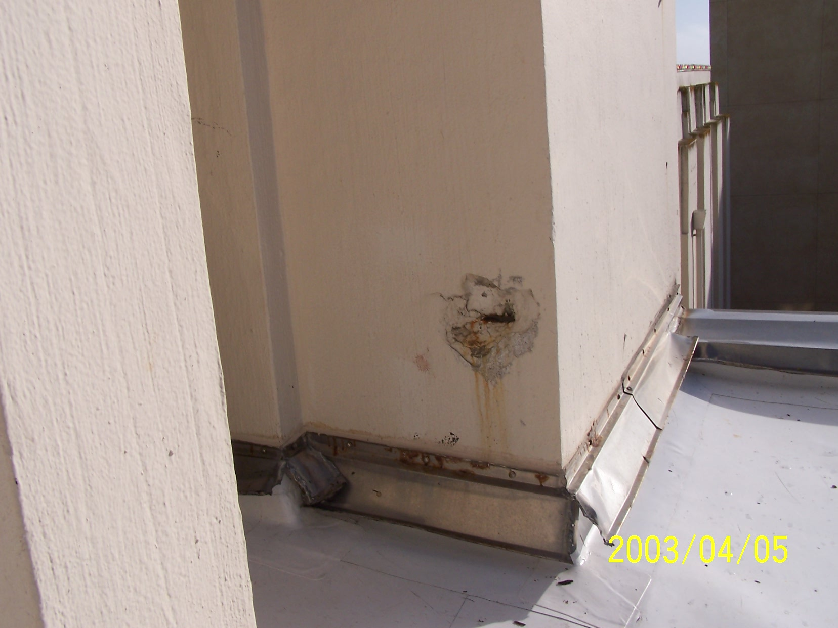

Slide 13
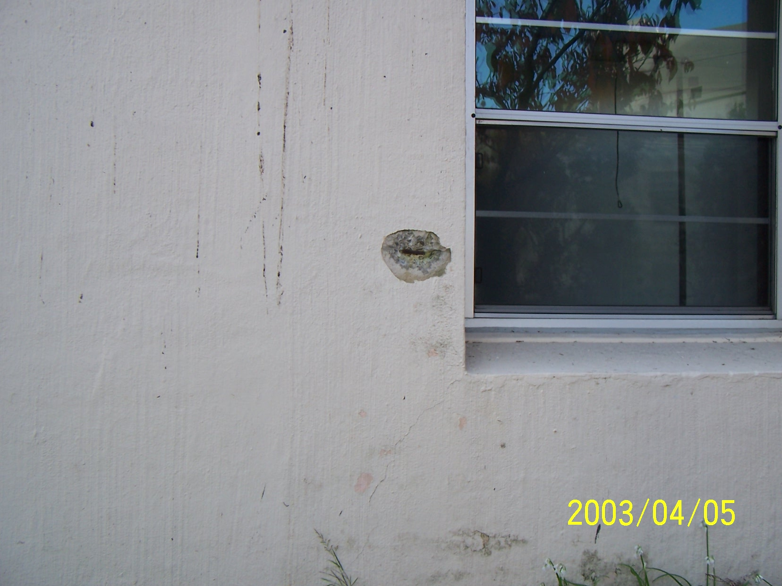

Slide 14
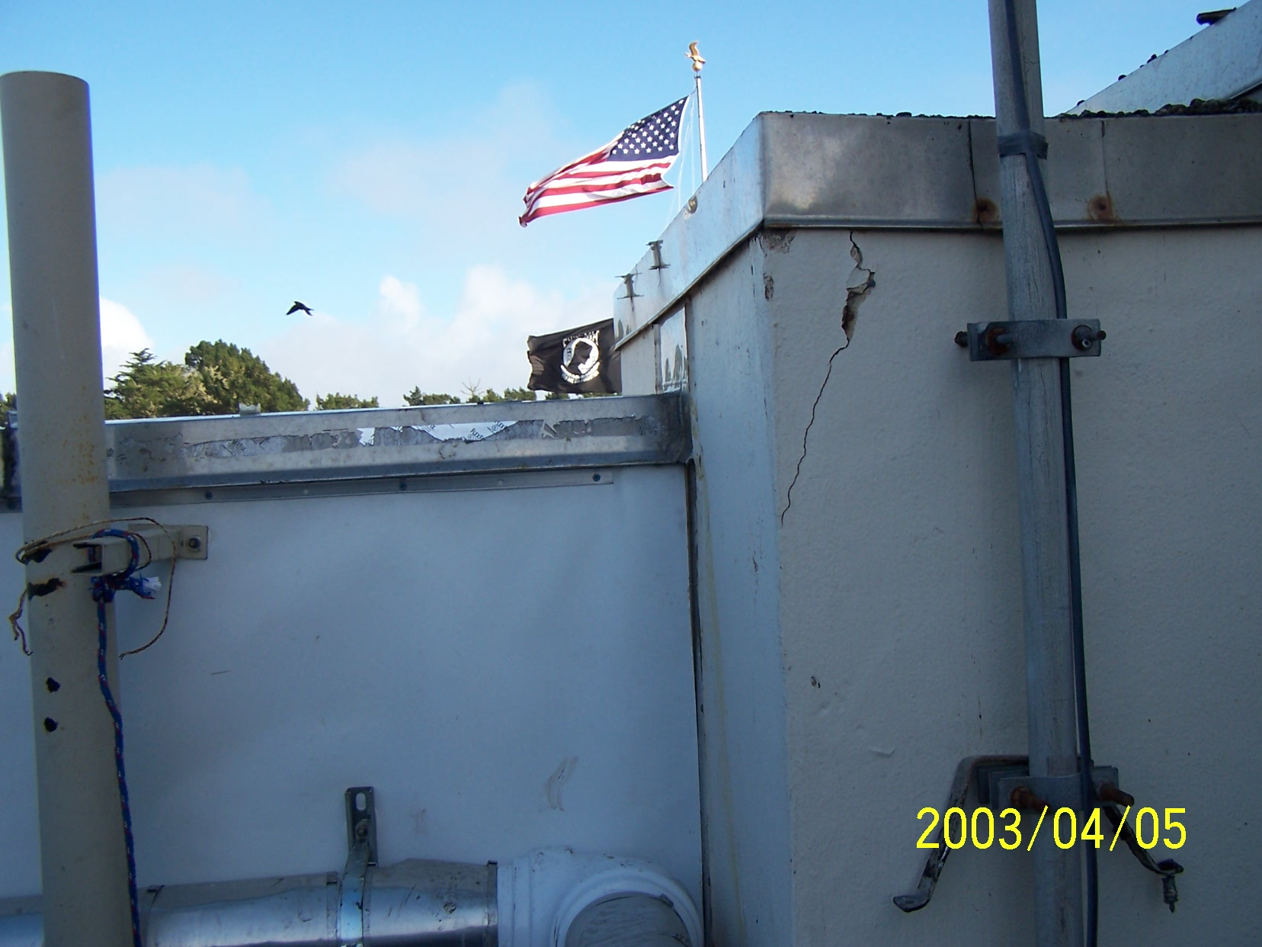

Slide 15
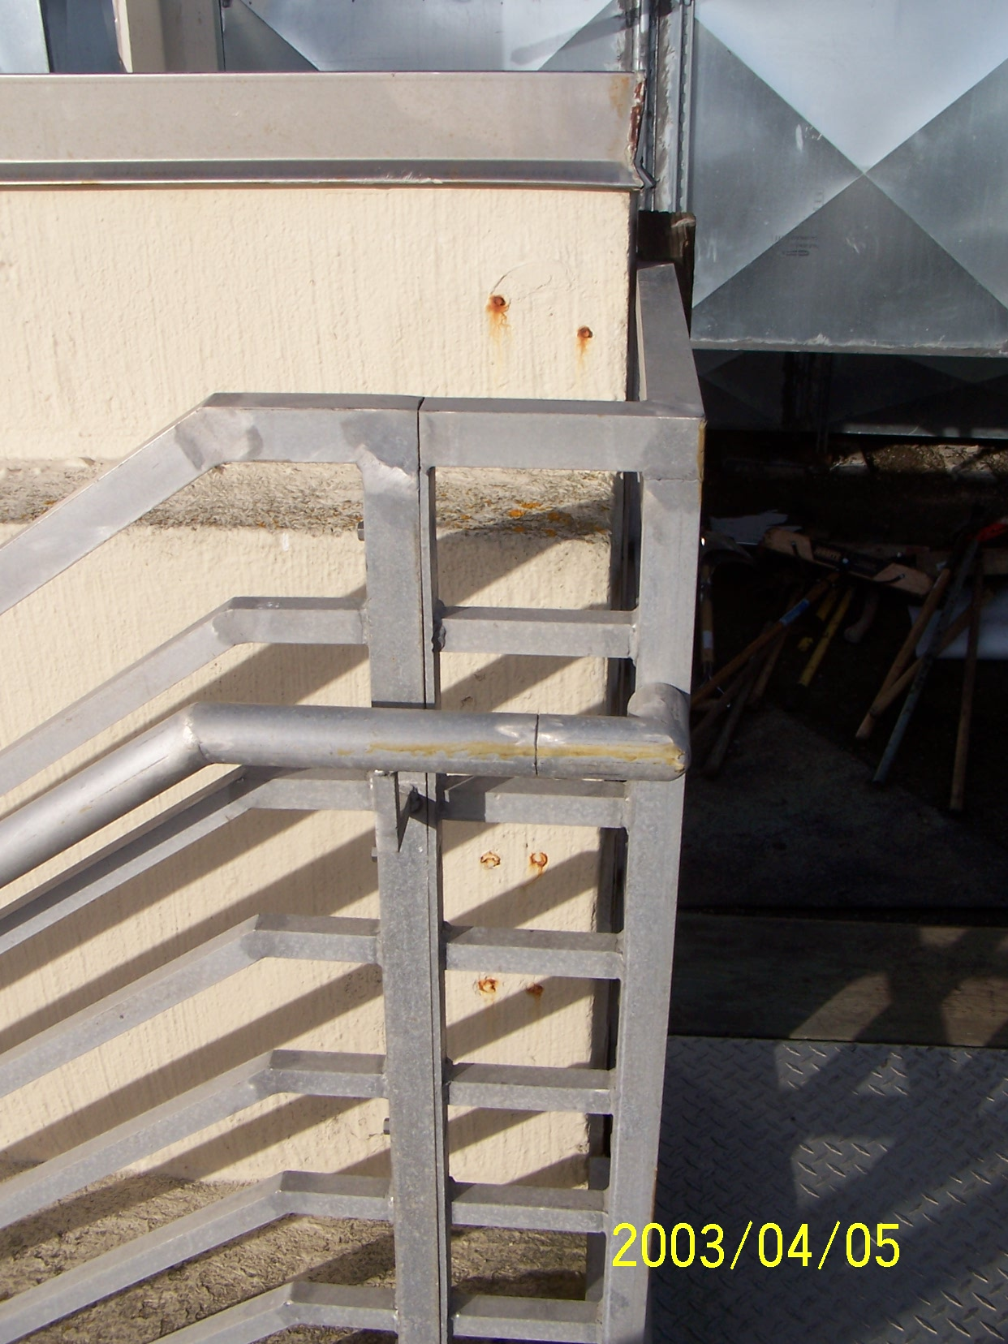

Slide 16
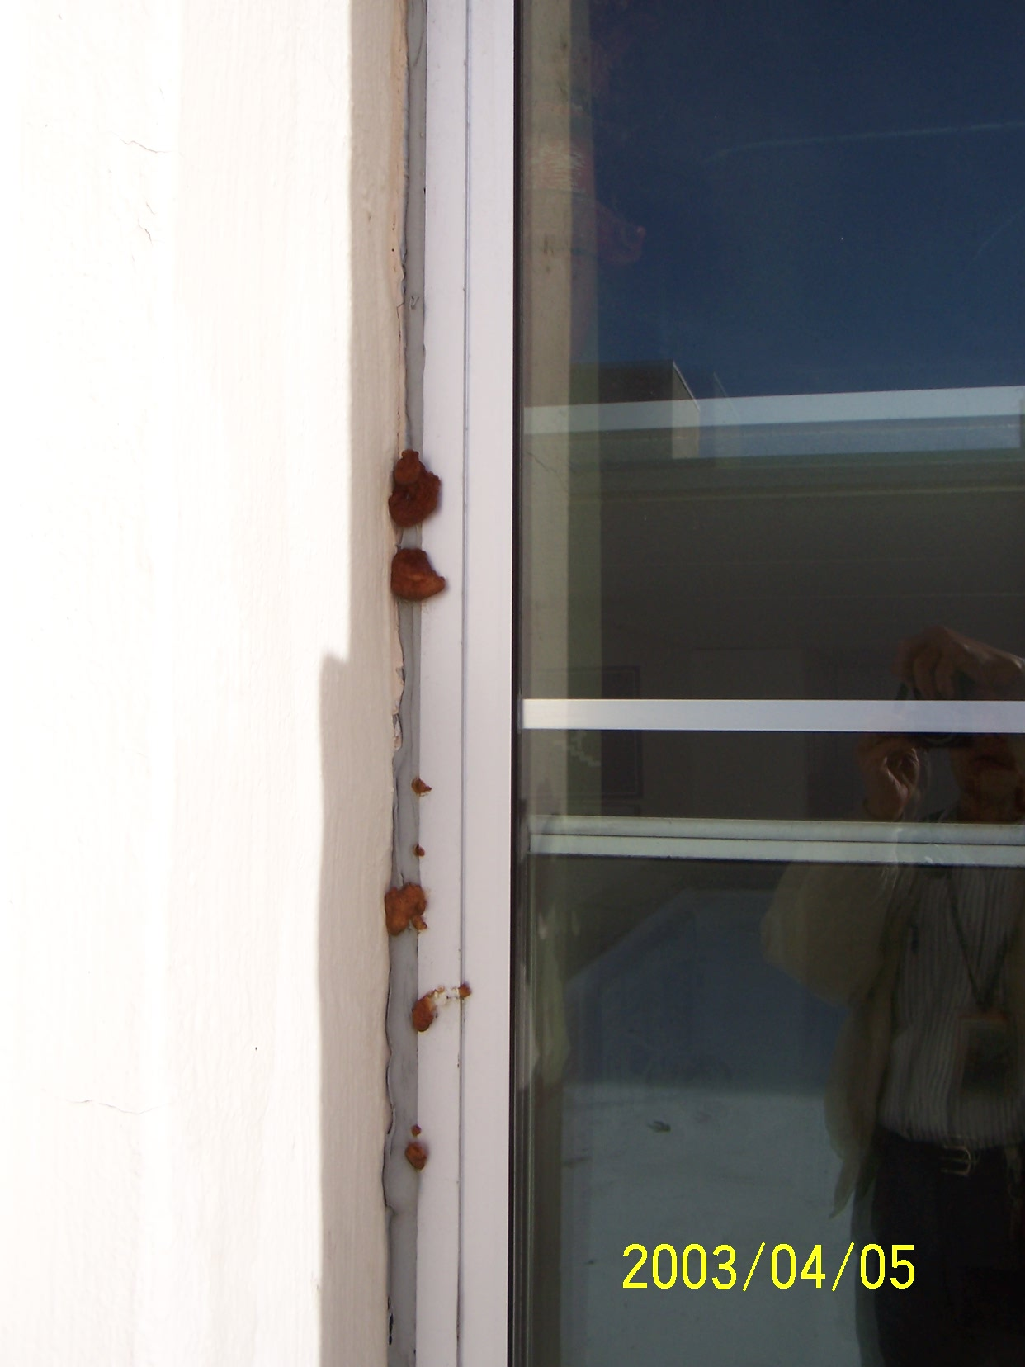

Slide 17
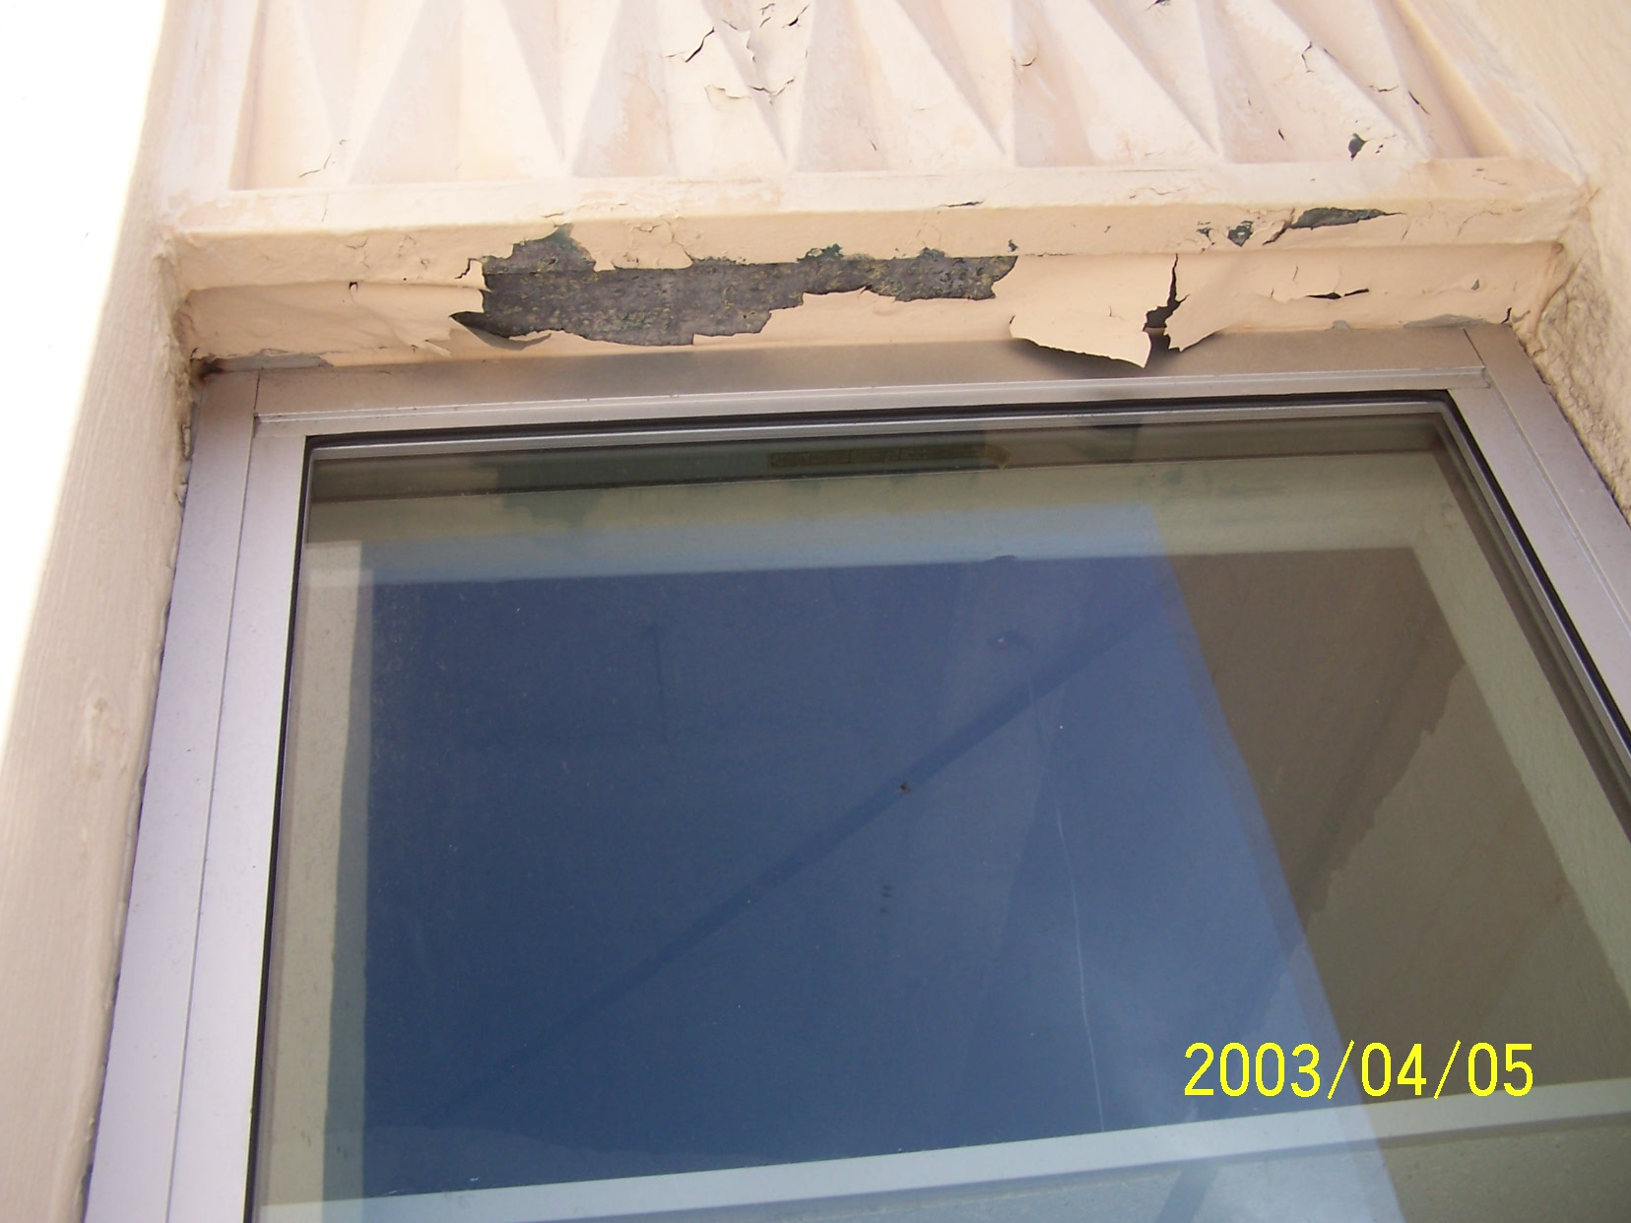

Slide 18
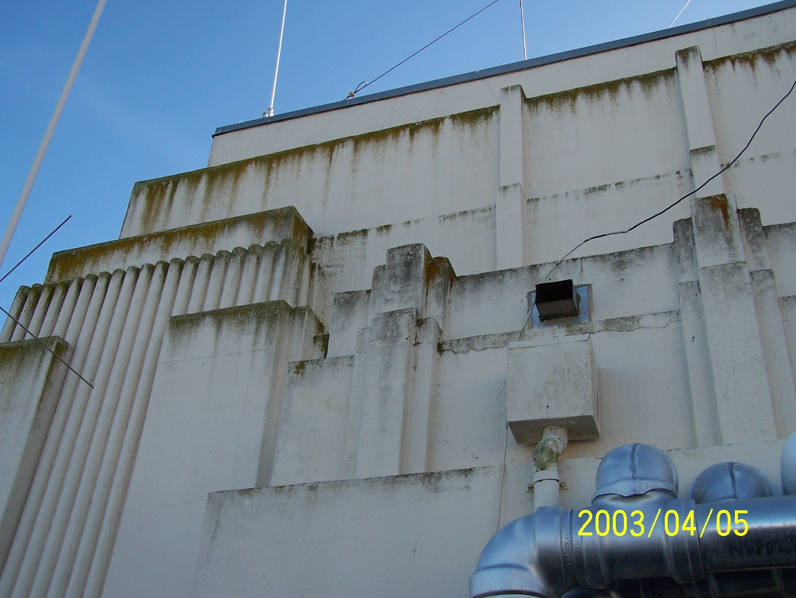

Slide 19
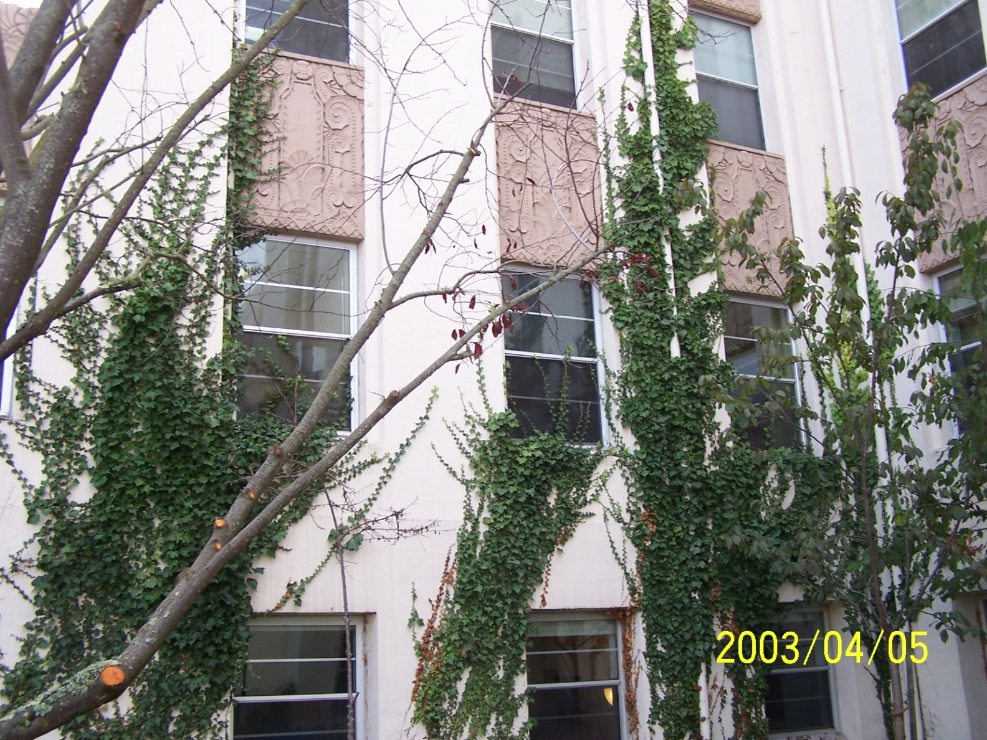

Slide 20
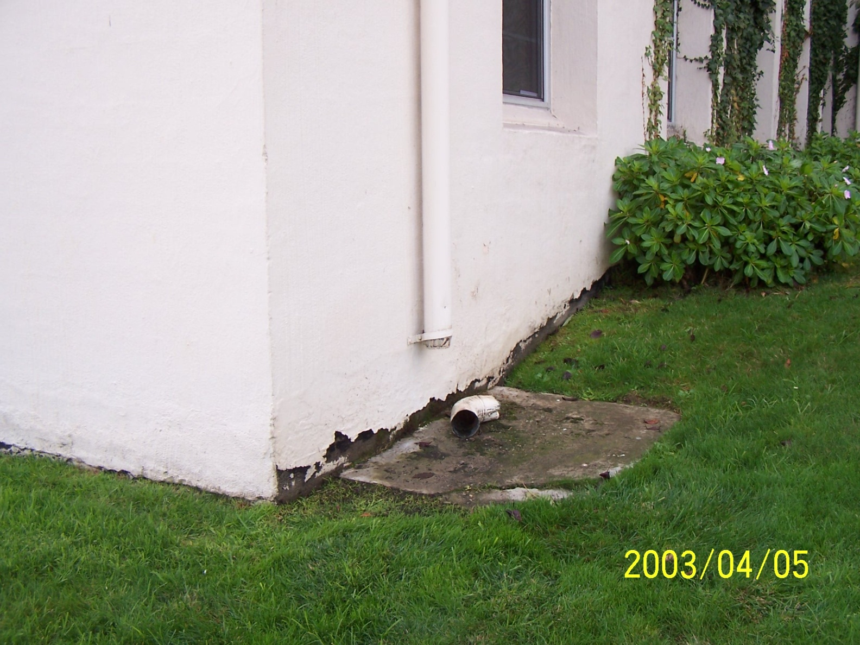

Slide 21
No parking spaces around the building will be temporarily eliminated at the time the contractor performs his work.
Protect the surround landscaping, buildings, and most importantly the cars that will be parked near the buildings.

Slide 22
1.6 OPERATIONS AND STORAGE AREAS
Only the area on both sides of the concrete staircase entering Building 1 from its east entrance can be used for temporary staging to perform the work.
When permitted, limit the size of this staging area to no more than 8 feet from the base of Building 1 and the staircase. Chain link fenced in with green vinyl inserts to shield the area from view.

Slide 23
At the end of the project restore the lawn to its original condition including reinstallation.
ACTION - Take dated pictures to document the existing conditions (such as the landscaping around each building) just before start of work. Submit one set to the COR on a CD for proof.

Slide 24
There will be no parking space on site available to the contractor for staging (except mentioned in slide, container, debris box, or any contractor motor vehicle used for personal or business or construction.
Vehicle parking is not allowed on any part of SFVA site, during the day or overnight.
(END)

