Slide 1
Project Eagle: Denver Medical Center Facility Replacement
Overview
February 12, 2013
VA ECHCS

Slide 2
Agenda
Background and history of project
Facility Overview
Challenges
Next Steps

Slide 3
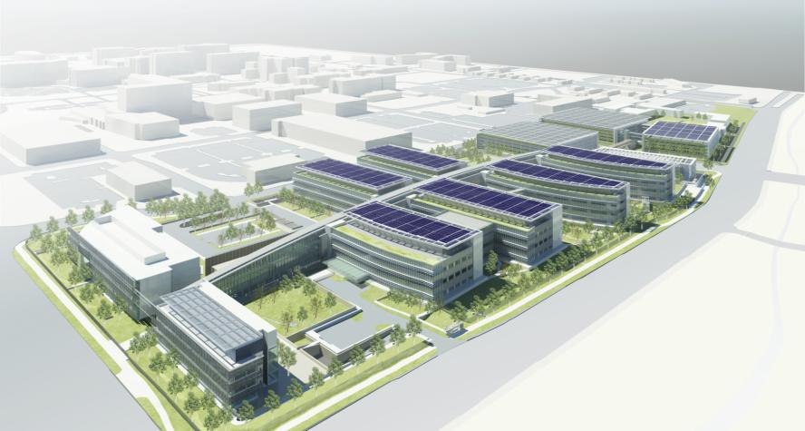
Background and History

Slide 4

Background and History
Approved 2004 as a full replacement facility following recommendation by CARES Committee
Change in mission from Secretary to Secretary changed design
Secretary Shinseki approved full service hospital campus in early 2009

Slide 5
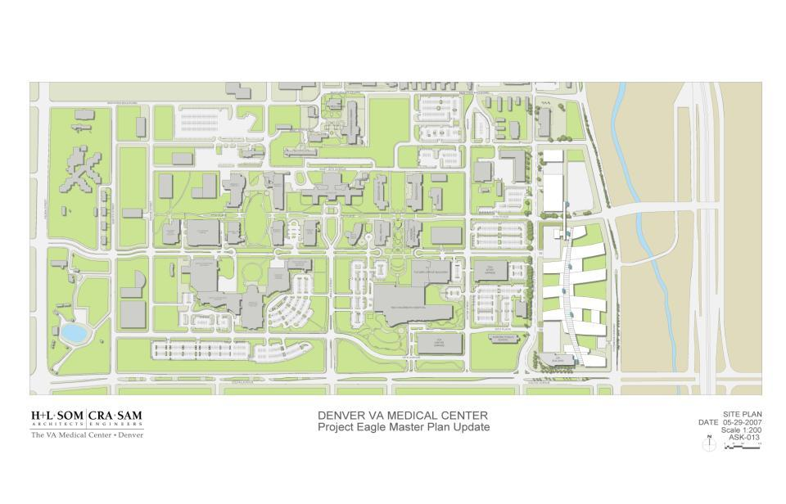
Background and History
Building 500
VA
UCH
CHC

Slide 6
Background and History
Facility square footage now at 1,069,985 BGSF with new scope and budget

Slide 7
Background and History
Facility square footage 1,069,985 BGSF
Eastern Colorado Healthcare System has multiple stakeholders in the loop of communications
      Colorado Delegation
      United Veterans of Colorado
      Veteran Service officers
      Campus stakeholders (University Hospital, Colorado Children’s Hospital, Fitzsimons Redevelopment Authority, and others)
      Local hospital planning board
      State Delegation

Slide 8
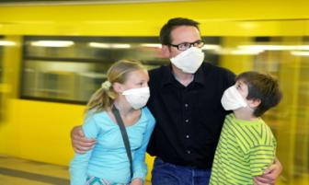
Guiding Principles
Enhance patient safety
Enrich the patient’s experience
Promote the families’ role in care delivery
Provide for new and changing technologies

Slide 9

Design Process
Overall concepts of design
  Veterans first
  Standardization of rooms (exam, offices, inpatient rooms, procedure rooms, etc)
  Single patient rooms with the exception of Mental Health and SCI who require some double rooms for therapeutic purposes

Slide 10

Design Process
Overall concepts of design
  Maintain outdoor space for staff, Veterans, and families
  Maintain expansion capability
  Apply Lean Principles whenever possible
  On stage/off-stage
  Bring the outdoors indoors

Slide 11
Design Process
Over 80 different subgroups of “user” were identified
Unions invited to all meetings
Veterans were involved in meetings where possible
Multiple stages

Slide 12
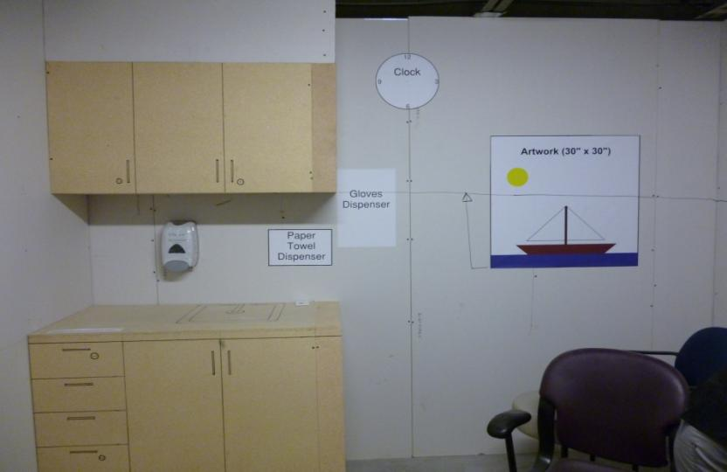
Design Process

Slide 13
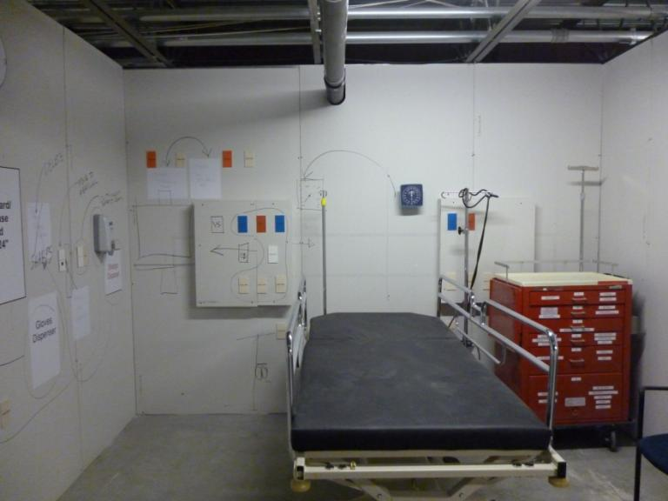
Design Process

Slide 14

Design Process
3D model was constructed and place in atrium of current facility for veterans, visitors, and staff to visualize
3D “fly through” also developed; displayed next to 3D model in atrium and is on a looped display

Slide 15

Overview
9 buildings, 3 parking garages
Two inpatient buildings, 3 clinic buildings, CLC, Research, Diagnostic and Treatment, and Energy Center
Footprints held for Fisher House and PTSD Residential Rehab Program facility

Slide 16
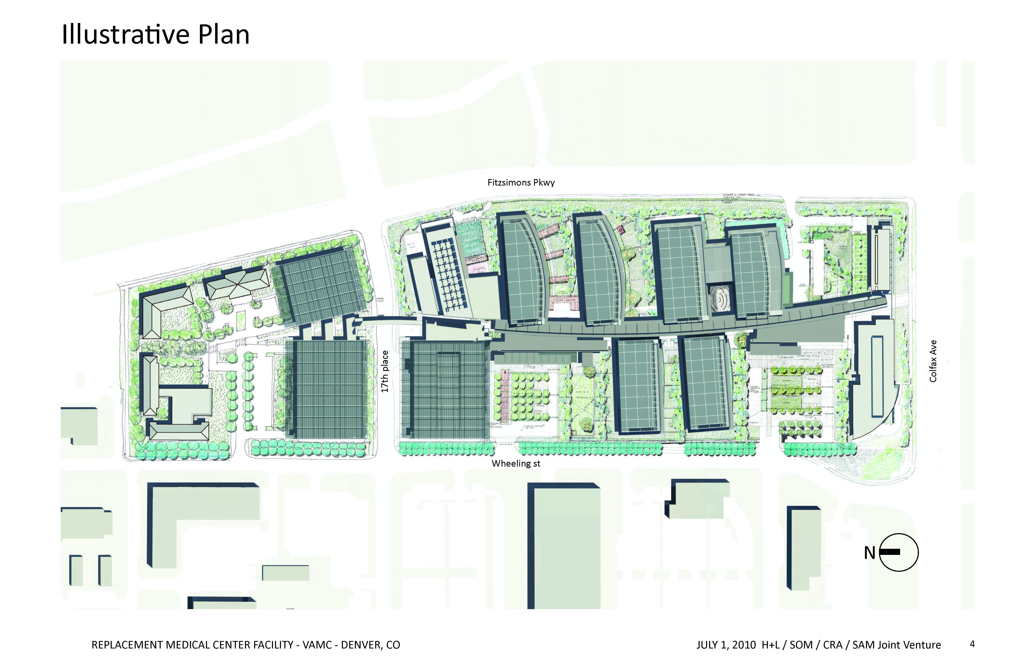
Inpatient Towers :
130,000 SF each
D&T:
306,000 SF
Research: 59,000
Fleet
Parking
Energy Center:
52,000
Fisher House
PRRTP
Concourse: 145,000
South Clinic:
112,000 sf
CLC:40,000
North and Central Clinics: 95,000 sf each
Staff Parking
Patient Visitor
+Parking
Patient Visitor
+Parking
Notes:
42% is diagnostic treatment and inpatient
21% outpatient
37% includes Research, CLC, Energy Center, Concourse and Administration

Slide 17
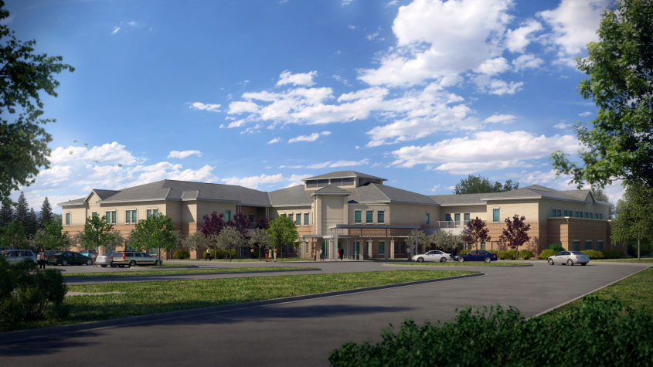
Overview
Community Living Center

Slide 18
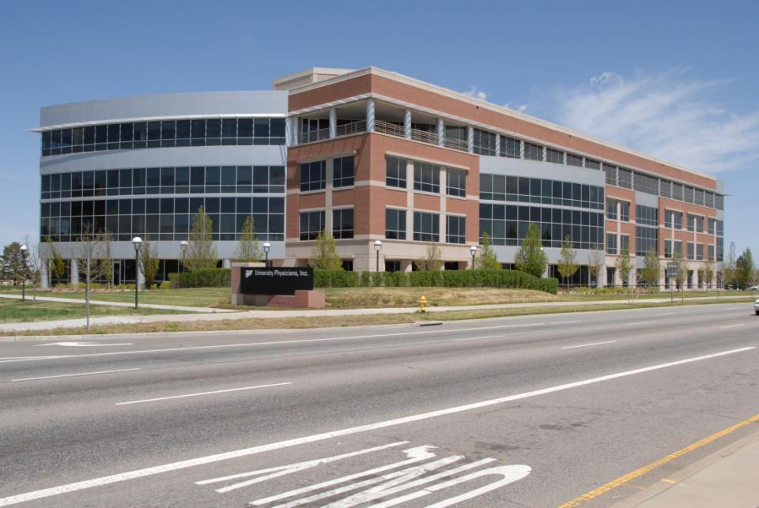
Existing Building 4 story 120,000 sf

Slide 19
Overview
Changes to current bed capacities
Parking: Current - 990
Parking: New - 2,391 *
*With add alternate of additional level PSN
Beds | Current | New
Medical/Surgical | 73 | 60
Mental Health | 36 | 30
Intensive Care | 24 | 28
Blind Rehab | 0 | 4
PTSD | 19 | 20
Spinal Cord Injury | 0 | 30
CLC |  | 30

Slide 20
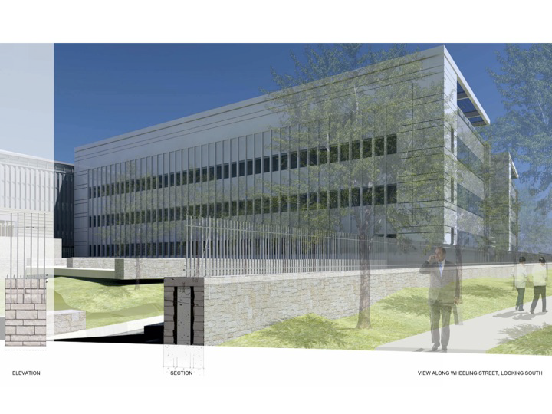
Overview

Slide 21
Fly through
www.denvervahospital.com

Slide 22
Time Frames
Overall completion date for the majority of the project is October, 2015
The above footprints being utilized for parking and lay down until very late in construction

Slide 23
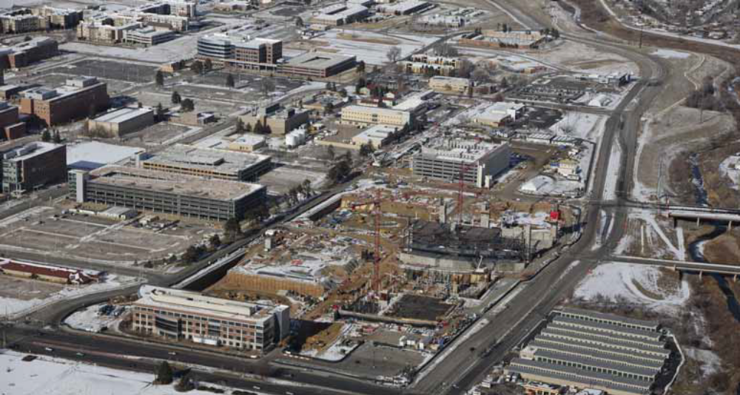
Construction Site February 2013

