Slide 1

Department of Veterans Affairs
Network Contracting Office (NCO) 21
Overview
Multiple Award Task Order Contract (MATOC)
Department of Veterans Affairs
Construction & Construction Services

Slide 2
MATOC Overview/Ordering Guide
PART 1: (VISN 21) MATOC Holder General Information
Scope of MATOC
Contract Capacity & Order Limitations
Authority To Place Task Orders
Task Order Funding
Conflicts of Interests
PART 2: Contracting Officer Roles and Responsibilities
Procuring Contracting Officer & Administrative Contracting Officer
Ordering Contracting Officer
Contracting Officer’s Representative

Slide 3
MATOC Overview/Ordering Guide
PART 3: Ordering Requirements
Ordering Requirements (2268’s, D&F, Market Research, Acquisition Planning)
Reviews (Dollar Thresholds)
Requests for proposals
PART 4: Task Order Monitoring and Contract Administration
Contract & Task Order Administration & Management
Task Order Competition
Protests
PART 5: Contract & Task Order Administration & Monitoring
Contract & Task Order Administration
Task Order Debriefings

Slide 4
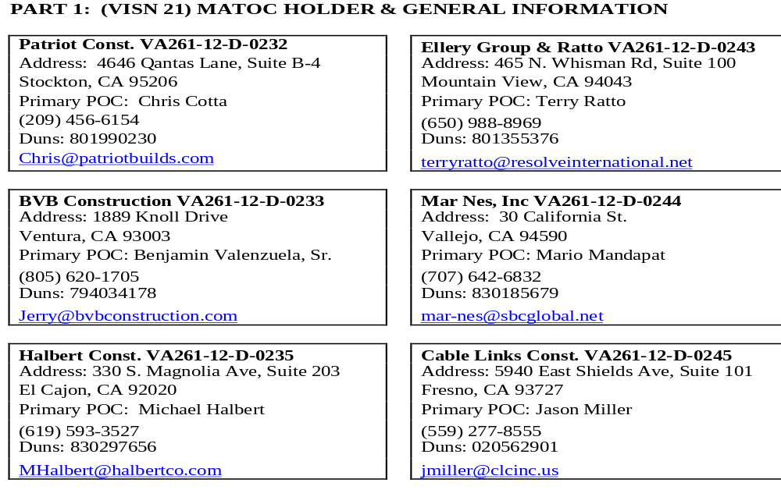
(VISN 21) MATOC Contract Holder General Information

Slide 5
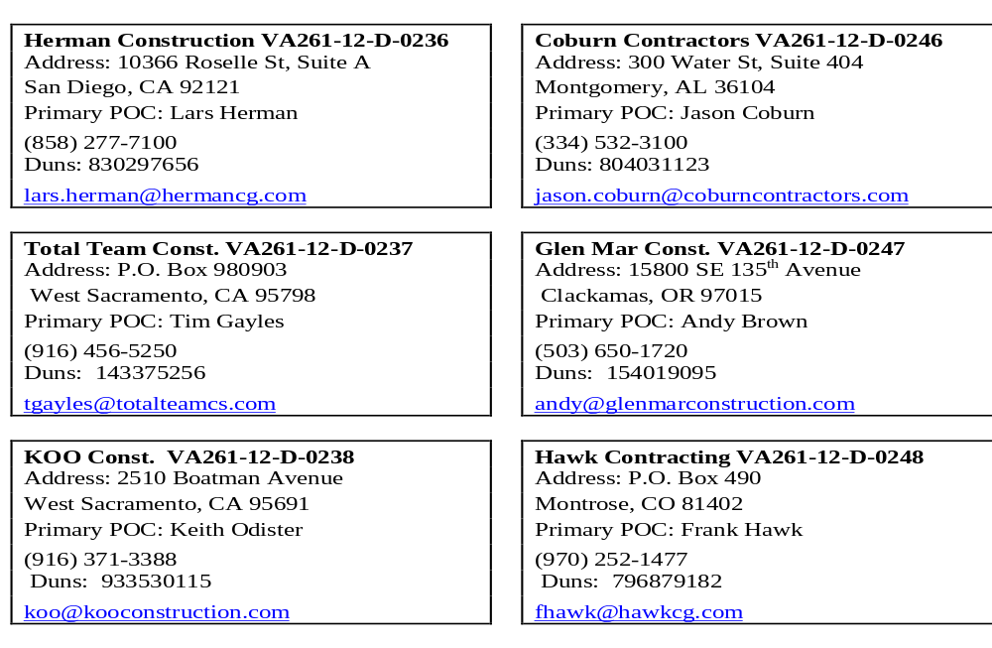
(VISN 21) MATOC Holder General Information

Slide 6

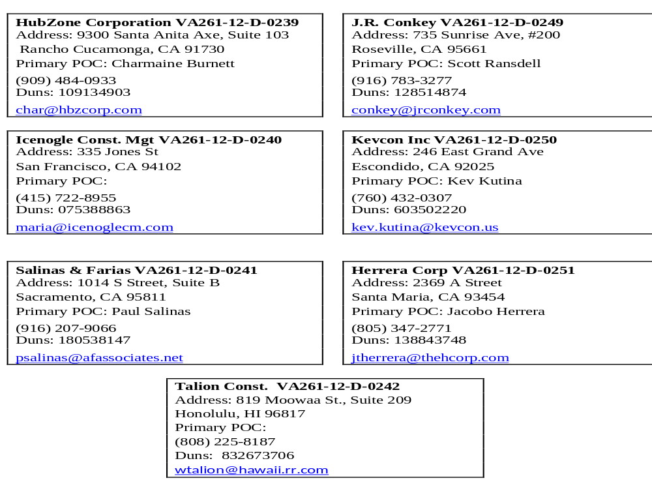

Slide 7
Scope of MATOC
(MATOC) is a competitive indefinite delivery/indefinite quantity (IDIQ) for construction based on general specifications contained in the statement of work (SOW) within each individual Task Order (TO). The work will consist of multiple disciplines of construction: repair and alteration of facilities, interior and exterior renovations, heating and air-conditioning, HVAC controls, plumbing, fire suppression, interior and exterior electrical and lighting, fire and intrusion alarms, communications, limited utilities, and other construction-related work required to support Veterans Integrated Service Network 21 (VISN 21) facilities.
Contractors shall provide all plant labor, equipment, appliances, materials, expertise and supervision as required by the SOW and project specifications within each individual TO. FOB: Destination

Slide 8
CONTRACT CAPACITY & ORDER LIMITATIONS
The aggregate value of this MATOC is $400 Mil for all task orders, inclusive of all options. The contract value of individual MATOC award shall not exceed $50 Mil, inclusive of all options.
The period of performance for all MATOC contracts shall consist of a base period from the date of award through September 30, 2013, and four (4) option periods to extend one (1) year each.

Slide 9
CONTRACT CAPACITY & ORDER LIMITATIONS
The guaranteed minimum amount for each contract is $5,000 for the life of the contract, inclusive of all options.
The MINIMUM ordering limit per task order is $2,000. Task orders may be issued non-competitively in order to satisfy the minimum guarantee. When the Government requires supplies or services covered by this contract in an amount less than $2,000, the Government is not obligated to purchase, nor is the Contractor obligated to furnish, those supplies or services under the contract.
The MAXIMUM ordering limit per task order is $10 Mil. The Contractor is not obligated to honor any order for a single item in excess of $10 Mil.

Slide 10
ORDERING REQUIREMENTS
2268- Not required as all MATOC holders are SDVOSB’s and 2268 was previously approved by OSDBU
Determination & Findings- Not required as all MATOC holders are SDVOSB’s
Market Research Report- Not required as market research was conducted for basic MATOC Award
Acquisition Plan Formal/Informal: Required, Dependent On Dollar Threshold. Sample Formal Acquisition Plan Attached for use/editing
Reviews: As required per local current SOP

Slide 11
REQUEST FOR PROPOSAL
It is the Ordering Contracting Officer’s preference as to how RFP’s are provided (Letter Format RFP or SF 1442). At a minimum, contractors shall be provided a (SOW), drawings and specifications, pertinent supplemental specifications, and any other requirements (e.g. proposal requirements, price schedule, etc.) needed for adequate proposal submission. Electronic media, such as web postings, e-mail or CD ROM may be utilized. All further reproduction of the SOW, specifications, and drawings shall be solely at the contractor's expense.

Slide 12
RFP Acceptable Methods
The following are acceptable methods available for ordering contracting officers when requesting proposals from MATOC Holders:
Via Email- Outlook Mail Group- NCO21 MATOC VENDORS- Submit either letter format RFP or SF 1442 via email to all MATOC Holders Requesting Proposals
Palo Alto VA Secure File Transfer Protocol Palo Alto VASFTP is available for all VISN 21 Facilities, not just Palo Alto. (Instructions for the use of the site and software download instructions are included in attachments) Philip Buscemi is the technical point of contact for assistance with the site:
philip.buscemi@va.gov; (415) 713-8234

Slide 13
ORDERING CONTRACTING OFFICERS
Ordering Contracting Officers are responsible for the following:
Serve as local contracting focal point for coordination and awards of TOs i.e., developing RFP’s, scheduling pre-proposal conferences, site visits
Ensure TO requirements are within the MATOC scope, terms and conditions
Ensure TO request packages are properly prepared and complete
Prepare contractor Performance Assessment Reports, as required
Working with ACO & Legal Counsel on termination issues
Updating MATOC Award Tracker within 2 business days to include tracking minimum guarantees

Slide 14
CONTRACTING OFFICER’S REPRESENTATIVE (COR)
The Contracting Officer shall delegate authority to COR. This authority is typically to:
Accomplish day-to-day surveillance and oversight of contractor performance
Inform contracting officer of any potential problems
Prepare and submit to the contracting officer a written evaluation of the contractor’s performance upon completion of the TO
Review invoices in comparison to actual work completed
The ordering contracting officer should consider the nomination submitted by the requesting activity. Nominated individual must provide a current COR Training Certificate.

Slide 15
Task Order Evaluation & TO Awards
Each individual TO RFP will describe the criteria that are to be utilized for evaluation of proposals. i.e., Sealed Bid, Best Value, LPTA
In making a decision on the award of an individual order, ordering contracting officer may consider factors such as past performance on previously awarded orders under the MATOC, and take into consideration, quality and timeliness of work performed, and/or other factors that may be relevant to the award of a particular order.

Slide 16
TASK ORDER COMPETITION
MATOC contractors shall be provided fair opportunity to compete for task orders unless the following FAR 16.505(b)(2) exceptions apply:
(1) The agency’s need for the services or supplies is of such urgency that providing such opportunity to all such contractors would result in unacceptable delays;
(2) Only one such contractor is capable of providing the services or supplies at the level of quality required because the services or supplies ordered are unique or highly specialized;
(3) The task order should be issued on a sole-source basis in the interest of economy or efficiency because it is a logical follow-on to an order already issued under the contract, provided that all awardees were given a fair opportunity to be considered for the original order; or
(4) It is necessary to place an order to satisfy a minimum guarantee.

Slide 17
Protests
In accordance with FAR 16.505(a)(10), NO protest shall be authorized in connection with the issuance or proposed issuance of an order under task-order Contract, except for a protest on the grounds that the order increases the scope, period, or maximum value of the contract.

Slide 18
TASK ORDER DEBRIEFINGS
Although CO’s are not required to provide debriefings for TO’s, it is highly recommended and encouraged that feedback be given to the MATOC contractors regarding the strengths and weaknesses of the contractor’s overall response and execution. Feedback is provided only as a courtesy to the contractor to assist the contractor in preparing and executing future TO’s. Feedback may be provided orally, in writing, or by any other method deemed appropriate by the Ordering Contracting Officer.

Slide 19
EVALUATION OF CONTRACTOR PERFORMANCE
Contractor performance shall be evaluated upon completion of each Task Order.
Interim evaluations may be prepared at any time during contract performance when it is determined to be in the best interest of the Government.
Evaluations maybe processed through the CPARS (Contractor Performance Assessment Reporting System), Past Performance Information Retrieval System [PPIRS], and/or Federal Awardee Performance and Integrity Information System [FAPIIS]).

Slide 20
Disclaimer
Rusty Stevenson created the MATOC user guide with assistance from Javier Castro. Approximately 2 hours ago, Mr. Castro contacted Mr. Stevenson requesting assistance with a quick PowerPoint presentation. This PowerPoint presentation in no way shape or form represents the quality of work normally presented by Mr. Stevenson. This was short notice. You owe me one Javier. Enjoy!

