Slide 1


Puget Sound Health Care System
Building 101 Mental Health - Phase 1 Parking Structure and
Main Entry Drive
Project Overview
William Ulibarri
Project Manager
August 21, 2013
Department of Veterans Affairs – West Region

Slide 2
Table of Contents
VA Mission and CFM’s Goal
Proposed Siteplan
Project Scope
Project Cost Range, Schedule and Risks
Points of Contact

Slide 3
VA Mission and CFM’s Goal
Mission Statement
To fulfill President Lincoln's promise “To care for him who shall have borne the battle, and for his widow, and his orphan” by serving and honoring the men and women who are America’s veterans.
Goal
Focus CFM resources, services, and products to support VA asset management goals and objectives.

Slide 4
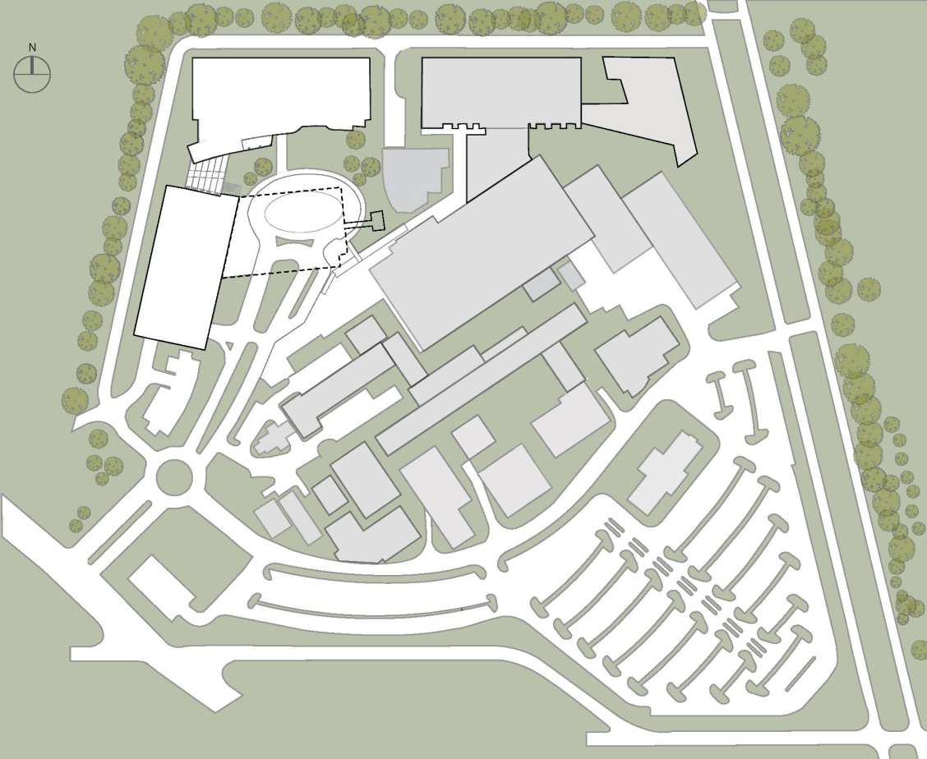
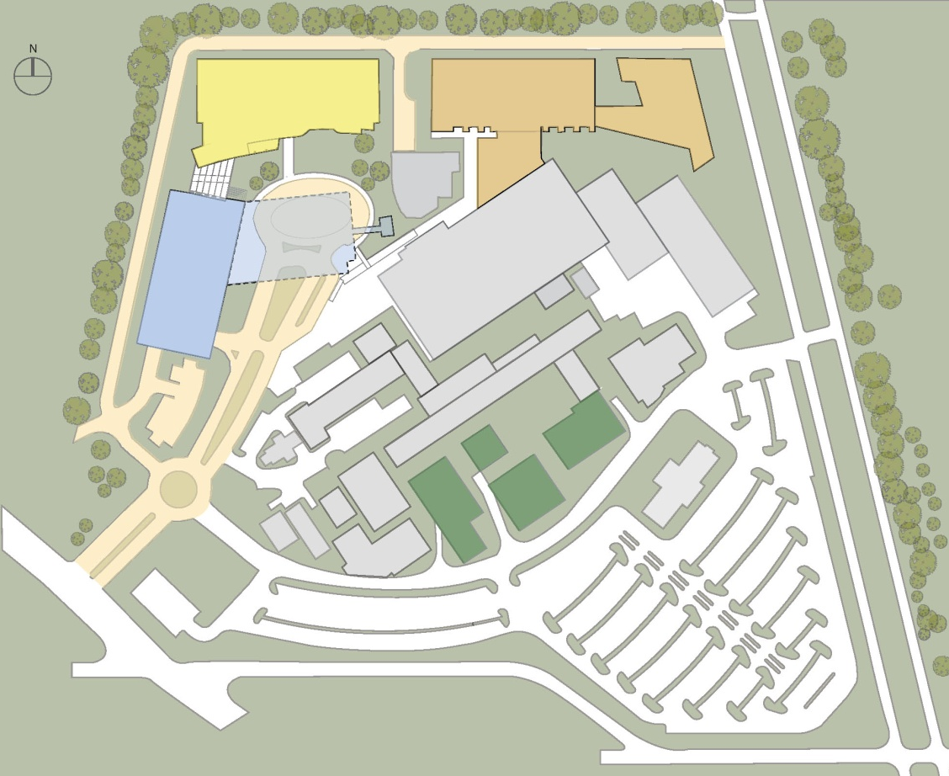
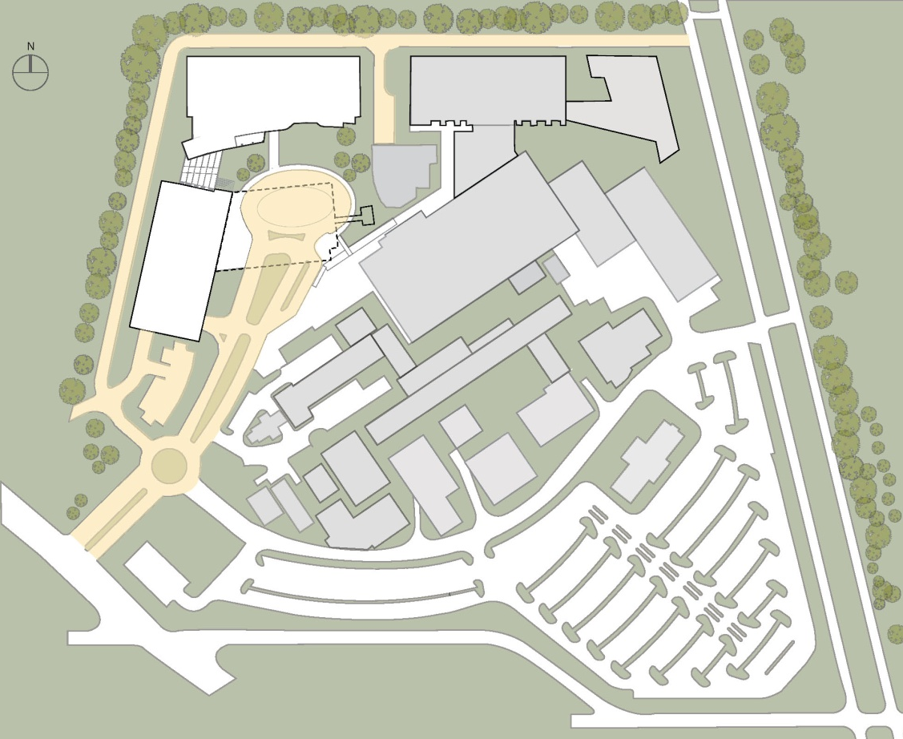
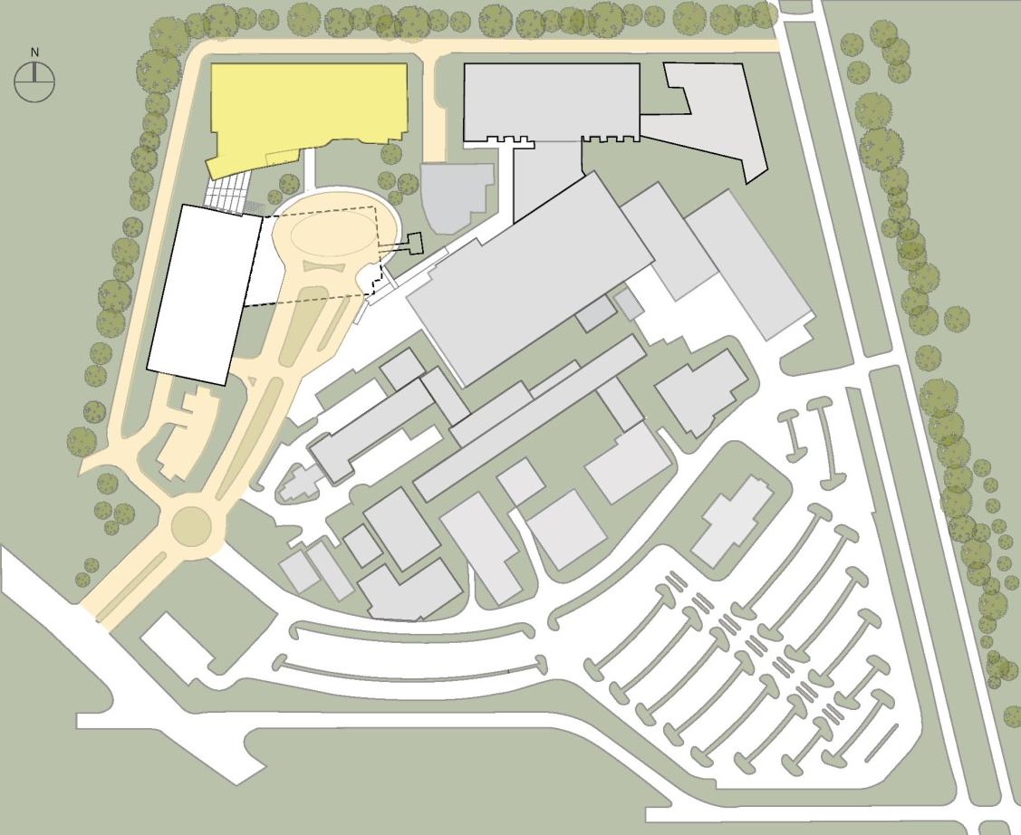
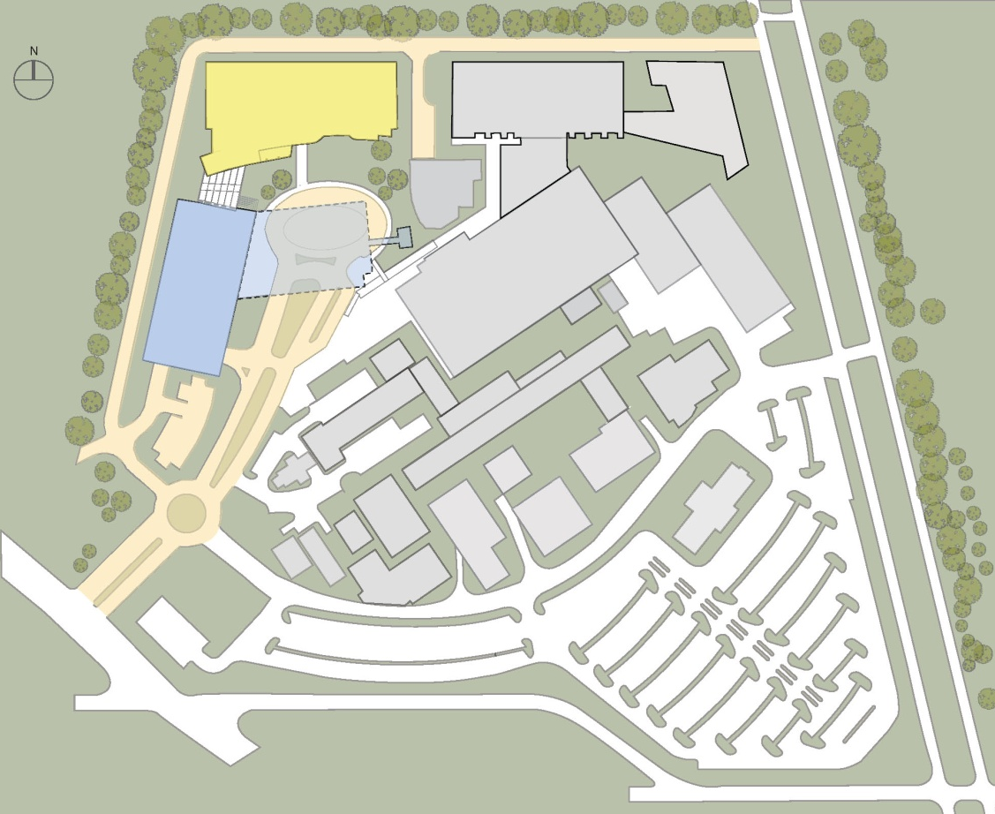
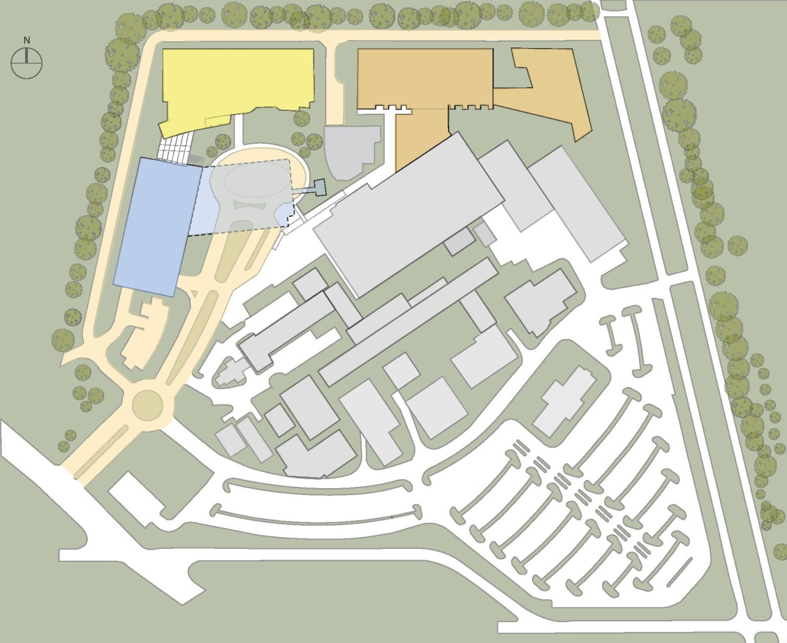
Proposed Siteplan
MENTAL HEALTH & RESEARCH BUILDING
SEISMIC
CORRECTIONS
PARKING
STRUCTURE
DEMO EXISTING
BUILDINGS
SITE ENTRY

Slide 5
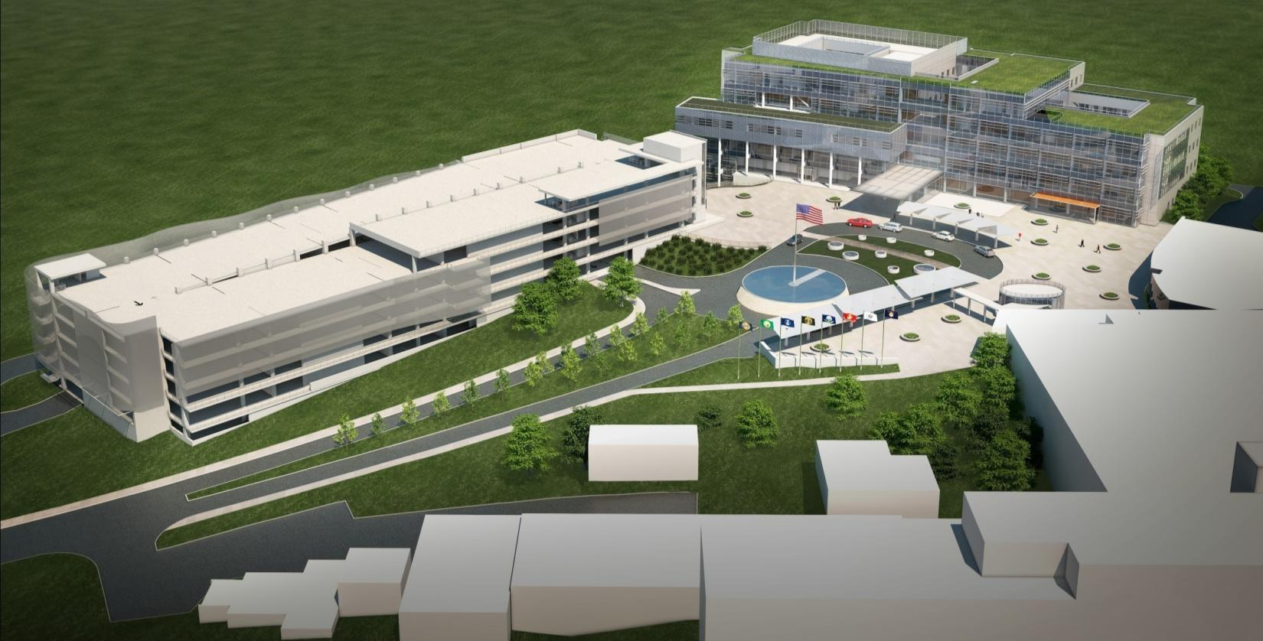
Project Scope
New multi-level 1,000 car parking structure consisting of approximately 343,000 SF aboveground and 66,000 SF underground. The underground portion will include ventilation systems, lighting, emergency power and elevators. Elevators will also be included at two locations in the aboveground portion of the garage.
Relocation of major underground utility systems, extensive civil grading and retaining-wall work as well as construction of an emergency power duct bank.
The Entry Drive work includes grading, realignment and widening of the campus entry drive and walkways that serve the main hospital, a new garage and the provision of temporary access routes for emergency vehicles during construction.

Slide 6
Project Cost Range, Schedule and Risks
Cost Range - The estimated cost range for this project is
between $50,000,000 and $100,000,000.
Schedule Objectives - The anticipated completion of this project
is 730 calendar days after “Notice to Proceed” (NTP).
Major Project Risks:
Operational Environmental
Communication and Coordination
Emergency Vehicle Access

Slide 7
Point of Contact
Ronald Ferrer (Contracting Officer)
Ronald.Ferrer@va.gov
(707) 562-8465

